Slide 1



Jet quenching in evolving anisotropic matter
Andrey Sadofyev
IGFAE (USC)

Slide 2
Jet tomography
AS, M. Sievert, I. Vitev, PRD, 2021
J. Barata, AS, C. Salgado, PRD, 2022
C. Andres, F. Dominguez, AS, CS, PRD, 2022
J. Barata, AS, X.-N. Wang, PRD 2023
J. Barata, X. Mayo, AS, CS, TBA, 2023
Jets see the matter in HIC at multiple scales, and essentially X-ray it;
The existing jet quenching theory is based on multiple simplifying assumptions: large parton energy, static matter, no fluctuations, etc;
There is a very recent progress on the medium motion and structure effects in jet quenching and this is the focus of this talk;
The developed formalism can be also applied to include orbital motion of nucleons and some of the in-medium fluctuations to the energy loss in cold nuclear matter;

Slide 3
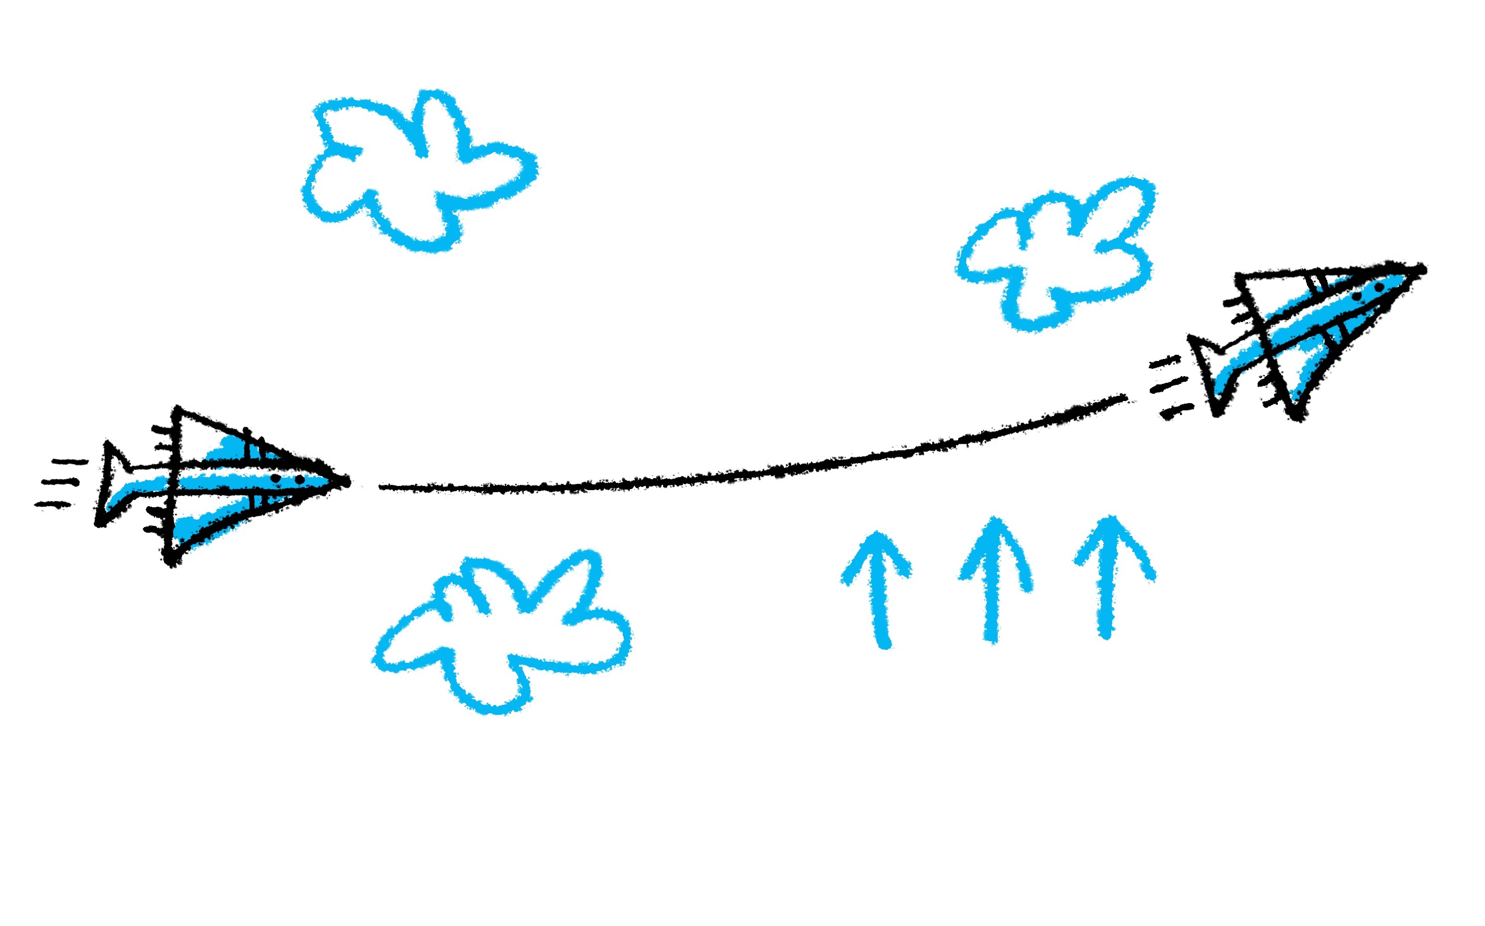

Slide 4
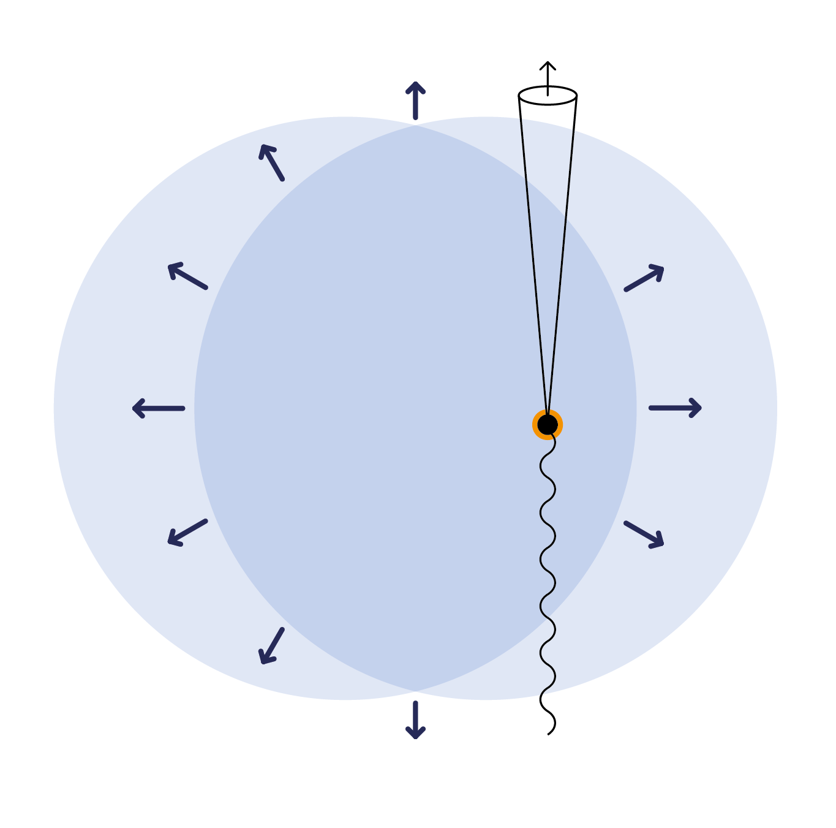

Slide 5
R. Baier et al, NPB, 1997
B. G. Zakharov, JETP, 1997
R. Baier et al, NPB, 1998
M. Gyulassy et al, NPB, 2000
M. Gyulassy et al, NPB, 2001

Slide 6
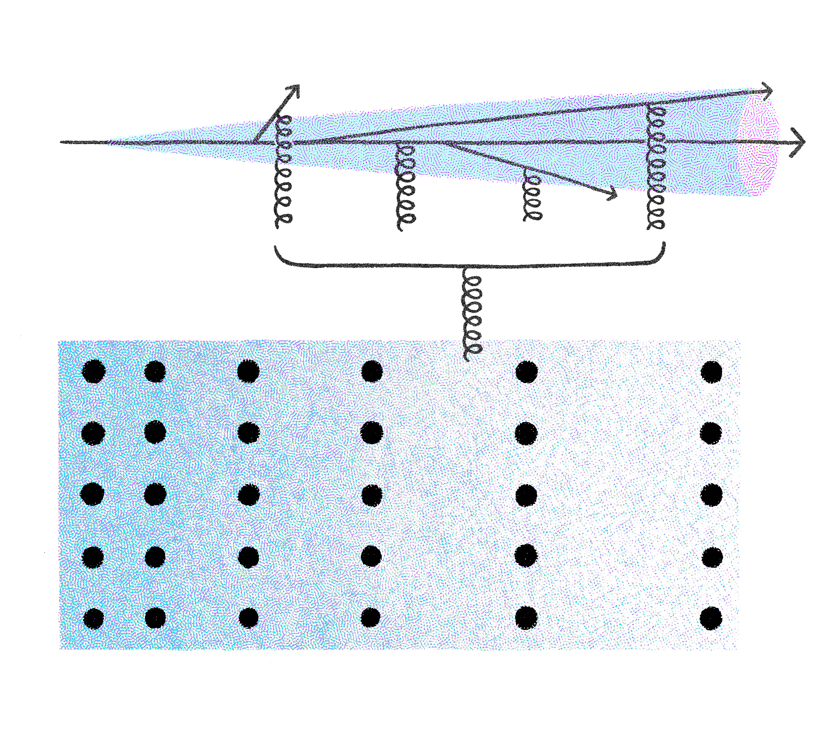
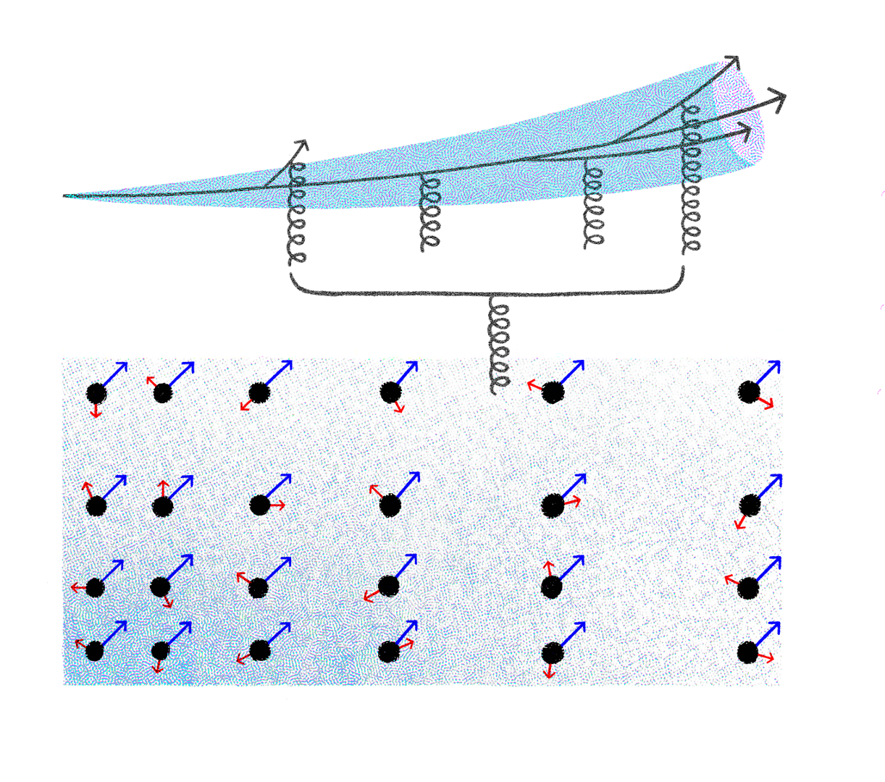

Slide 7
Color potential
the initial
distribution
the fluid velocity
inhomogeneity

Slide 8
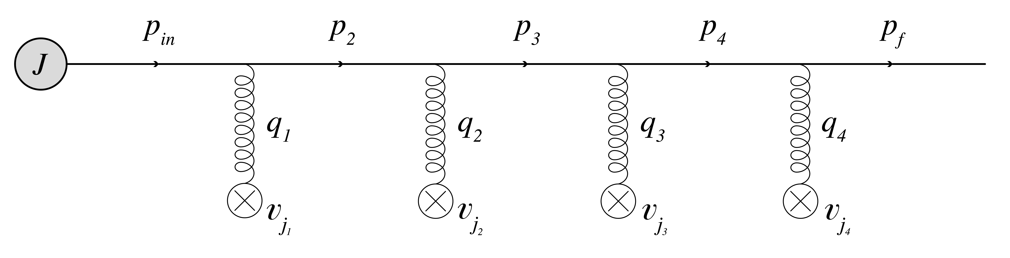
Medium averaging
2
color neutrality
source averaging

Slide 9
Medium averaging

Slide 10
Medium averaging

Slide 11
The broadening
single particle
propagator

Slide 12
The broadening

Slide 13
Jet broadening
inhomogeneous matter
13

Slide 14
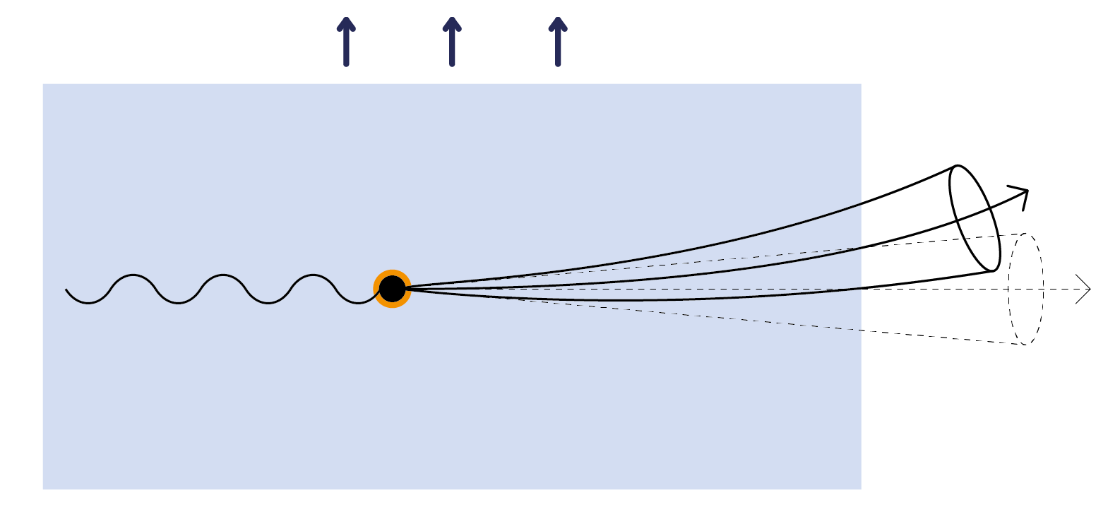

Slide 15
Color potential
the initial
distribution
the fluid velocity
inhomogeneity

Slide 16
Jet broadening

Slide 17
Jet broadening
uniform matter
Eikonal approximation --
Opacity expansion --
17

Slide 19
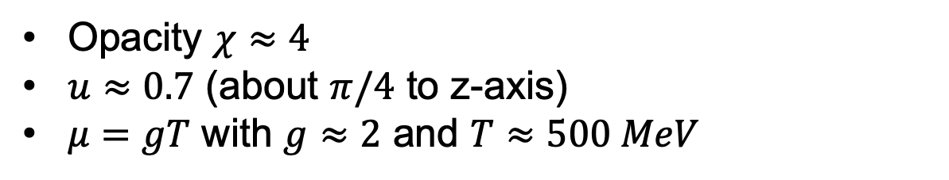

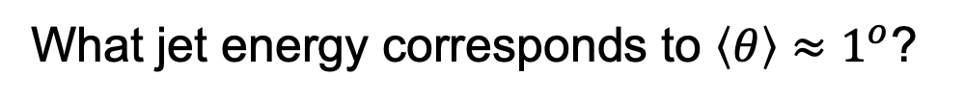
Jet broadening
uniform matter
Opacity $χ≈4$
$u≈0.7$ (about $π/4$ to z-axis)
$μ=gT$ with $g≈2$ and $T≈500 MeV$
What jet energy corresponds to $\left\langle θ\right\rangle ≈1^{o}$?
$$E\sim 50 GeV$$
19

Slide 20
Gluon emission

Slide 21

Gluon emission
energy fraction
Wilson line ($x≪1)$
the gluon (single-particle) propagator

Slide 22
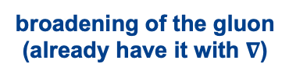
Gluon emission
broadening of the gluon
(already have it with $∇$)
emission kernel

Slide 23
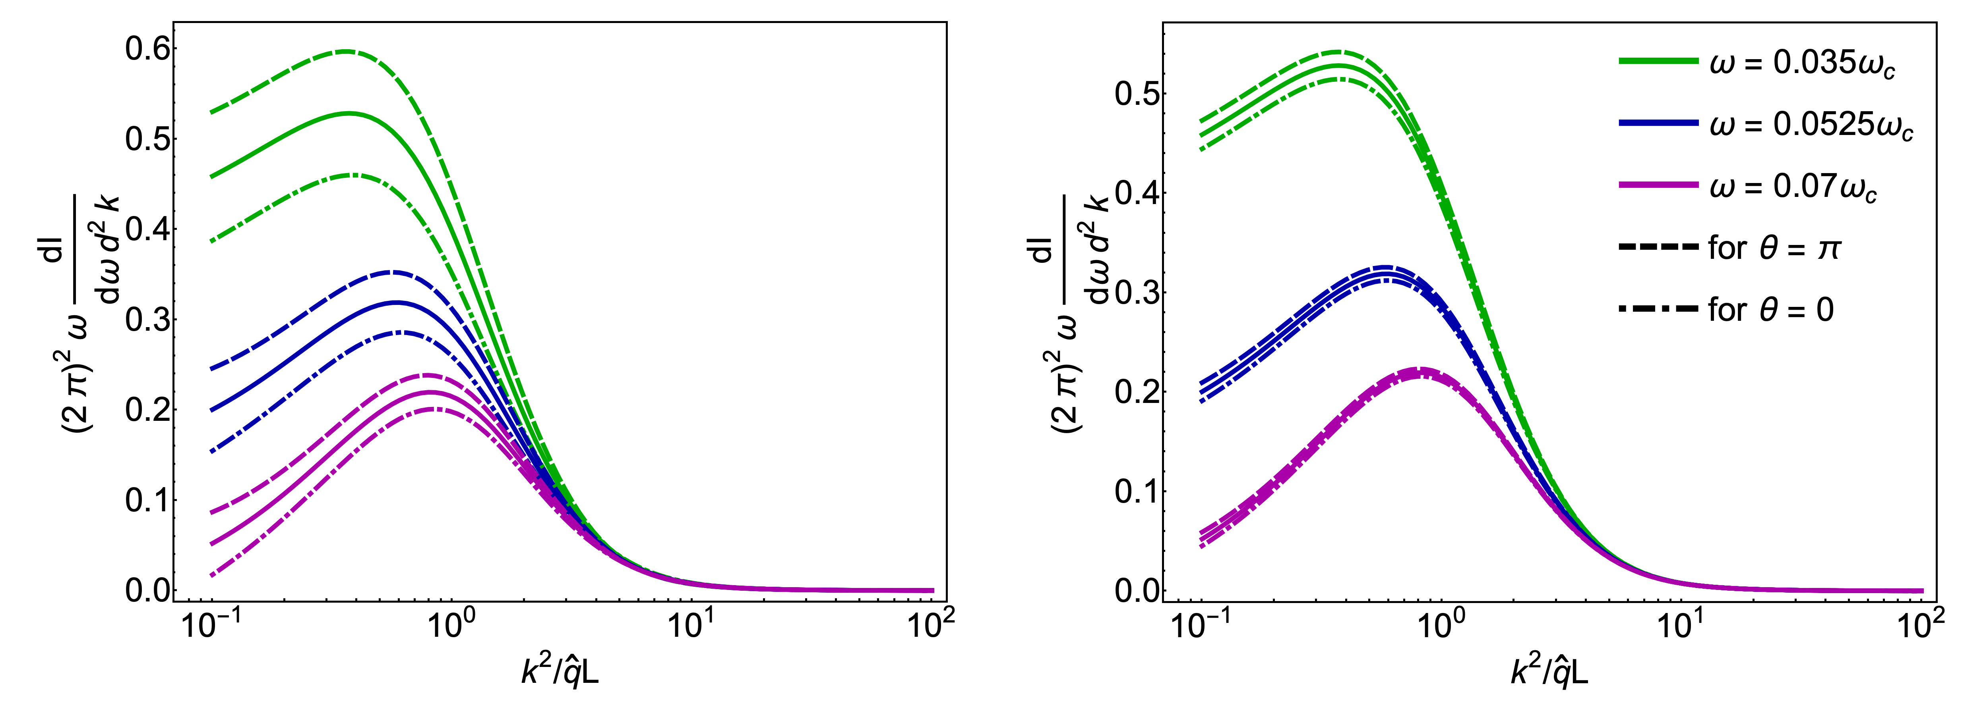

Slide 24
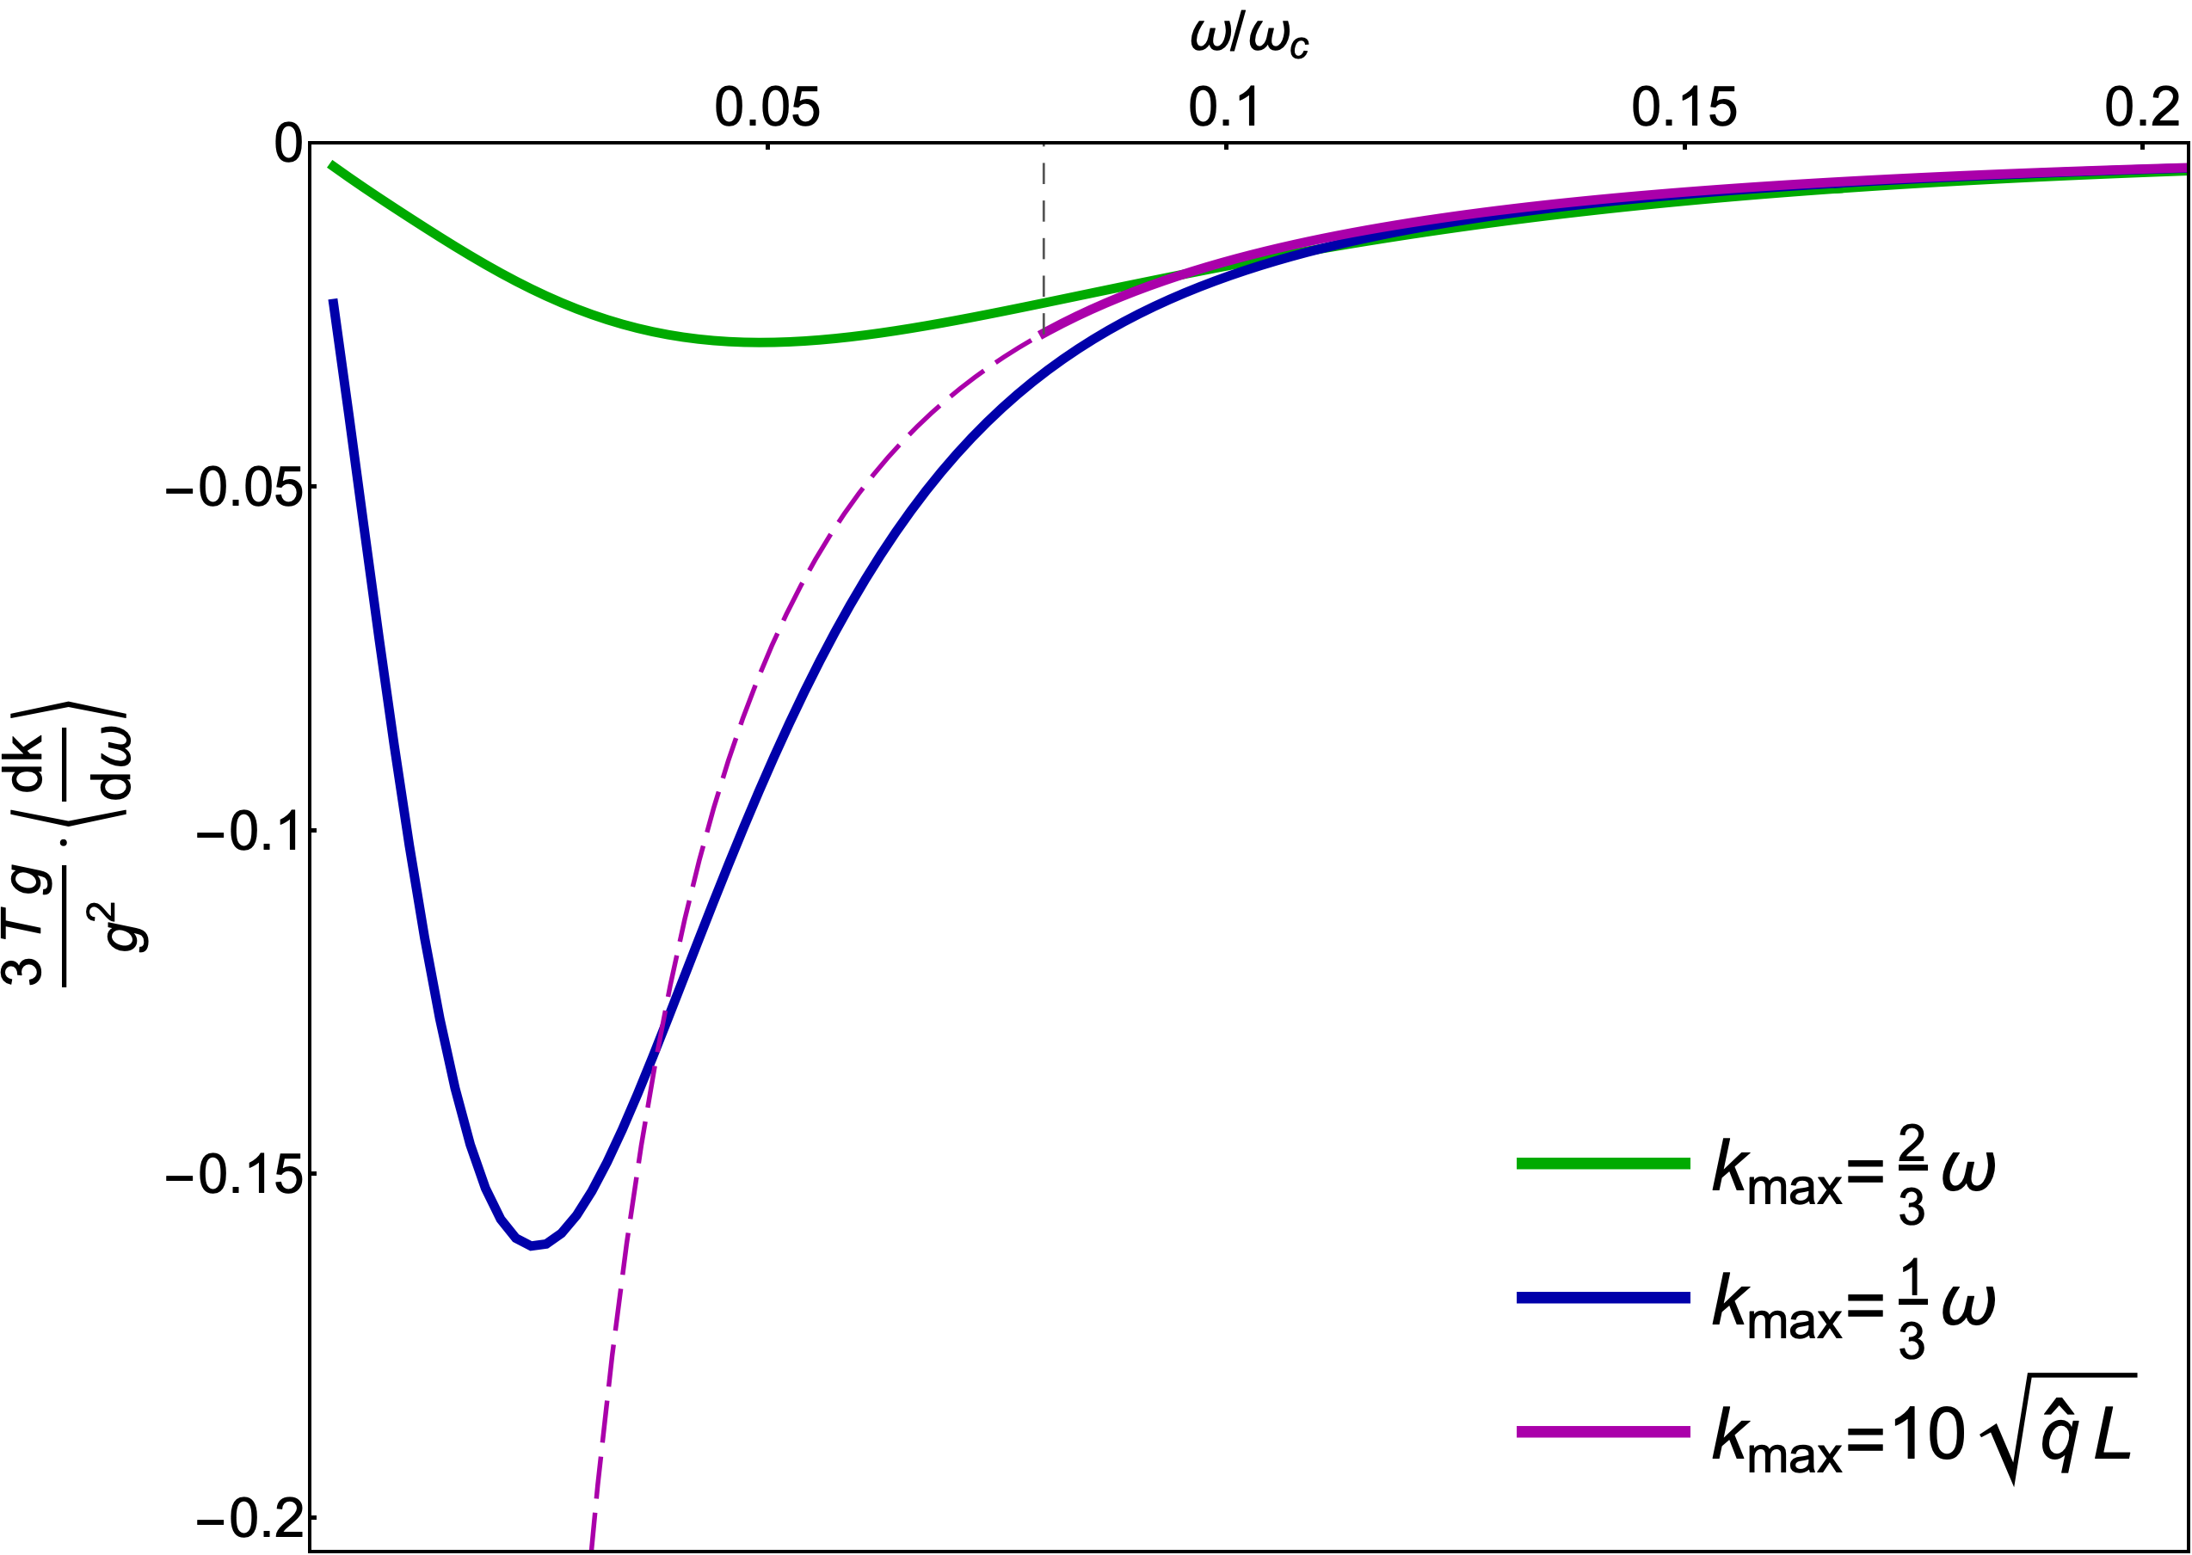
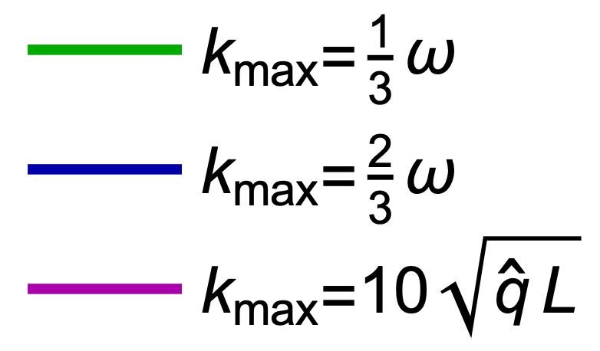

Slide 25
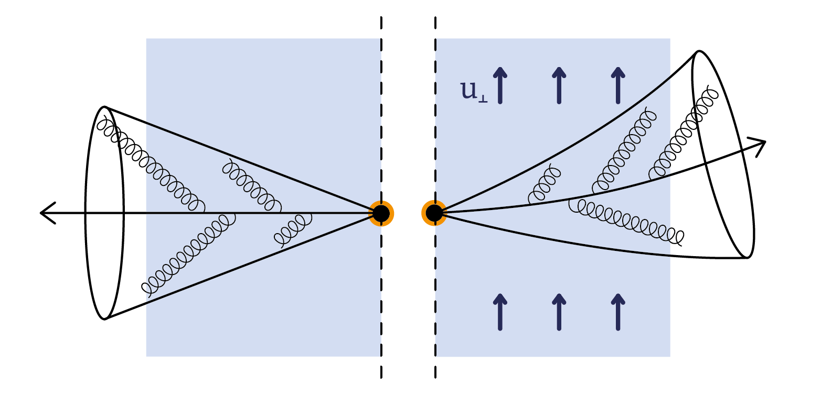

Slide 26
Summary
Jets do feel the transverse flow and anisotropy, and get bended;
The transverse flow and anisotropy do affect the medium-induced radiation, bending the substructure of jets;
These effects can be in principle probed in experiment, leading us towards actual jet tomography;
One should also expect similar evolution-induced effects for the other probes of nuclear matter;

