Slide 1

Medium-modified jet shape via transverse and longitudinal tomography
Hanzhong Zhang
Collaborated with Yu-Xin Xiao, Yayun He, Long-Gang Pang and Xin-Nian Wang
Institute of Particle Physics
Central China Normal University
Aschaffenburg 30/03/2023

Slide 2
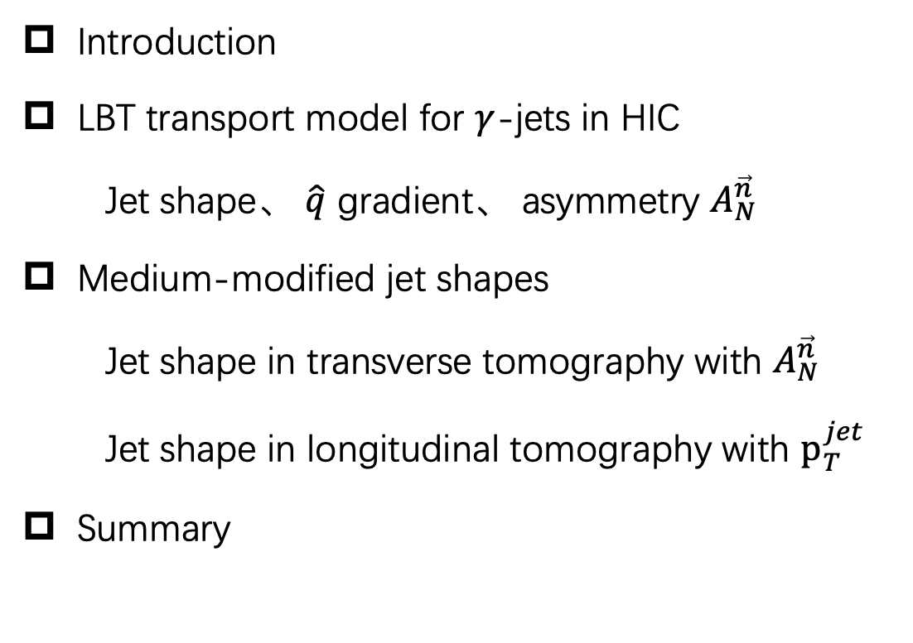
Outline
Introduction
LBT transport model for $γ$-jets in HIC
Jet shape、 $\hat{q}$ gradient、 asymmetry $A_{N}^{\vec{n}}$
Medium-modified jet shapes
Jet shape in transverse tomography with $A_{N}^{\vec{n}}$
Jet shape in longitudinal tomography with $p_{T}^{jet}$
Summary

Slide 3
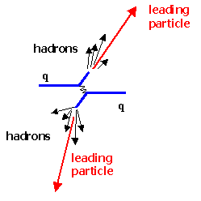
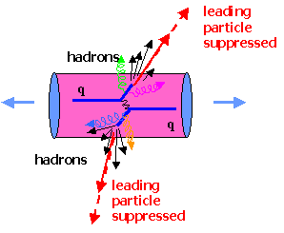
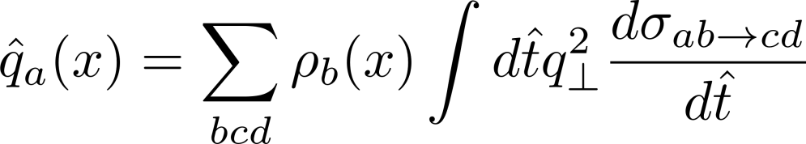
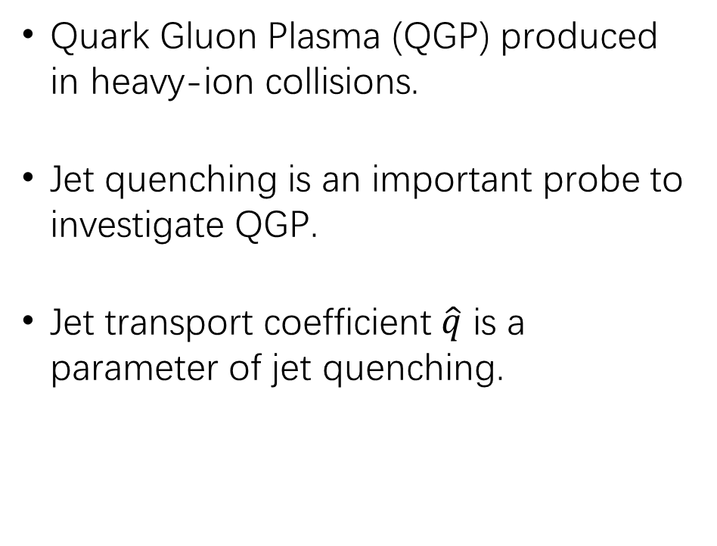
Heavy-ion collisions
Quark Gluon Plasma (QGP) produced in heavy-ion collisions.
Jet quenching is an important probe to investigate QGP.
Jet transport coefficient $\hat{q}$ is a parameter of jet quenching.
p-p collision VS A-A collision
M. Gyulassy and M. Plumer, Phys. Lett. B 243, 432(1990)
The density is not uniform for the medium evolution, so $\hat{q}$ gradient gives a spatial distribution of JQ strength.

Slide 4
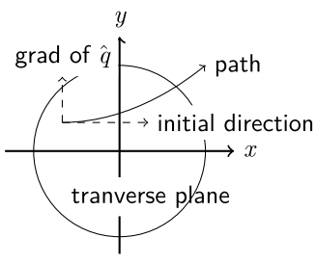
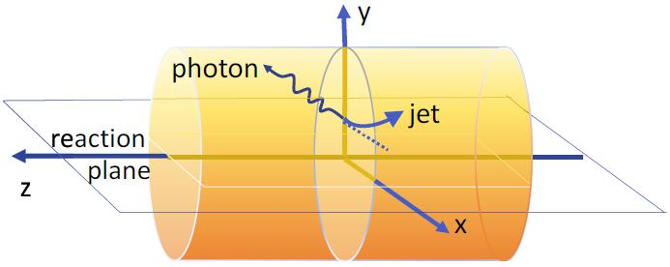

Gradient tomography of jet quenching
Gradient tomography of JQ is used to localize jet production points.
Photon-tagged jet deviates from the initial direction due to parton transports.
A final asymmetry $A_{N}^{\vec{n}}$ was introduced for the initial jet locations.
$A_{N}^{\vec{n}}$ selection gives a transverse tomography due to JQ gradient.
Y. He, L.-G. Pang, and X.-N. Wang, Phys. Rev. Lett. 125 (2020) 12, 122301

Slide 5
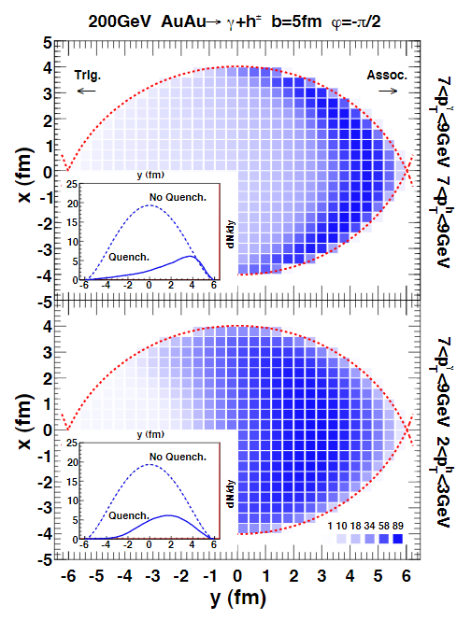
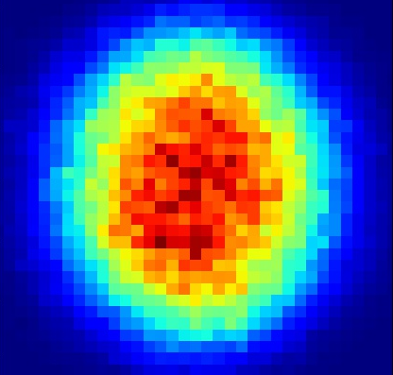

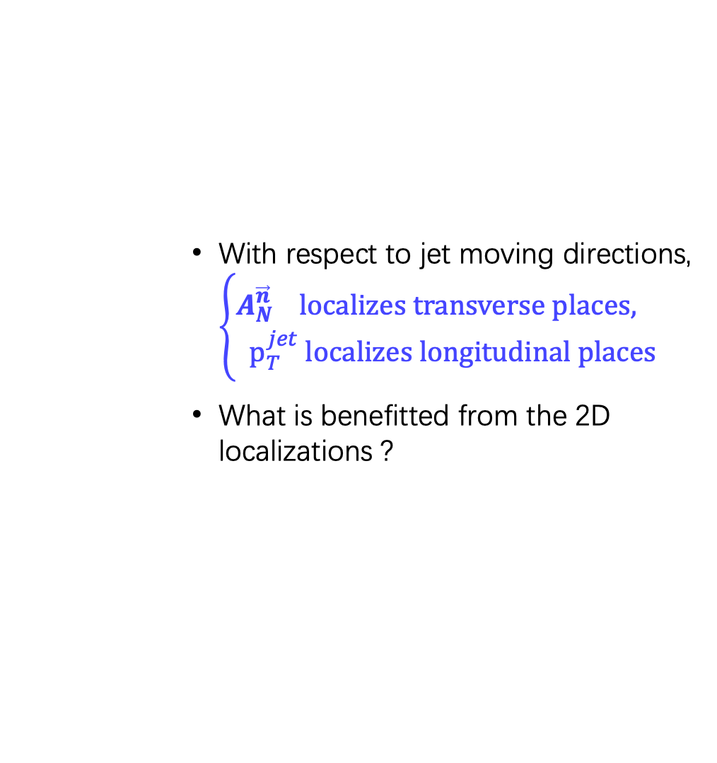

Transverse and longitudinal localizations
Surface emission appears for relatively large $p_{T}$ hadrons,
perpendicular to surface: longitudinal tomography
Mapping the QGP properties with final observables
Motivation - Medium-modified jet shape via transverse and longitudinal tomography
$$γ$$
jet
With respect to jet moving directions, $\left\{\begin{aligned}A_{N}^{\vec{n}} localizes transverse places, \\ p_{T}^{jet} localizes longitudinal places\end{aligned}\right.$
What is benefitted from the 2D localizations ?
A
B
C
D
H.-Z. Zhang, J. F. Owens, E.-K. Wang,
and X.-N. Wang, PRL103 (2009) 032302

Slide 6
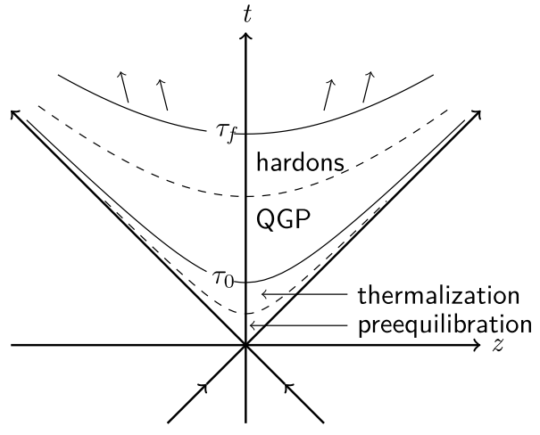
Model simulation of heavy ion collisions
AMPT
Initial condition of
A-A collisions
PYTHIA8
Initial parton shower
CLVisc (3+1)D viscous
Hydrodynamic model
Background evolution
LBT model
Jet transport
In medium
Fastjet code package
Reconstruction for the final jets
Y. He, T. Luo, X.-N. Wang, and Y. Zhu, Phys. Rev. C 97 (2018) 1, 019902
S. Cao, T. Luo, G.-Y. Qin, and X.-N. Wang, Phys. Rev. C 94 (2016) 1, 014909

Slide 7
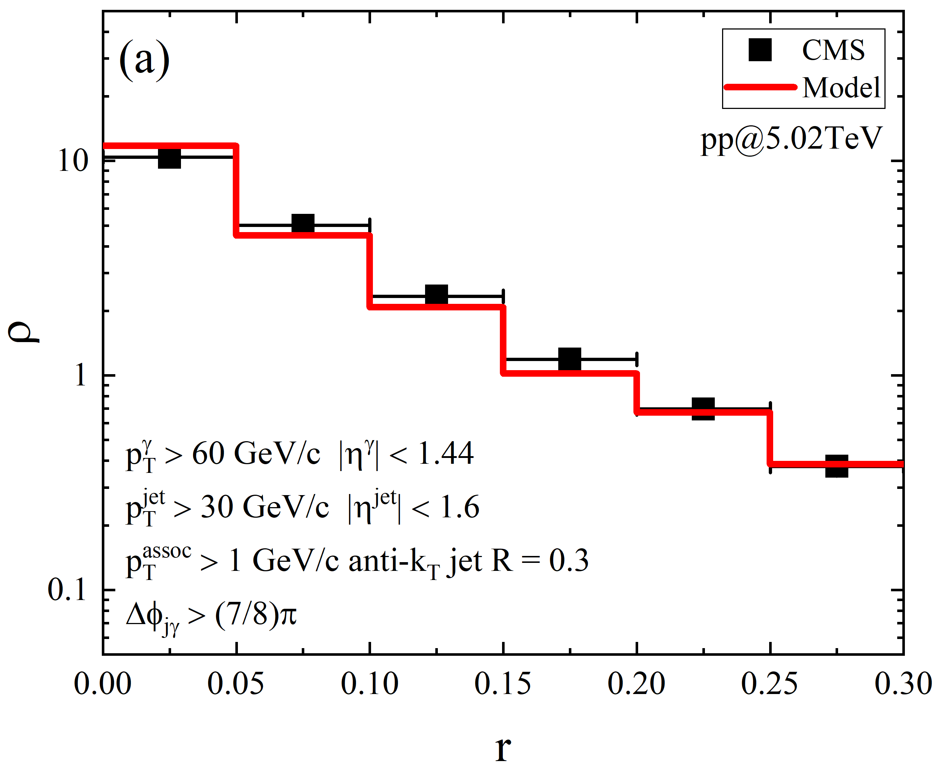
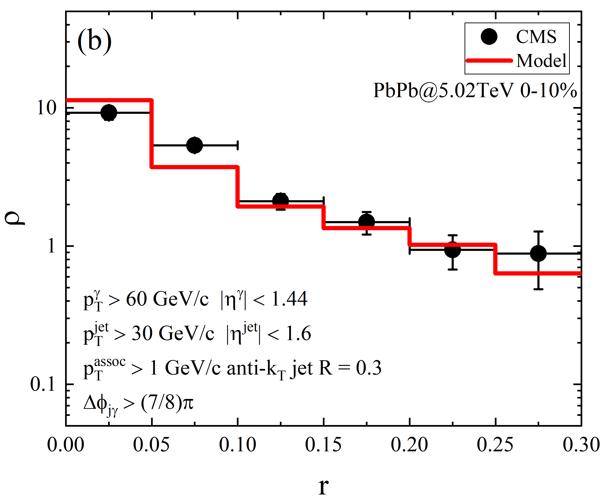
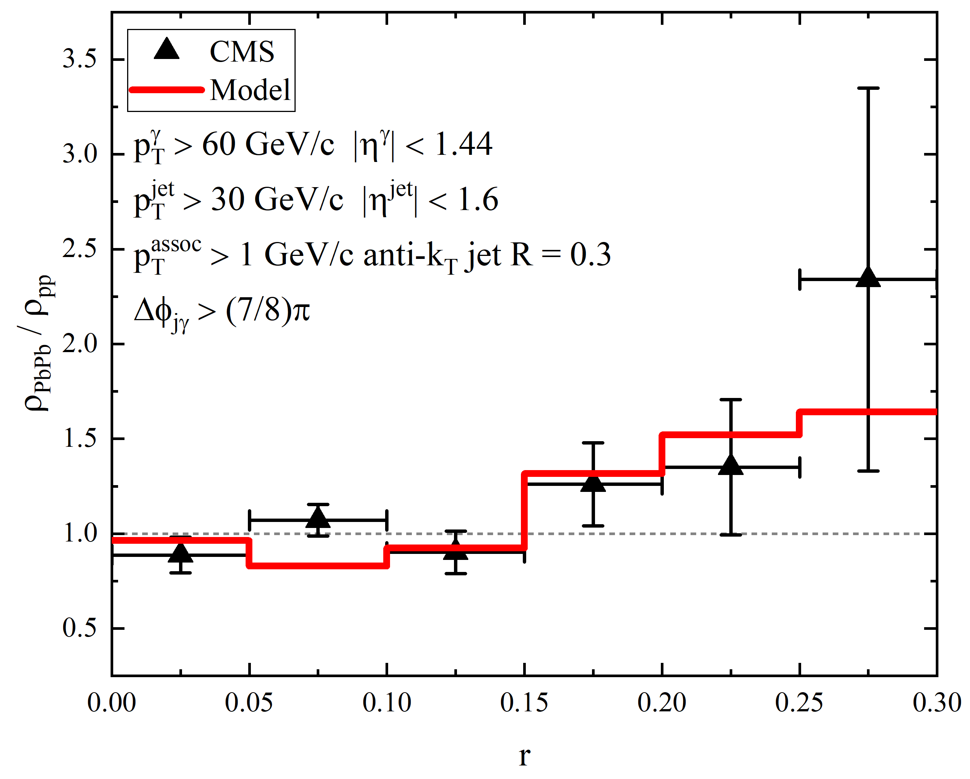
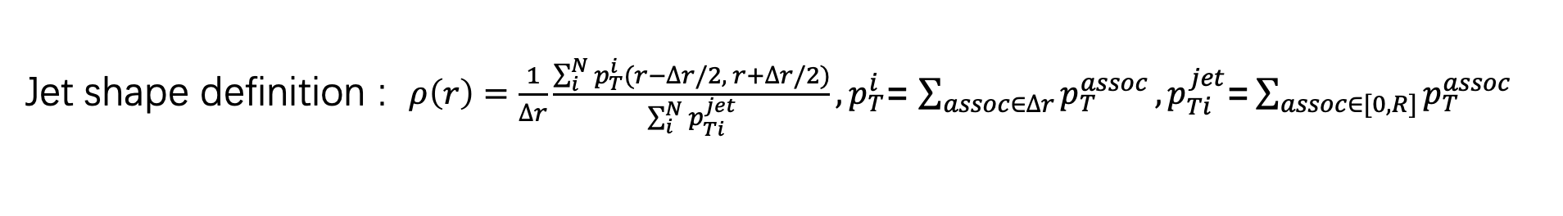
Jet shape of gamma-tagged jets
Jet shape definition : $ρ\left(r\right)=\frac{1}{∆r}\frac{\sum_{i}^{N}{p_{T}^{i}(r−∆r/2, r+∆r/2)}}{\sum_{i}^{N}{p_{Ti}^{jet}}},p_{T}^{i}$= $\sum_{assoc∈∆r}{p_{T}^{assoc}},p_{Ti}^{jet}\text{=}\sum_{assoc∈[0, R]}{p_{T}^{assoc}}$
for the possibility density of transverse momentum distribution inside a jet cone
Data from CMS, PRL(2019), 122(15)
(c)
Numerical results fit data well
Enhancement in large-r region due to elastic and inelastic scatterings

Slide 8
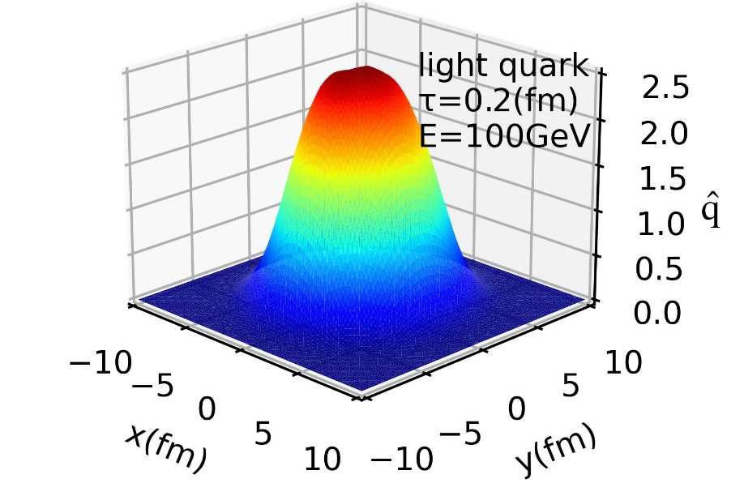
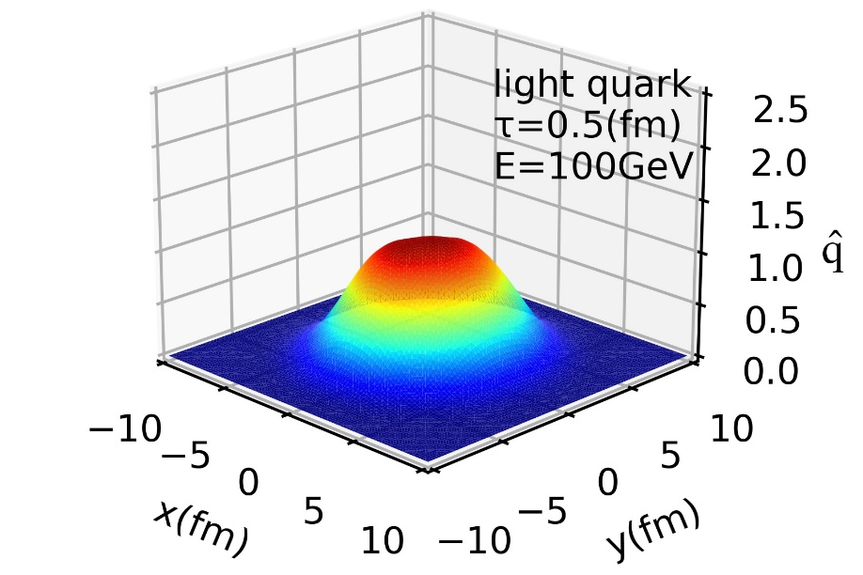
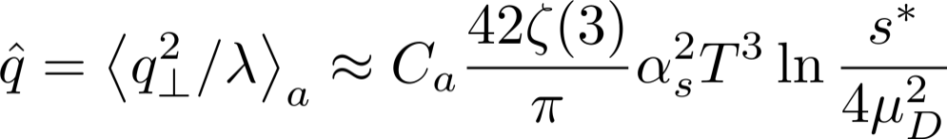
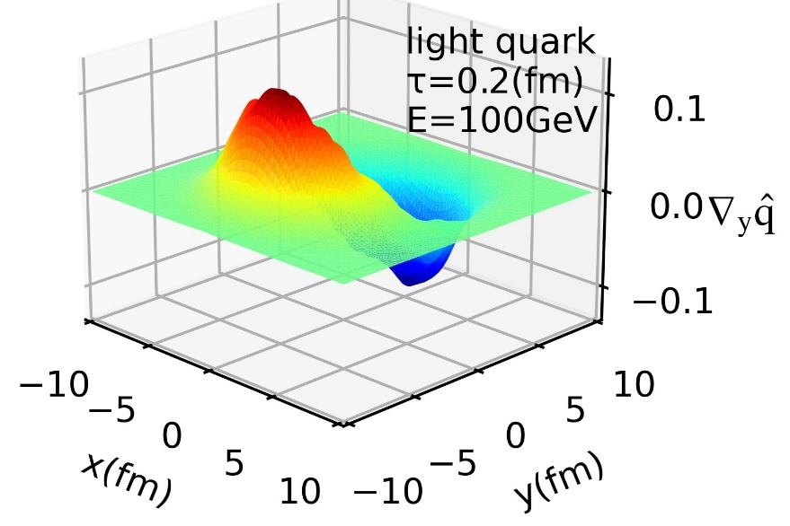
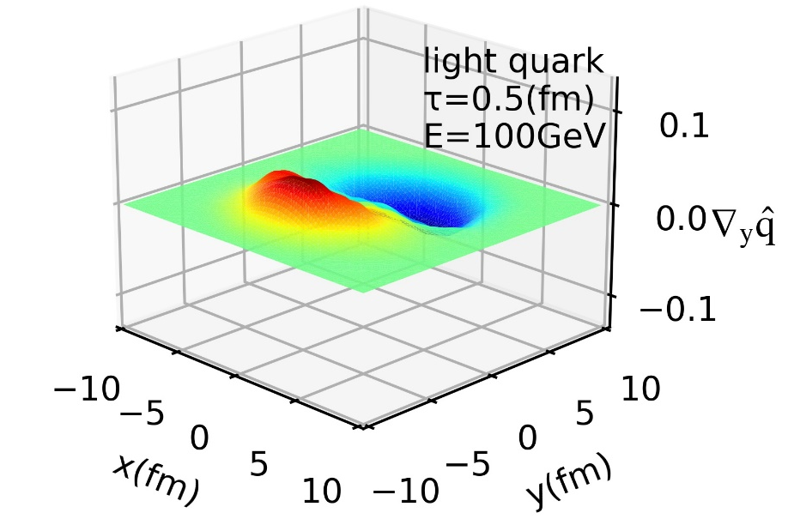




Spatial gradient of jet transport coefficient
$$ΔE∝\hat{q}$$
The jet transport coefficient $\hat{q}$ :
Y. He, T. Luo, X.-N. Wang, and Y. Zhu, Phys. Rev. C 91, 054908 (2015)
X.-N. Wang, S.-Y. Wei, and H.-Z. Zhang, Phys. Rev. C 96, 034903 (2017)
$\vec{n}$
$$\vec{n}$$
JQ strength is not uniform.

Slide 9
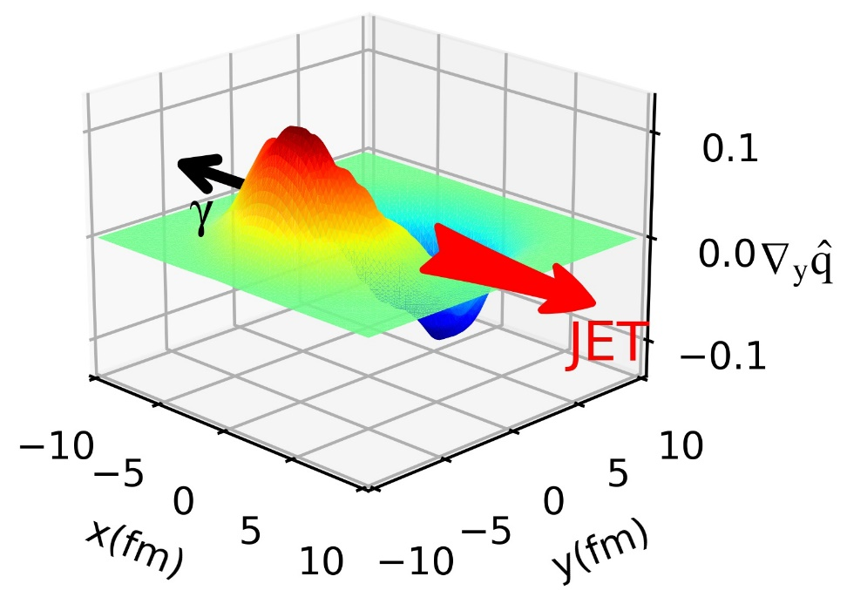
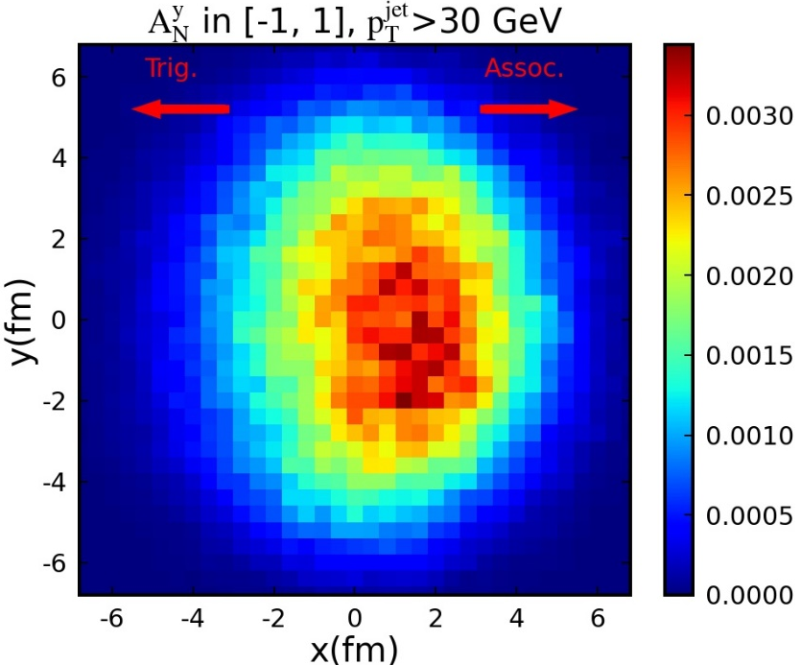
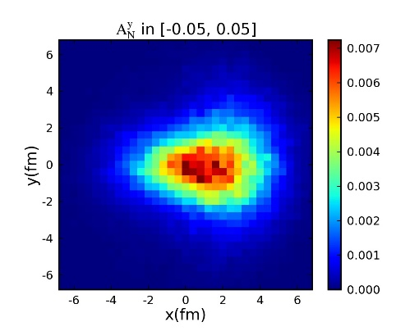
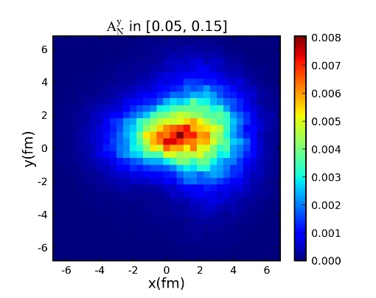
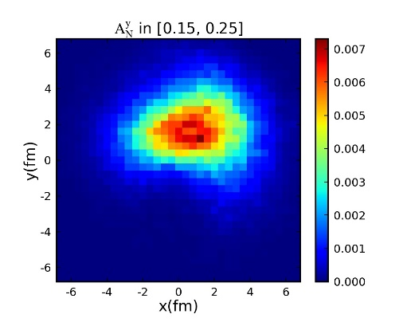
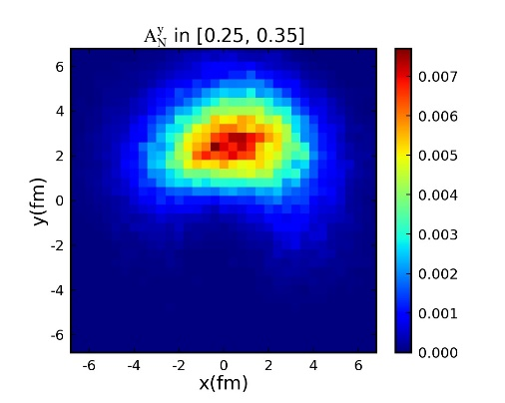
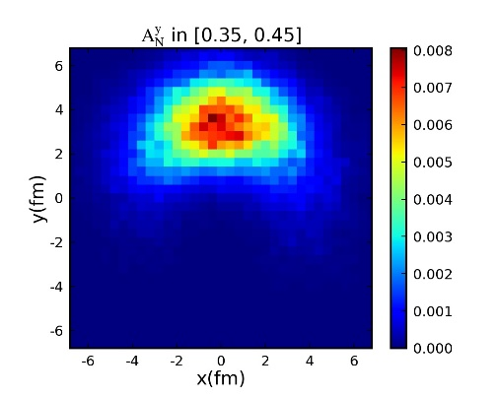
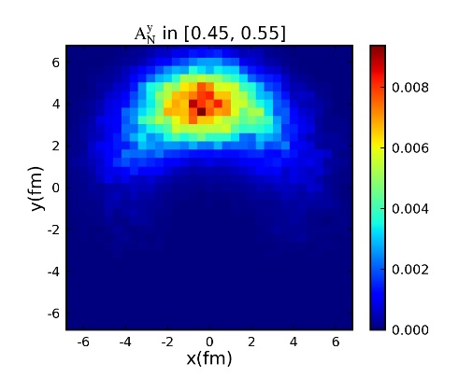
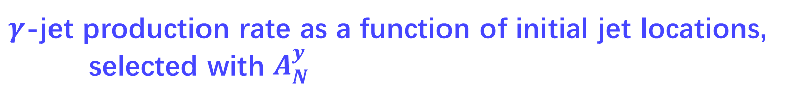


$γ$-jet production rate as a function of initial jet locations,
selected with $A_{N}^{y}$
Define asymmetry for final particle
distribution in one event :
$$γ$$
jet
$$\vec{n}$$
Y. He, L.-G. Pang, and X.-N. Wang,
Phys. Rev. Lett. 125 (2020) 12, 122301
The initial jet locations move up with the increasing of $A_{N}^{y}$ : transverse tomography

Slide 10
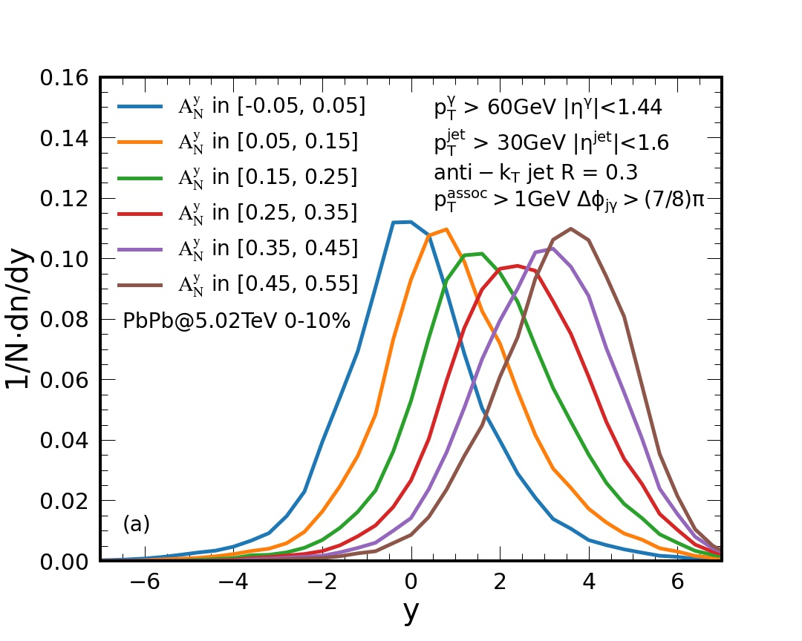
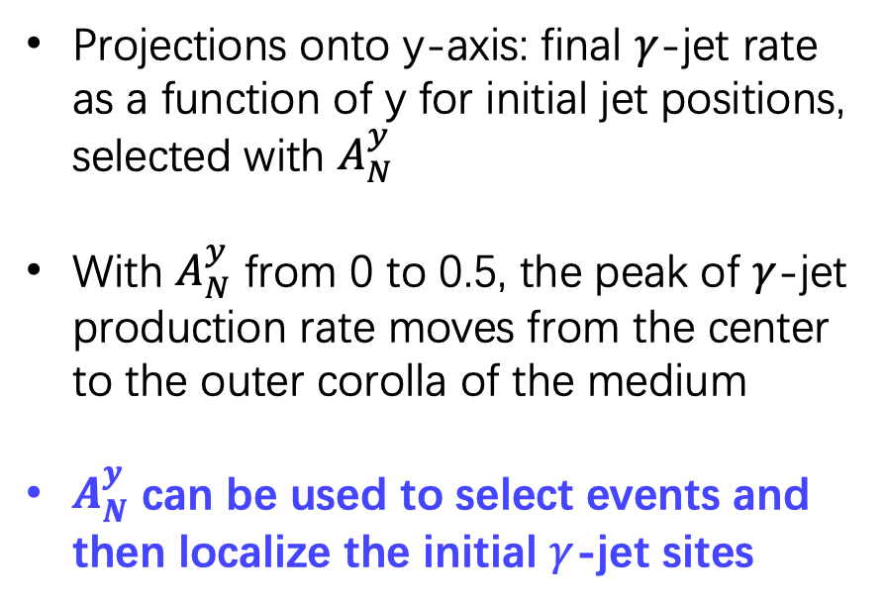
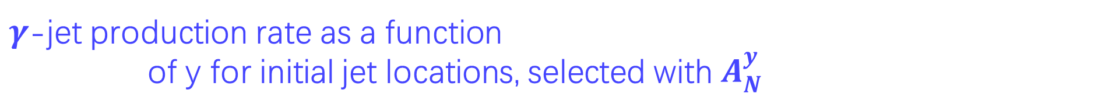
$γ$-jet production rate as a function of y for initial jet locations, selected with $A_{N}^{y}$
Projections onto y-axis: final $γ$-jet rate as a function of y for initial jet positions, selected with $A_{N}^{y}$
With $A_{N}^{y}$ from 0 to 0.5, the peak of $γ$-jet production rate moves from the center to the outer corolla of the medium
$A_{N}^{y}$ can be used to select events and then localize the initial $γ$-jet sites

Slide 11
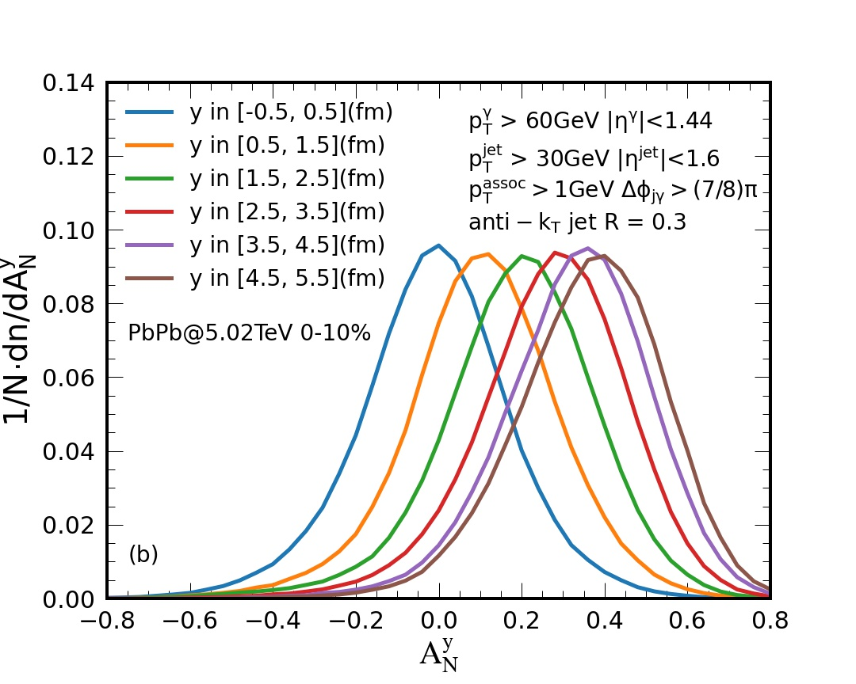
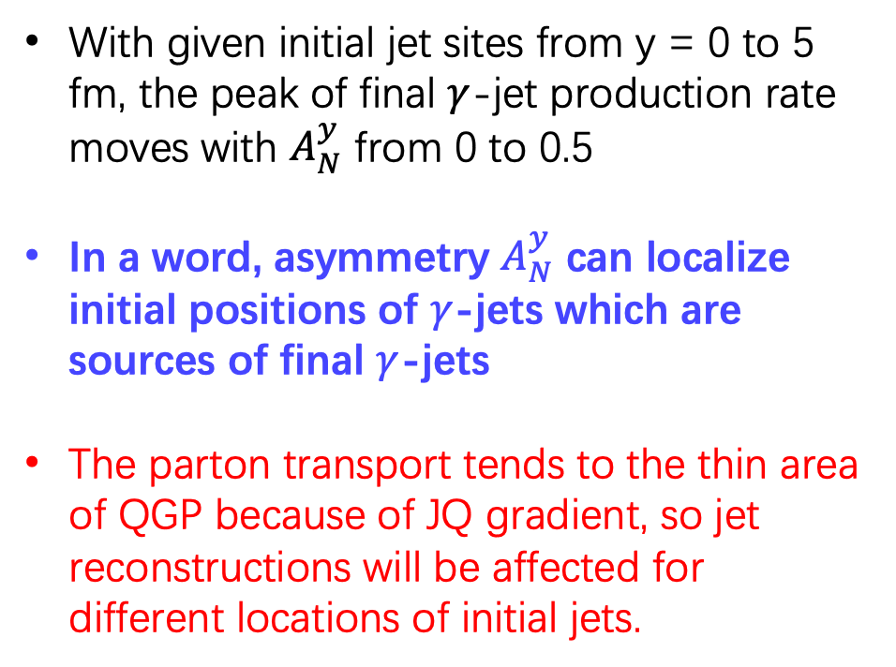
$γ$-jet production rate as a function of $A_{N}^{y}$,
with given initial jet positions
With given initial jet sites from y = 0 to 5 fm, the peak of final $γ$-jet production rate moves with $A_{N}^{y}$ from 0 to 0.5
In a word, asymmetry $A_{N}^{y}$ can localize initial positions of $γ$-jets which are sources of final $γ$-jets
The parton transport tends to the thin area of QGP because of JQ gradient, so jet reconstructions will be affected for different locations of initial jets.

Slide 12
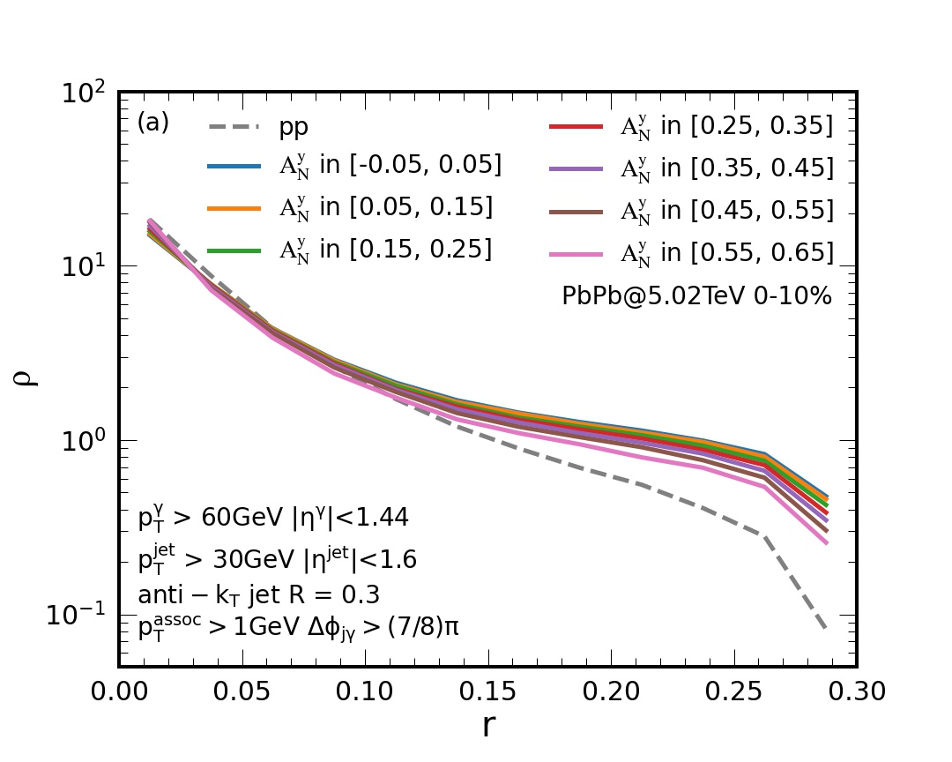
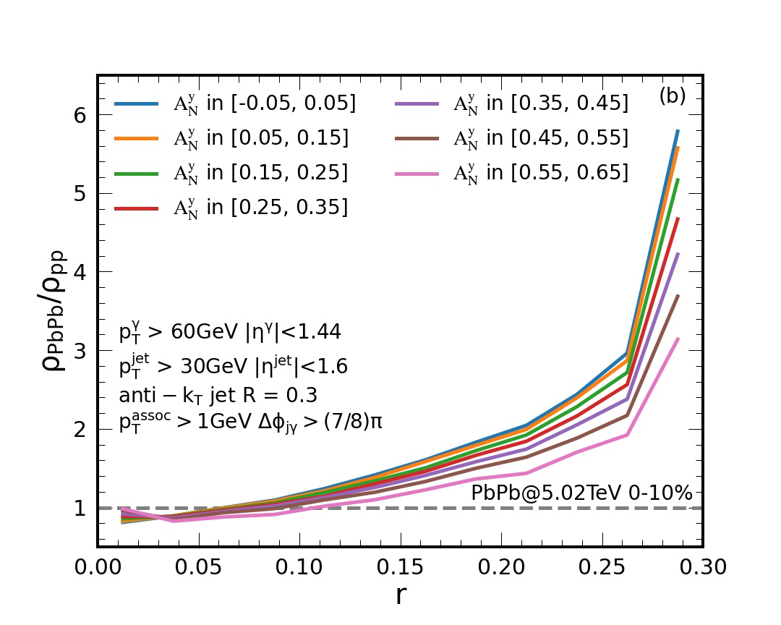
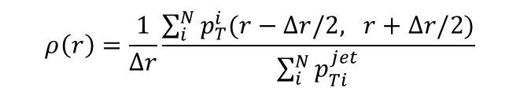
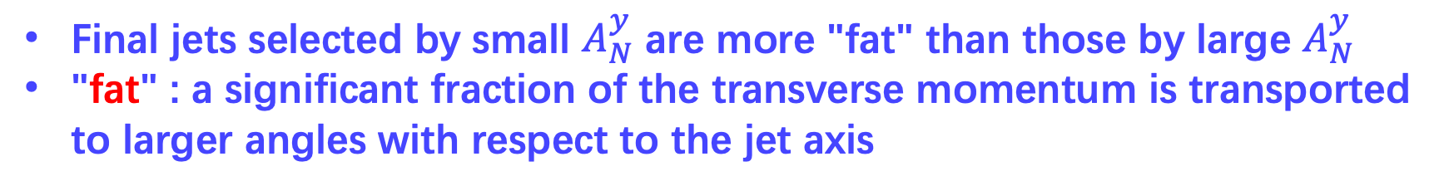
Jet shapes, selected with $A_{N}^{y}$
$$ρ\left(r\right)=\frac{1}{∆r}\frac{\sum_{i}^{N}{p_{T}^{i}(r−∆r/2, r+∆r/2)}}{\sum_{i}^{N}{p_{Ti}^{jet}}}$$
Fat
jet
Thin
jet
Final jets selected by small $A_{N}^{y}$ are more "fat" than those by large $A_{N}^{y}$
"fat" : a significant fraction of the transverse momentum is transported to larger angles with respect to the jet axis

Slide 13
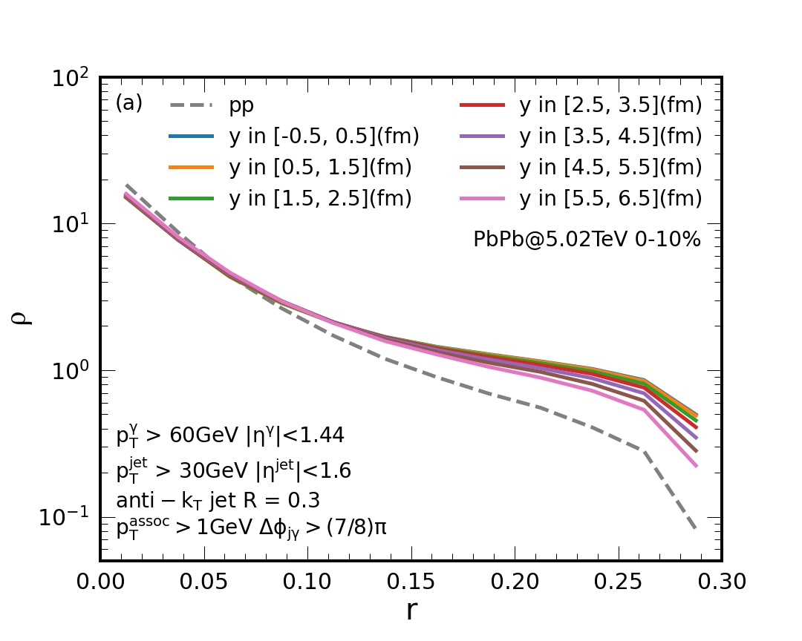
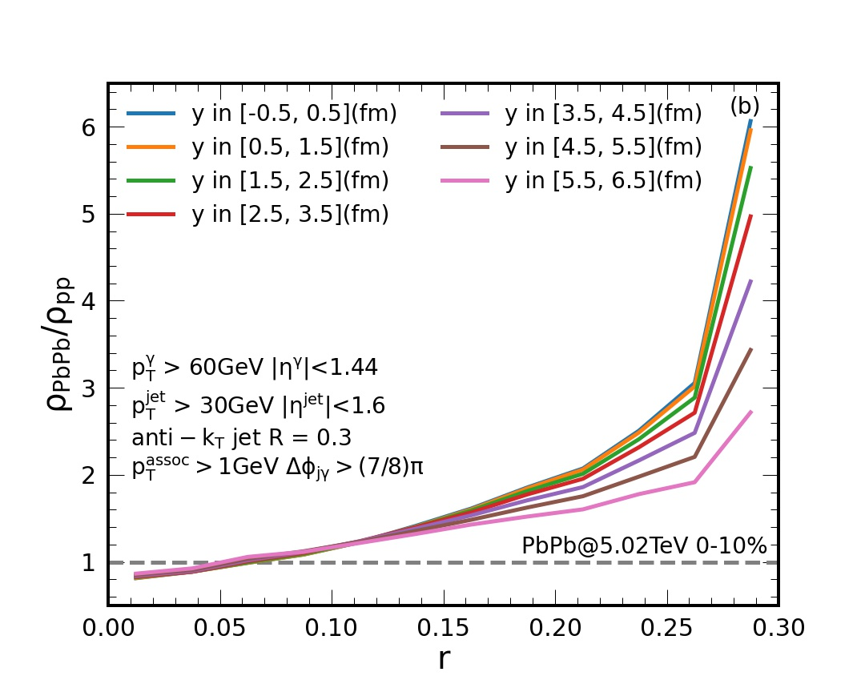
Jet shapes, with given initial jet positions
Fat
jet
Thin
jet
Final jets with initial central sites are more "fat" than with the initial outer corolla sites
Due to different strength of parton transports in the medium, the jet shape is affected with different propagating paths.

Slide 14
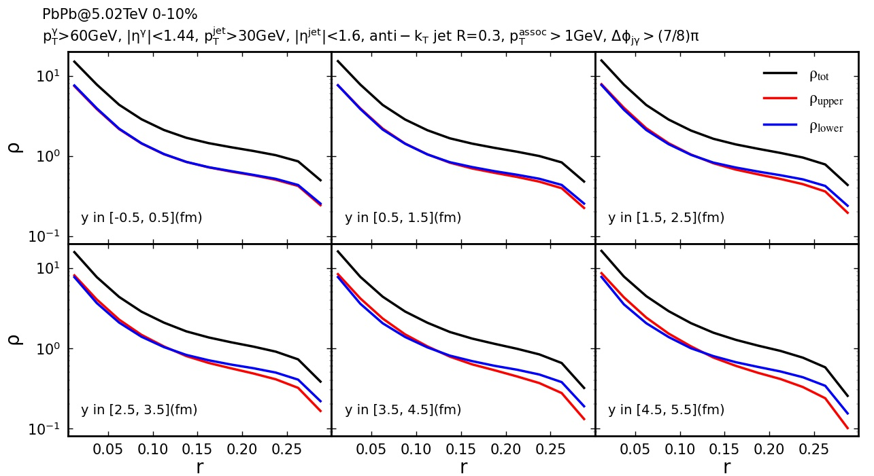
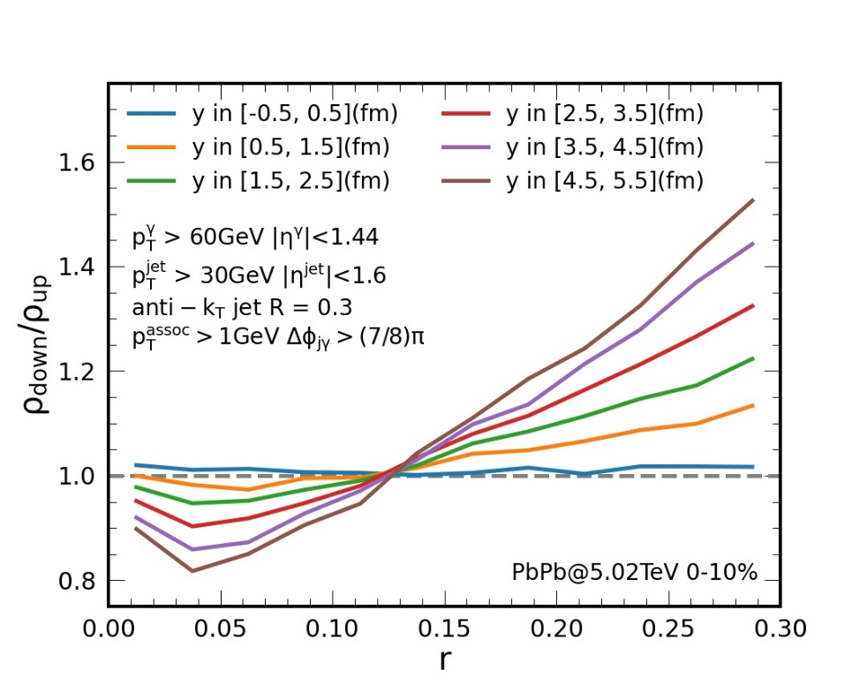


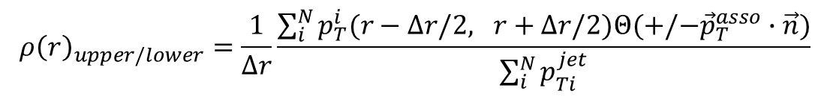
y
Jet shapes of $γ$-jets divided by jet reaction plane
$${ρ\left(r\right)}_{upper/lower}=\frac{1}{∆r}\frac{\sum_{i}^{N}{p_{T}^{i}(r−∆r/2, r+∆r/2)Θ(+/−{\vec{p}}_{T}^{asso}∙\vec{n}})}{\sum_{i}^{N}{p_{Ti}^{jet}}}$$
$\hat{q}$
upper
lower
x
center jets
corolla jets
$${ρ\left(r\right)}_{lower}/{ρ\left(r\right)}_{upper}$$
The transverse momentum inside a jet cone is transported from small to large angles away from jet axis
It is stronger in the lower cone than in the upper cone, especially for a corolla jet than a center jet

Slide 15

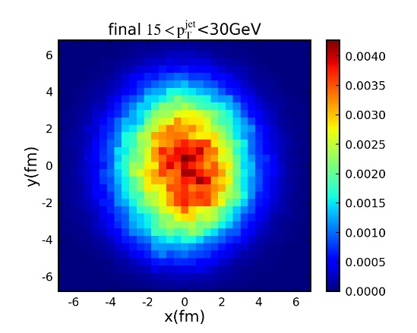
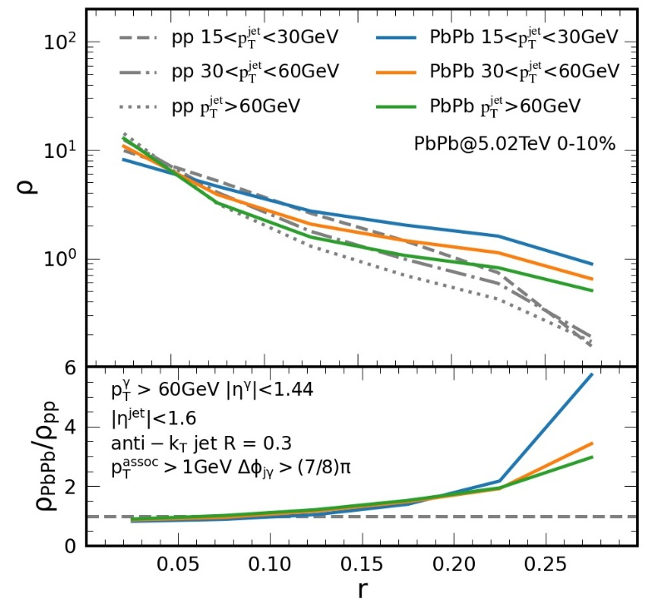
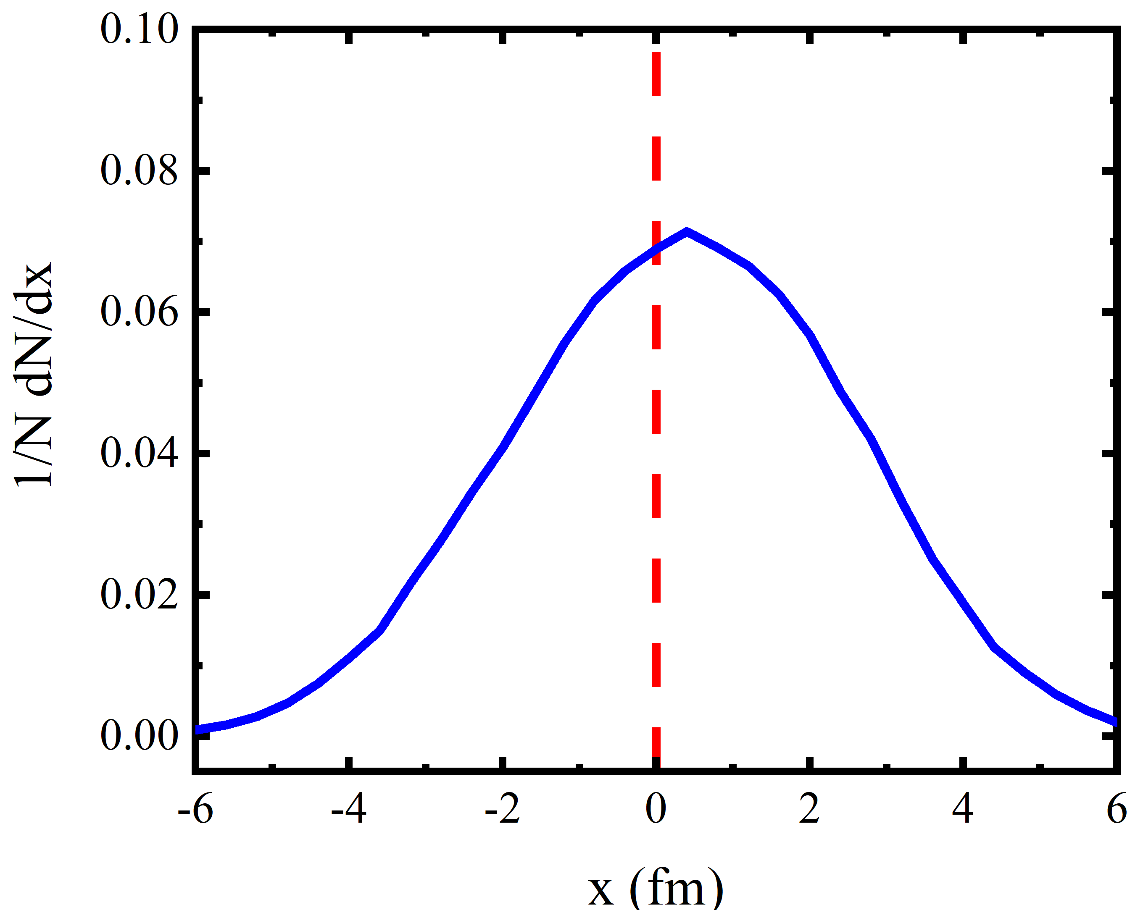
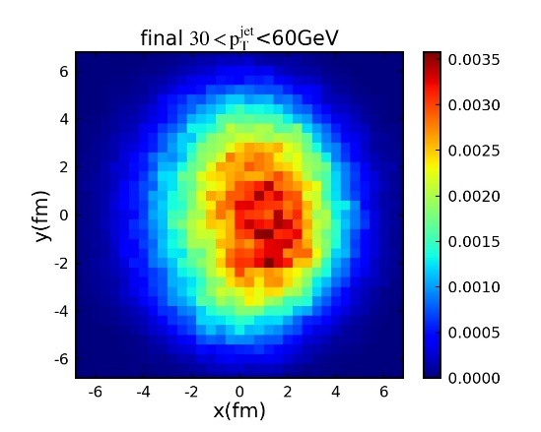
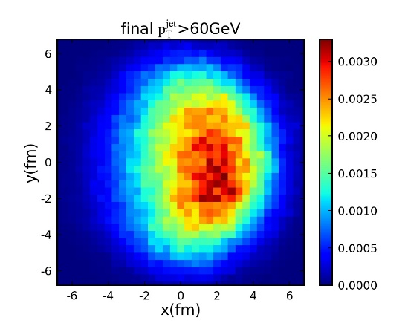





Jet shapes, selected with diff. $p_{T}^{jet}$: Longitudinal tomography
$γ$-jet production rate as a function of initial jet locations
$$ρ\left(r\right)=\frac{1}{∆r}\frac{\sum_{i}^{N}{p_{T}^{i}(r−∆r/2, r+∆r/2})}{\sum_{i}^{N}{p_{Ti}^{jet}}}$$
$$γ$$
jet
$$\vec{n}$$
Fat jet
Volume emission
Thin jet
Surface emission
Volume / surface → Fat / thin

Slide 16







Transverse and longitudinal tomography
$$p_{T}^{jet}>30 GeV$$
$${|A}_{N}^{y}|<1$$
$$γ$$
jet
$$γ$$
jet
Volume emission, selected with small $A_{N}^{y}$ or small $p_{T}^{jet}$
Surface emission, selected with large $A_{N}^{y}$ --- tangential to surface Transverse tomography
or large $p_{T}^{jet}$ --- perpendicular to surface Longitudinal tomography

Slide 17


Medium-modified jet shapes via transverse and longitudinal tomography
“Fat” jet:
because of volume emissions,
selected with small $A_{N}^{y}$ + small $p_{T}^{jet}$
“Thin” jet:
because of surface emissions,
selected with large $A_{N}^{y}$ + large $p_{T}^{jet}$
Other jets, e.g.:
large $A_{N}^{y}$ + small $p_{T}^{jet}$,
small $A_{N}^{y}$ + large $p_{T}^{jet}$

Slide 18

Summary
We study medium-modified jet shape via transverse and longitudinal tomography of $γ$-jets in heavy ion collisions.
Asymmetry $A_{N}^{\vec{n}}$ selection for $γ$-jets gives a transverse tomography, while $p_{T}^{jet}$ selection for $γ$-jets gives a longitudinal tomography: 2D localizations.
Due to gradient tomography of JQ, a fat jet is gotten with small $A_{N}^{y}$ or $p_{T}^{jet}$ from volume emission, while a thin jet with large $A_{N}^{y}$ or $p_{T}^{jet}$ from surface emission of transverse or longitudinal tomography, respectively.
Thank for your attentions ！

Slide 19




The LBT model
Boltzmann transport equation:
Y. He, T. Luo, X.-N. Wang, and Y. Zhu,
Phys. Rev. C 97 (2018) 1, 019902
Elastic:
J. Auvinen, K. J. Eskola, and T. Renk,
Phys. Rev. C 82 (2010) 024906
Inelastic:
X.-F. Guo, and X.-N. Wang, Phys. Rev. Lett. 85 (2000) 3591-3594
B.-W, Zhang, E.-K. Wang, and X.-N. Wang, Phys. Rev. Lett. 93 (2004) 072301

Slide 20
y
y
x
x

