Slide 1





Excited Hadron Channels in Hadronization
Rainer J Fries
Texas A&M University
work with M Kordell, C M Ko and J Purcell
Based on: M. Kordell, R. J. Fries, C. M. Ko, Annals Phys. 443 (2022) 168960

Slide 2
Hadronization and Resonances
arXiv:2203.11601
Renewed interest in Hadronization
  New experimental information!
  More realistic modeling?
Here we suggest a modest but physically important improvement.
Hadronic resonances play an important role in many aspects of heavy ion collisions. We expect this to be also the case for hadronization.
Concretely, we study the inclusion of meson resonances into quark recombination.

Slide 3
Hybrid Hadronization
A hybrid of string fragmentation and recombination.
Interpolates smoothly in between, two limits:
  Dilute systems → Dominance of string fragmentation
  Dense systems → Dominance of quark recombination
Monte Carlo implementation available, e.g implemented in JETSCAPE since v2.0.
Necessary ingredients: probabilities for coalescence of quarks based on their phase space coordinates.
Need to compute the necessary probabilities for meson resonances.
K. C. Han, R. J. Fries, C. M. Ko, Jet Fragmentation via Recombination of Parton Showers, Phys.Rev.C 93, 045207 (2016)

Slide 4



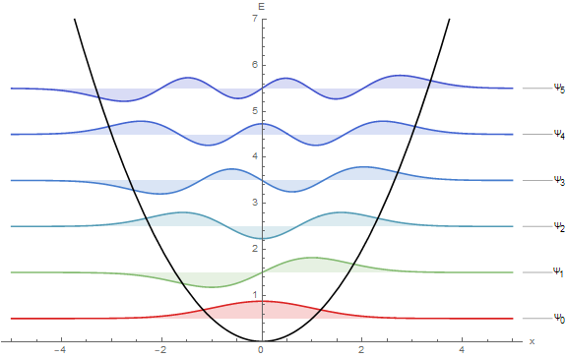

Setting up the problem
Quarks/antiquarks = wave packets in phase space
For simplicity: Gaussian wave packets around centroid phase space coordinates $\left({\vec{r}}_{i},{\vec{p}}_{i}\right)$, of given width $δ$. Color and spin information might be available (otherwise treated statistically).
Short range interaction modeled by isotropic harmonic oscillator potential of width $1/ν$.
Use the Wigner formalism in phase space. We need angular momentum eigenstates.
Attractive force

Slide 5

3d-Harmonic Oscillator in Phase space
Wigner distribution in phase space for given wave functions $ψ_{1}, ψ_{2}$:
(Diagonal) results known for the 3-D harmonic oscillator: S. Shlomo, M. Prakash, Phase space distribution of an N –dimensional harmonic oscillator, Nucl. Phys. A 357,157 (1981); formally known but hard to use.
In 2-D: R. Simon, G. S. Agarwal, Wigner representation of Laguerre-Gaussian beams, Opt. Lett. 25, 1313 (2000); results are in closed form and elegant!
Recalculate Wigner distributions using an expansion of angular momentum eigenstates in products of 1D-states.

Slide 6
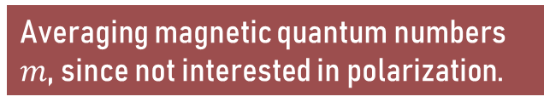
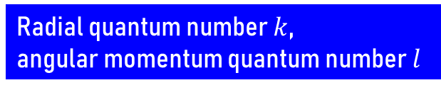
3d-Harmonic Oscillator in Phase space
Use the well-studied 1D-phase space distributions to build the 3D ones
The off-diagonal 1-D Wigner distributions are known [T. Curtright, T. Uematsu, C. K. Zachos, J. Math. Phys. 42 (2001)]
Three off-diagonal 1-D Wigner distributions
Radial quantum number $k$,
angular momentum quantum number $l$
Expansion coefficients for angular momentum eigenstates in terms of products of 1-D states
Averaging magnetic quantum numbers $m$, since not interested in polarization.

Slide 7

Wigner Distributions
Recall that Wigner distributions can be negative.
When summed over $m$, they only depend on magnitudes of position and momentum, and the relative angle $θ$ between.
Examples of a few lowest states

Slide 8

Coalescence
Probability for coalescence of Gaussian wave packets using the Wigner distributions.
Again sum over $m$, since we are not interested in polarization here (see remark later).
Results discussed here for $1/ν=2δ$ (relation between quark wave packet width $δ$ and harmonic oscillator length scale $1/ν)$.
Bound state Wigner distribution;
only depends on relative phase
space corrdinates
Wigner distributions of two Gaussian wave packets.
Wigner for center of mass motion.

Slide 9

Coalescence Probabilities
Probabilities depend on the relative coordinates of the wave packet centroids, called $r$ and $q$ here.
$θ$ = angle between $r$ and $q$.

Slide 10

Coalescence Probabilities
Probabilities can be written in terms of just two variables: total phase space distance squared $v$ and total angular momentum squared $t$.
If summed over states with the same energy, the probabilities are simply Poissonian given by phase space distance
  Same as in 1-D
Energy degeneracy broken by orbital angular momentum of the quarks. $t$ makes an intuitive connection between the relative angular momentum of the incoming quarks and the quantum number $l$ of their bound state.
Both are states with N=3

Slide 11

Excited Mesons and their decays
We include excited mesons up to $N=k+2l=4$.
Hybrid Hadronization uses PYTHIA 8 for decays: available excited states are limited, but the user can easily add more.
Many more resonances in the PDG -> add
Add as of yet unconfirmed bound states: extrapolate unknown properties.
PDG states
Unconfirmed states

Slide 12
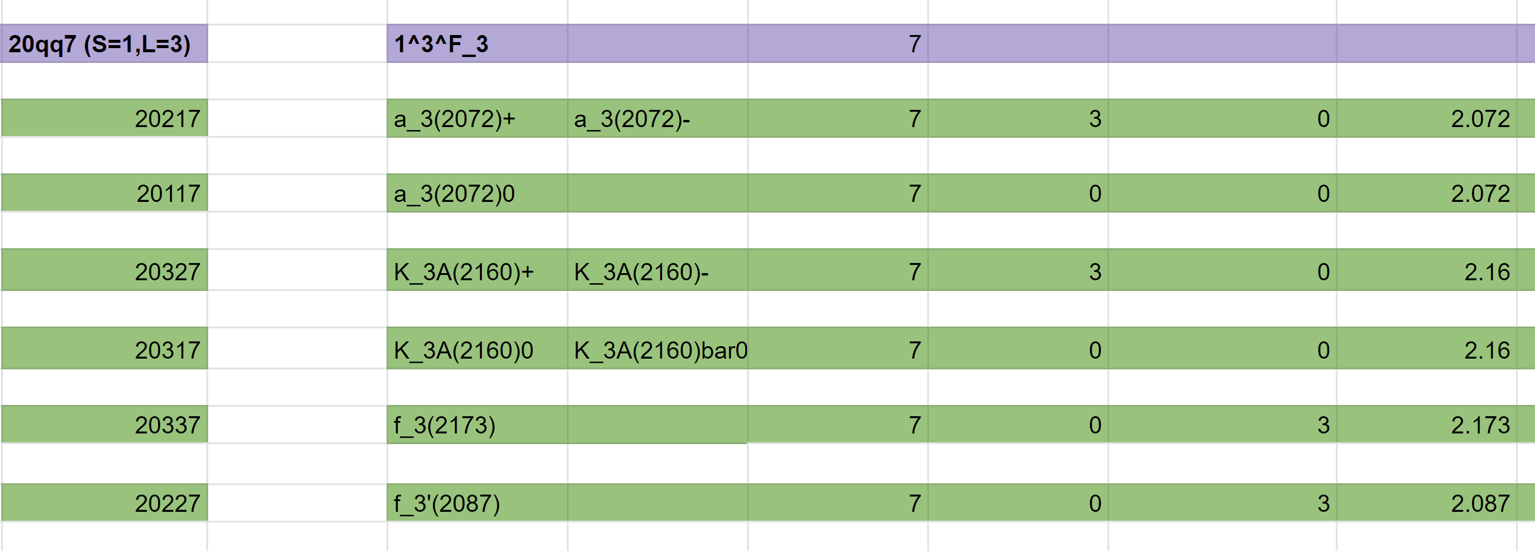
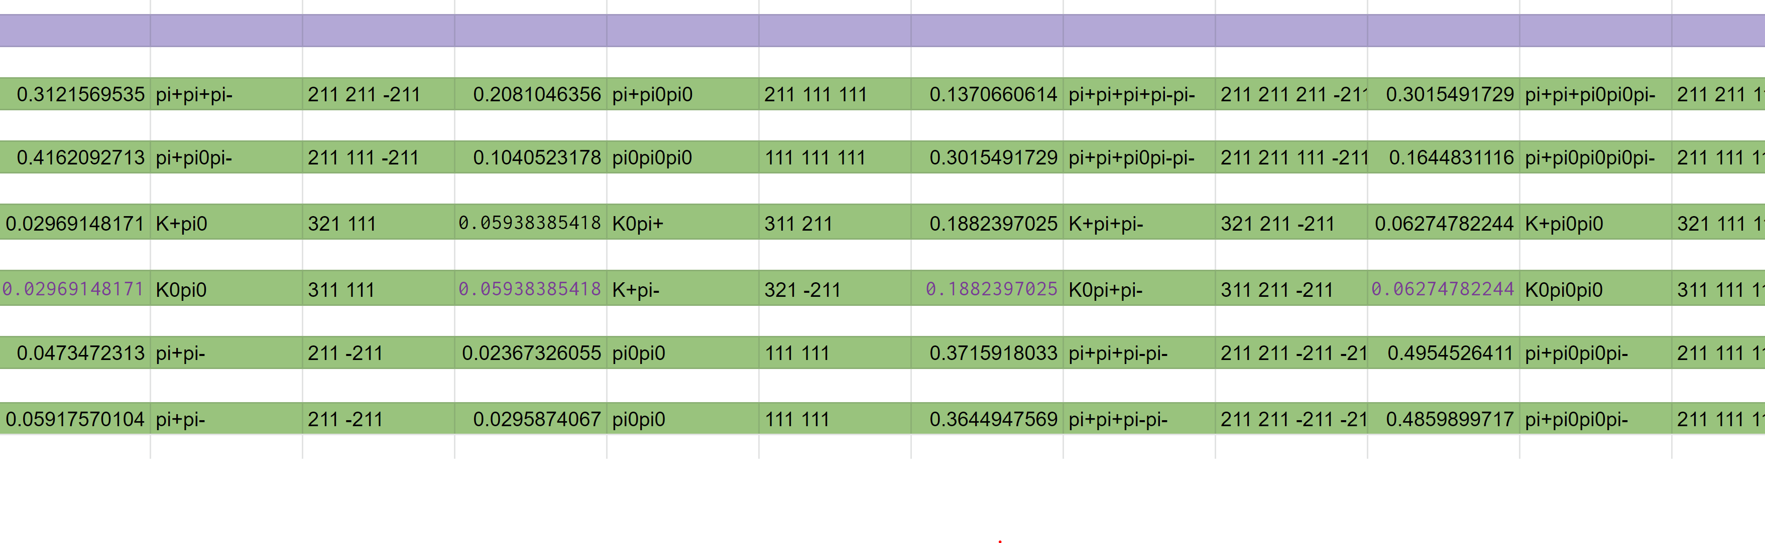
Excited Mesons and their decays
Use scaling laws for masses
Decays from minimum set of assumptions: Flavor/OZI, G-parity, phase space weights (up to 5-particle decay) [R. H. Milburn, Rev. Mod. Phys. 27, 1 (1955)], isospin algebra
A. V. Anisovich, V. V. Anisovich, A. V. Sarantsev,
Systematics of qqbar states in the (n,M²) and (J,M²) planes,
Phys. Rev. D 62, 051502 (2000)

Slide 13
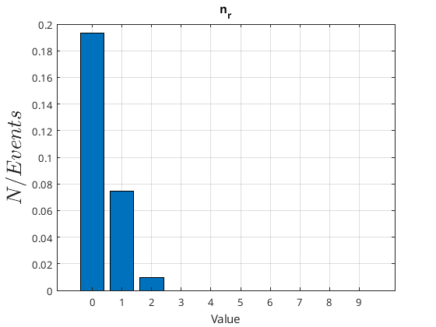
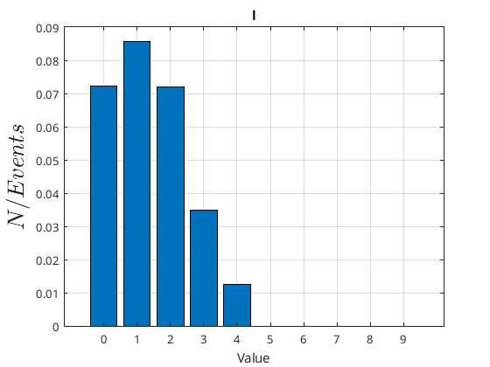
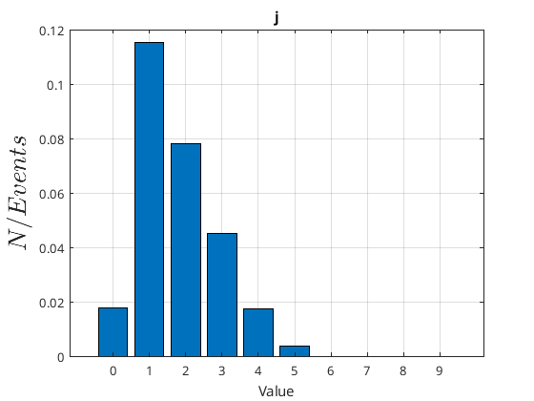

First test: abundances of Resonances
Use parton states from running PYTHIA 8 e+e- at 91 GeV
Hybrid Hadronization with $N=4$, no decays;
Spin treated statistically, color flow from PYTHIA.
Hadrons from recombination only
Radial
Orbital angular mom.
Total angular mom.

Slide 14
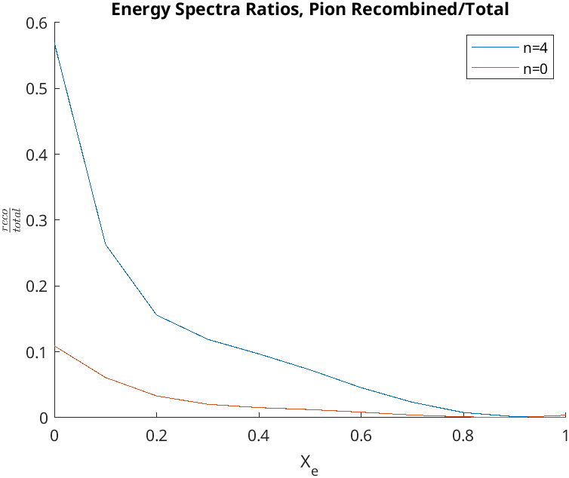
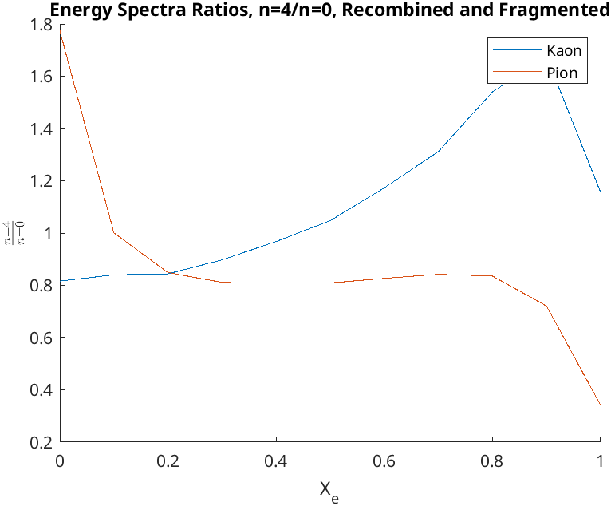

First test: spectra
e+e- at 91 GeV, $N=4$, decays=on
Left panel: $N=4$ vs $N=0$ means more recombination, less fragmentation
Right panel: Competing mechanisms: increasing $N$ increases low momentum decay products, also allows for more recombination at large $x_{e}$.

Slide 15

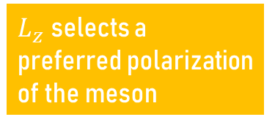


Preview: Polarization
$P_{011}=e^{−v}\left(\frac{1}{2}v_{T}+\frac{L_{z}}{2ℏ}\right)$
$P_{011}=e^{−v}v_{L}$
$P_{01 −1}=e^{−v}\left(\frac{1}{2}v_{T}−\frac{L_{z}}{2ℏ}\right)$
What if we don’t sum over magnetic quantum numbers and ask for the polarization of the meson?
Probabilities are sensitive to the angular momentum component $L_{z}$.
Conclusion: if the collective motion of the quarks at carries net orbital angular momentum, hadronization can give you correspondingly polarized $p$- and $d$-wave mesons.
$L_{z}$ selects a preferred polarization of the meson
$v_{T}$, $v_{L}$: squared phase space distance perpendicular and parallel to the quantization axis.

Slide 16
summary
We have laid the foundation to include excited meson states into the recombination formalism:
  Coalescence probabilities for Gaussian wave packets have been calculated.
  Excited meson lists have been assembled.
First test in e⁺e⁻: 𝒑- and 𝒅-wave mesons are important hadronization channels.
Explore effects in systems beyond e⁺e⁻
Adding baryons: tedious but doable
Novel manifestation of polarization effects from orbital angular motion of quarks?

Slide 17
Backup

Slide 18
JETS in Hybrid Hadronization
Decay gluons provisionally into qqbar pairs (gluons whose quarks don’t recombine are later reformed)
Go through all possible quark pairs/triplets, compute the recombination probability and sample it. Recombine the pair/triplet if successful.
Rejected partons again form acceptable string systems (only color singlets removed!)
Remnant strings are fragmented by PYTHIA 8.
Remnant strings from color flow
String Fragmentation

Slide 19

3d-Harmonic Oscillator in Phase space
Express angular momentum eigenstates through an expansion in products of 1D-states
Tedious but straight forward, e.g. for $k=0$:
Two conditions for non-zero coefficients:
Radial, orbital angular momentum
and magnetic quantum nubmers
Three 1D-quantum numbers
Condition for matching energy of states

