Slide 1



Gradient tomography of dijets in heavy-ion collisions
S
Hard Probes 2023, Aschaffenburg
2023.3.28
Information field based global Bayesian inference of the jet transport coefficient
Man Xie (SCNU)
Poster #32
Yayun He (SCNU)
Xin-Nian Wang
Lawrence Berkeley National Laboratory

Slide 2
Parton energy loss and jet transport
(High-twist approach)
Elastic energy loss
Jet 1
Jet transport coefficient:
q
q
Jet 2
Notes:
\frac{dE_{el}}{dx}=\int\frac{d^3k}{(2\pi)^3}dq_\perp^2 f(k) \frac{q_\perp^2}{2k}\frac{d\sigma}{dq_\perp^2}\approx C\frac{3\pi}{2}\alpha_s^2T^2\ln\frac{s^*}{4\mu_D^2}
\frac{dE_{el}}{dx}=\int\frac{d^3k}{(2\pi)^3}dq_\perp^2 f(k) \frac{q_\perp^2}{2k}\frac{d\sigma}{dq_\perp^2}\approx \langle \frac{1}{2\omega}\rangle \hat q
\frac{dE_{rad}}{dx}\approx \frac{2C_A\alpha_s}{\pi} \hat q (x) \int dz \frac{d\ell_\perp^2}{\ell_\perp^4}zP(z)\sin^2\frac{\ell_\perp^2 (x-x_0)}{4z(1-z)E}
\widetilde P_{a\rightarrow ag}(z)
d\sigma_h=\sum_{a,b,c} f_a\otimes f_b\otimes d\sigma_{ab \rightarrow c+X}\otimes \widetilde D_{c/h}
\widetilde D_{c/h}(z_h)\approx
\widetilde P_{a\rightarrow ag}(z) \otimes D_{a/h}(z_h)

Slide 3
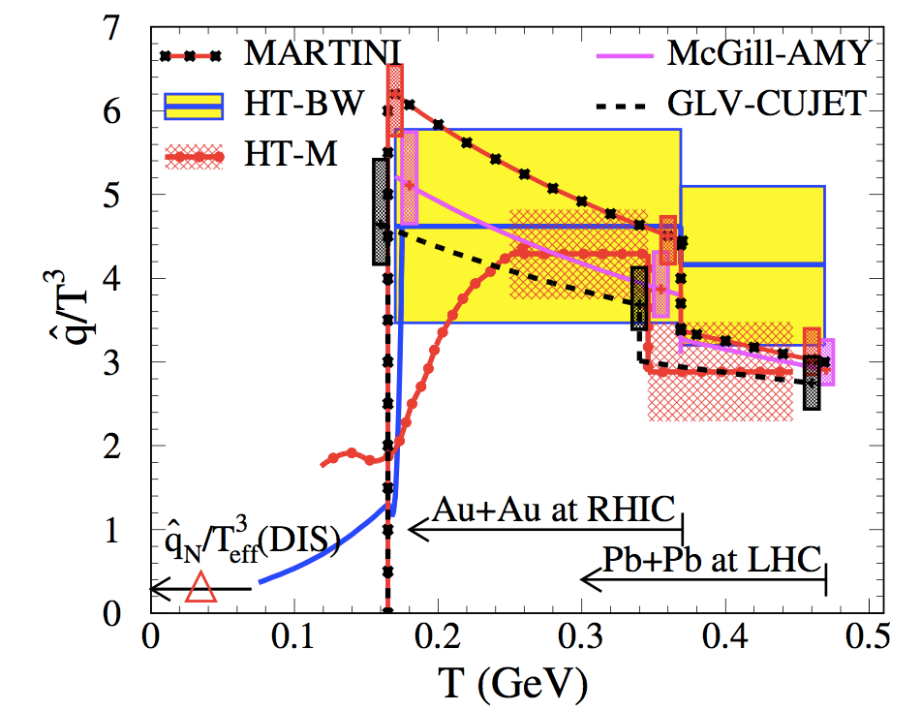
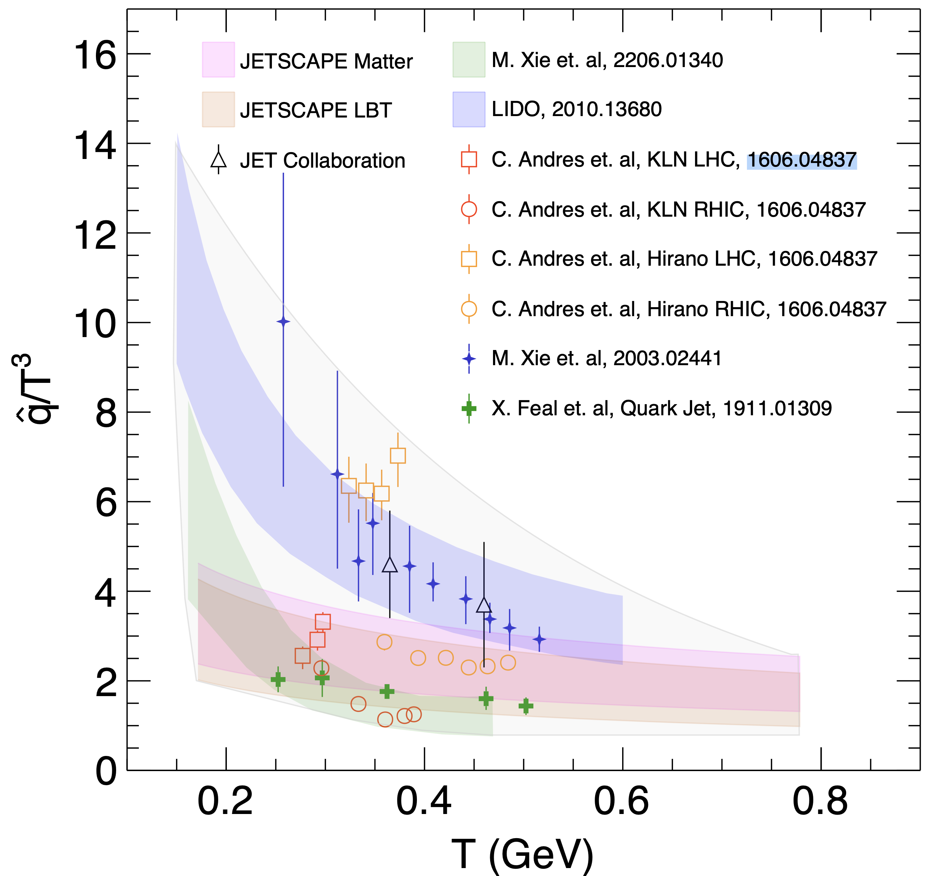
Jet Quenching at RHIC & LHC
JET Collaboration:
e-Print: 1312.5003
e-Print: 2203.16352
Apolinario, Lee & Winn
Notes:
The observation of jet quenching phenomena in single high pt hadron spectra at RHIC more than decade ago was a major discovery, It has since then become the focus of many experimental and theoretical studies at both RHIC and LHC,
The first systematic comparison of data end models by JET collaboration, show

Slide 4
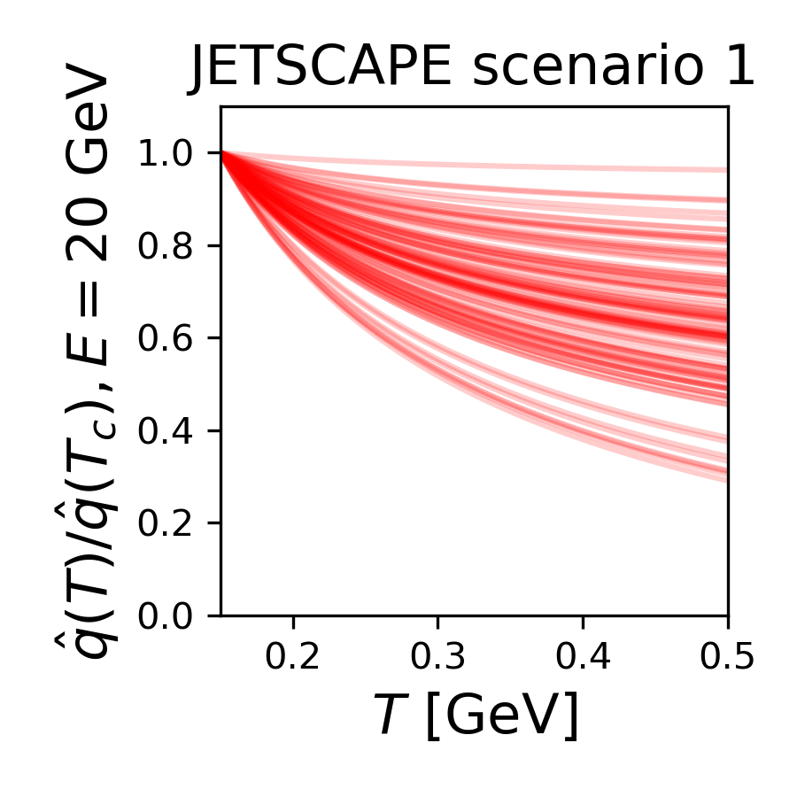
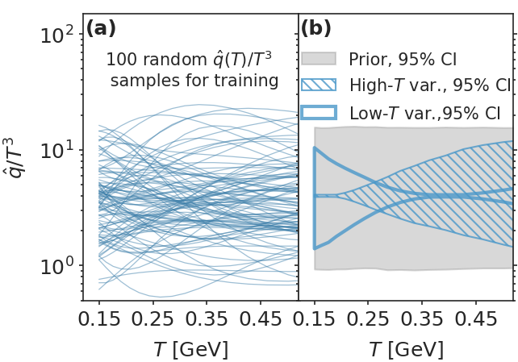
Information Field approach to Bayesian Inference
non-parametric representation of an unknown function
JET
Notes:
We are not done with hadron spectra and correlations, they can provide stringent constraints on qhat especially dihedron and gamma/Z-hadron correlations

Slide 5
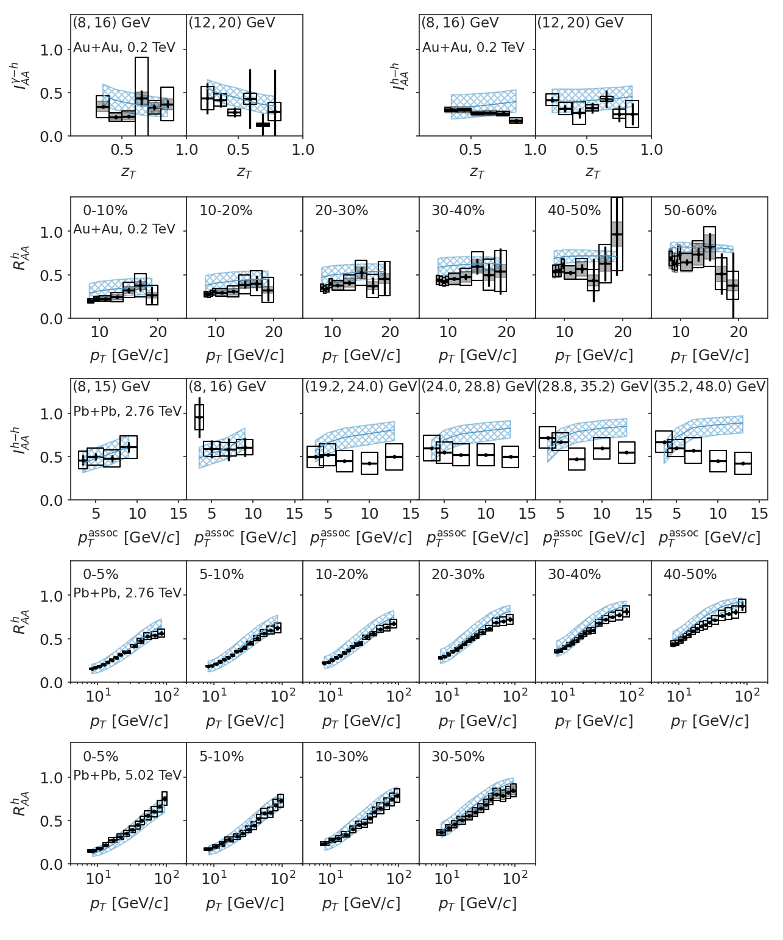
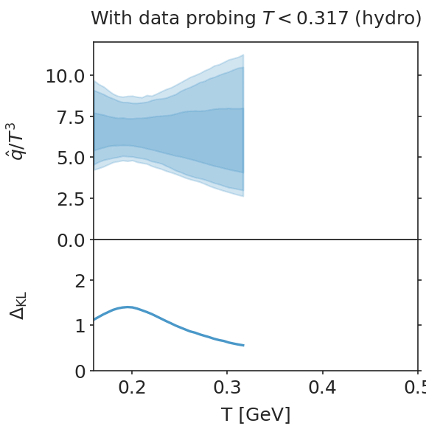
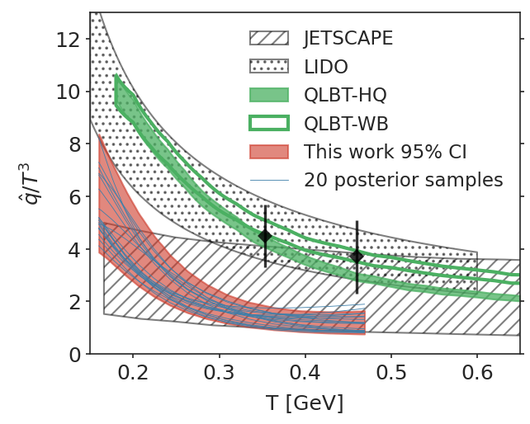
IF-Bayesian inference of jet transport coefficient
The most comprehensive Bayesian analysis of world data
on single inclusive, dihadron and gamma-hadron spectra
Strong T-dependence
Weak E-dependence
JET
e-Print: 2208.14419
Xie, Ke, Zhang & XNW
e-Print: 2206.01340
Notes:
We are not done with hadron spectra and correlations, they can provide stringent constraints on qhat especially dihedron and gamma/Z-hadron correlations

Slide 6
High pT v2

Slide 7
Longitudinal jet tomography with gamma-jet
Zhang, Owens, Wang and XNW, Phys. Rev. Lett. 103, 032302 (2009)
length dependence
of parton Energy loss
γ-jet asymmetry x_{γjet}=p_{T}^{jet}/p_{T}^{γ}
Can be used to select
propagation length <L>

Slide 8
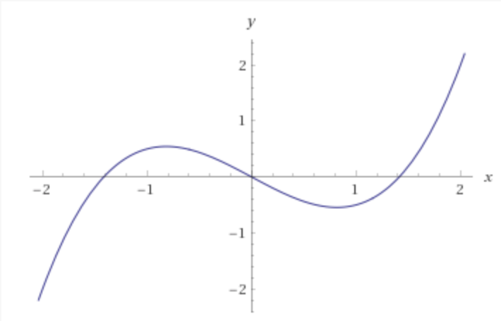
Asymmetric-diffusion in nonuniform medium
Boltzmann equation under approximation of small angle elastic scattering, no drag:
Momentum asymmetry:
y
Deflection due
to transverse
gradient along y
He, Pang & XNW,
PRL 125 (2020) 12, 122301
γ
jet
Barata, Sadofyev, XNW
Phys. Rev.D 107 (2023) 5, L051503
x
x
p_{x}
Notes:
\frac{\partial f}{\partial t}+\frac{\vec p_\perp}{E}\cdot \frac{\partial f}{\partial \vec r_\perp}=\frac{\hat q}{4}\vec\nabla_{p_\perp}^2 f(\vec p,\vec r)
f_s=3\left(\frac{4E}{\hat q t^2}\right)^2
\exp\left[-(\vec{r}_\perp-\frac{\vec p_\perp}{2E}t)^2\frac{12E^2}{\hat q t^3}-\frac{p_\perp^2}{\hat q t}\right]
f(\vec p,\vec r)_{t=0}=(2\pi)^2\delta^2(\vec{r}_\perp)\delta^2(\vec{p}_\perp)
\frac{1}{\pi \hat q t}\exp\left(-\frac{p_\perp^2}{\hat q t}\right)
\int \frac{d^2r}{(2\pi)^2}

Slide 9
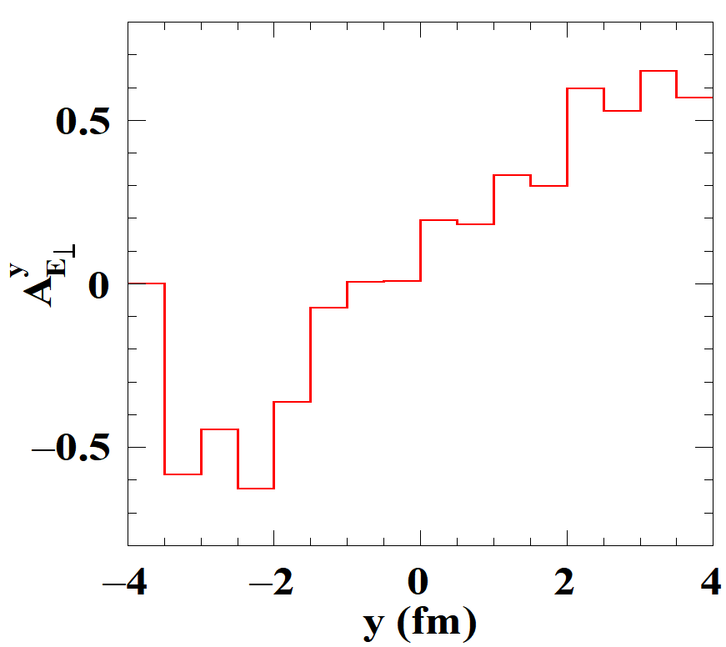
Transverse gradient tomography with gamma-jet
(p_{T}>3 GeV/c)
drift due
to transverse
gradient along y
y
γ
jet
x
He, Pang & XNW, Phys Rev Lett 125 (2020) 12, 122301
Jet energy loss → propagation length →
initial jet position in x: Longitudinal tomography
3D jet tomography
Notes:
A_{E_\perp}^{\vec n}=\frac{\int d^3rd^3pf_a(\vec p,\vec r) \vec p_T\cdot \vec n}{\int d^3rd^3pf_a(\vec p,\vec r)}

Slide 10
Gradient tomography for dijets
Pb+Pb 0-10% 5.02 TeV
y
y
jet
x
158 < p_{T,1} < 178 GeV
x

Slide 11
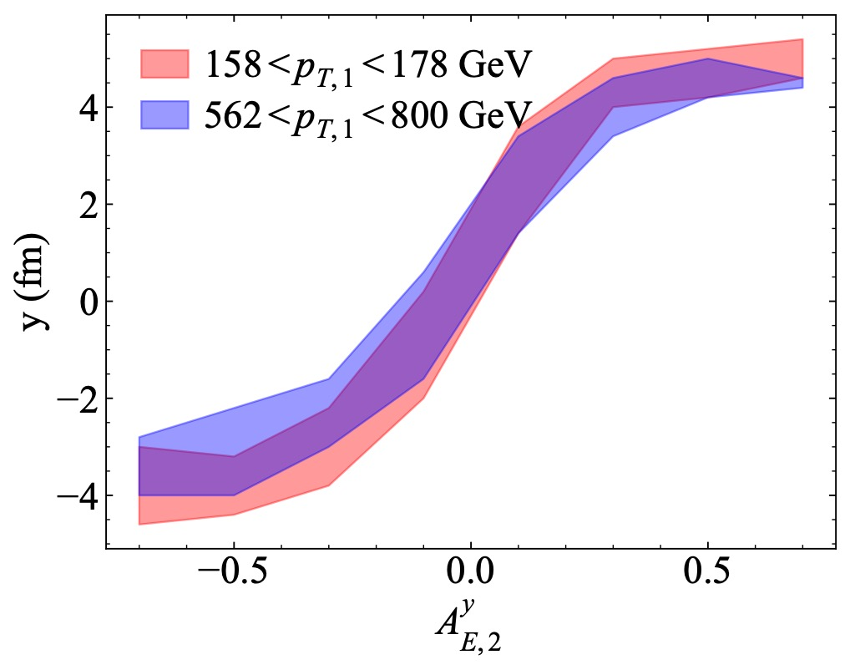
Gradient tomography for dijets
158 < p_{T,1} < 178 GeV
Pb+Pb 0-10% 5.02 TeV

Slide 12
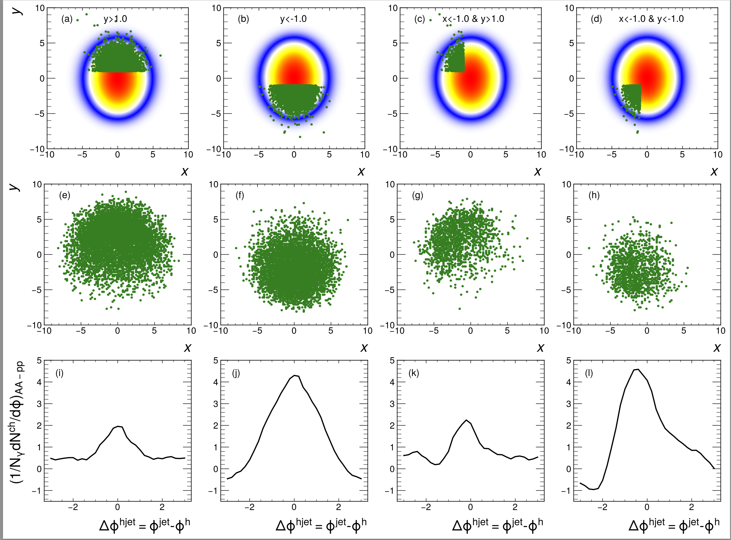
Deep learning assisted jet tomography
DL network selection
Actual distribution
γ-soft hadron correlation
Yang, He, Chen, Ke, Pang
and XNW, 2206.02393
p_{T}^{γ}=200-250 GeV/c, p_{T}^{jet}>100 GeV/c, p_{T}^{h}=1-2 GeV/c in 0-10% Pb+Pb @ 5.02 TeV

Slide 13
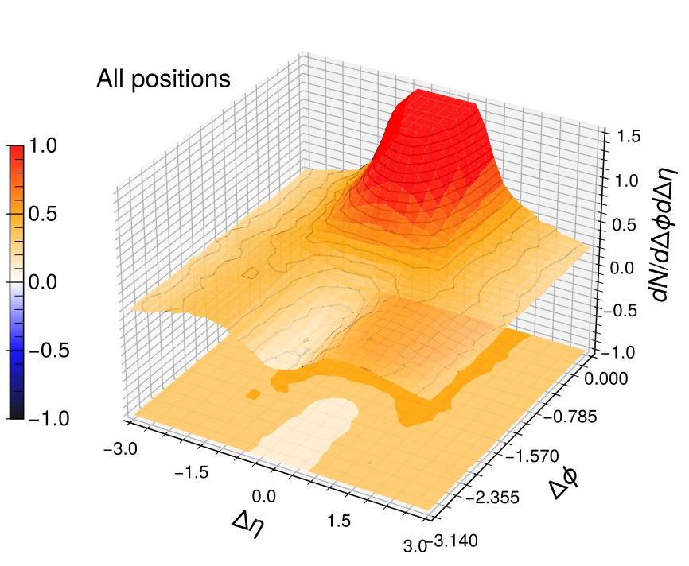
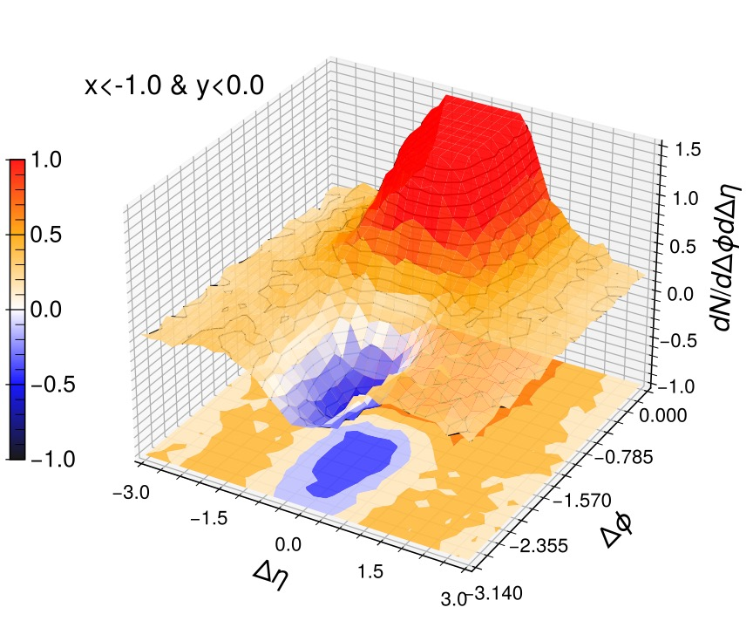
Enhanced DFW signal with ML jet tomography
p_{T}^{γ}=200-250 GeV/c, p_{T}^{jet}>100 GeV/c, p_{T}^{h}=1-2 GeV/c in 0-10% Pb+Pb @ 5.02 TeV

Slide 14
Summary
Information-Field based Bayesian inference provides unbiased nonparametric priors
  Reduce correlation between errors at different T
  qhat has stronger T dependence
Parton propagation in nonuniform medium leads to asymmetric pT broadening
Gradient jet tomography provides unparalleled information about initial production position for jet studies

Slide 16
γ/jet asymmetry and diffusion wake
Larger γ/jet asymmetry → more energy loss
→ long propagation length → larger diffusion wake
p_{T}=1-2 GeV/c

Slide 17
Jet trajectories & Mach cone shapes
p_{T}^{γ}=200-250 GeV/c, p_{T}^{jet}>100 GeV/c in 0-10% Pb+Pb @ 5.02 TeV

