Slide 1




A multistage framework for studying the evolution of jets and high-p_{T} probes in small collisions systems
Abhijit Majumder
For the JETSCAPE collaboration
Hard Probes 2023, Aschaffenburg, Germany, March 27-31 2023

Slide 2


Most of the physics portion of this work is done by
Ismail Soudi Wenbin Zhao
(in collaboration with the COMP group at JETSCAPE)
Neither of them could get a visa for this conference…

Slide 3
Outline
Transition from JETSCAPE to X-SCAPE
Framework level advances
Content/Module level advances
A new working model for small systems in p-p and p-A
Preliminary results

Slide 4
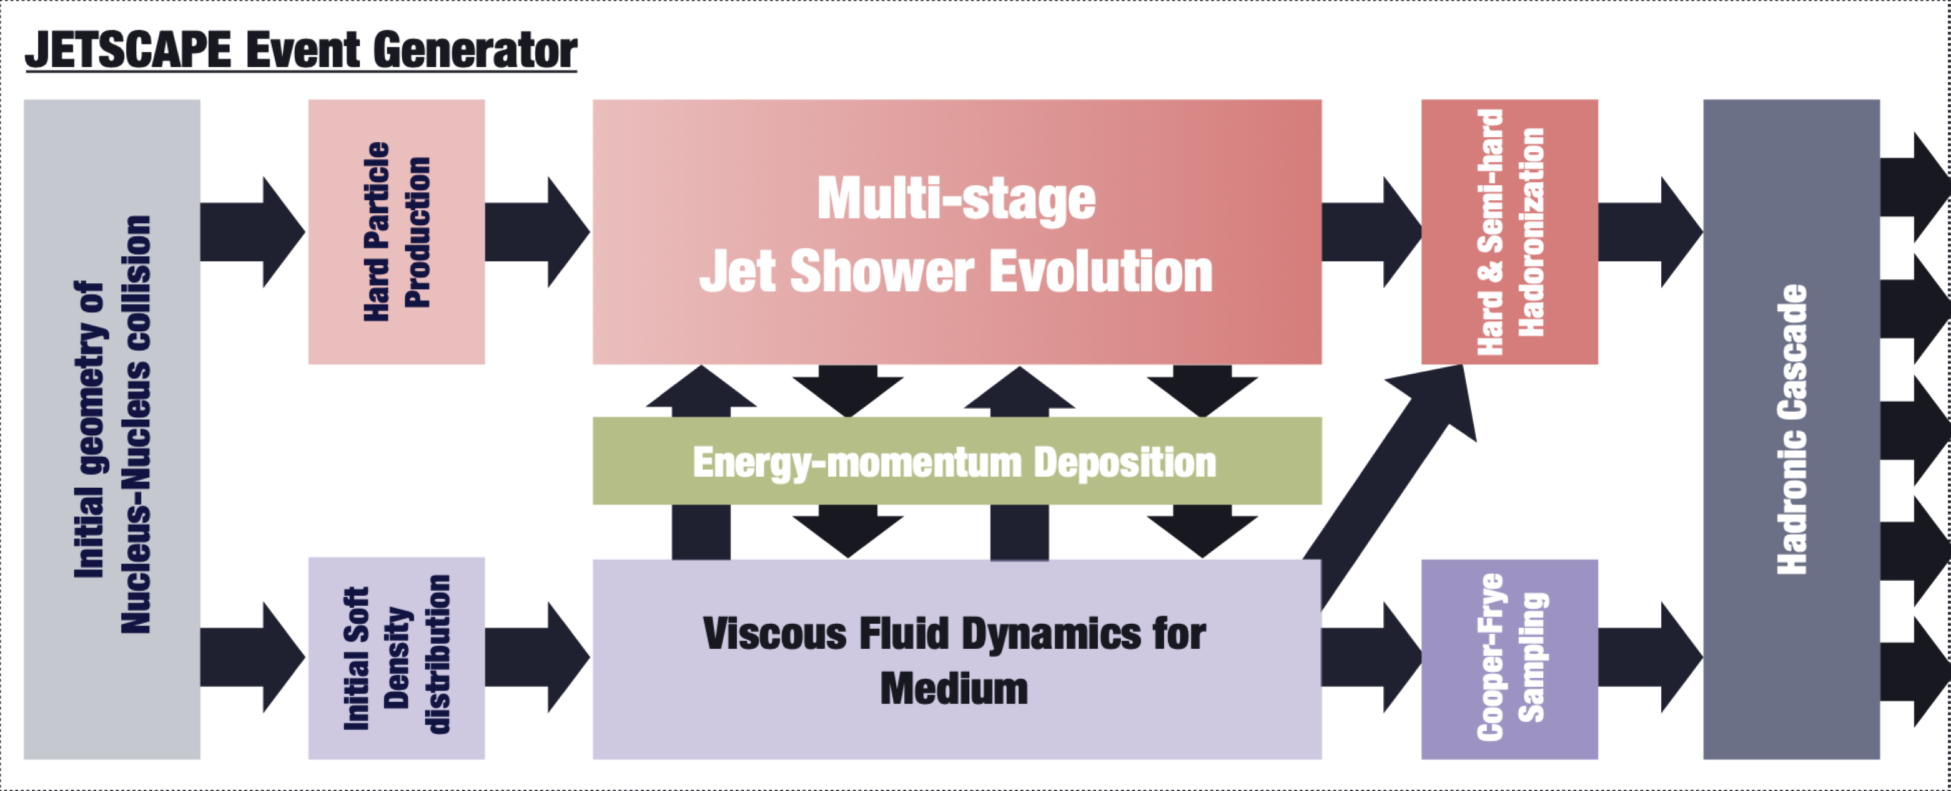
JETSCAPE: a p-p and A-A generator
Framework controls order of modules and information flow
Modules are user defined, replaceable, divisible
Can be run in pure bulk, pure hard, or interactive modes
Artwork by Y. Tachibana

Slide 5
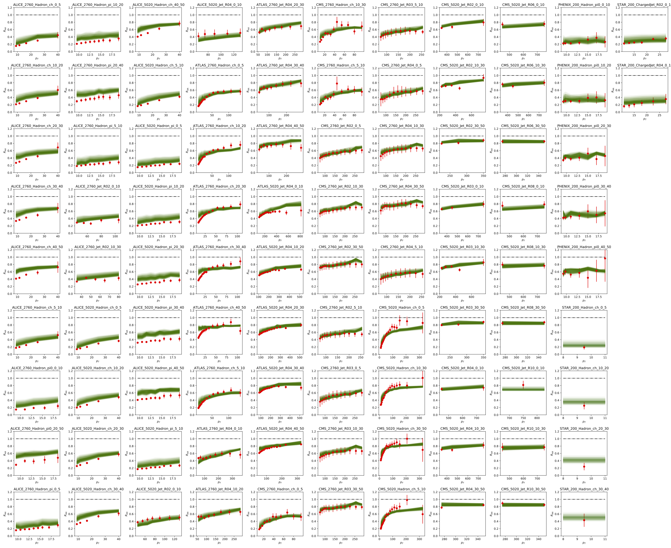
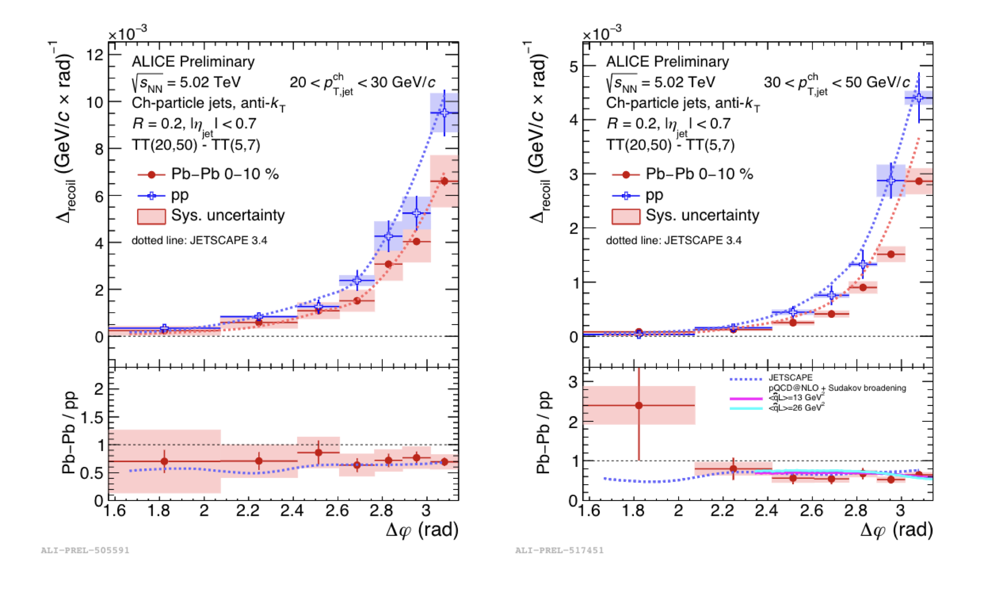
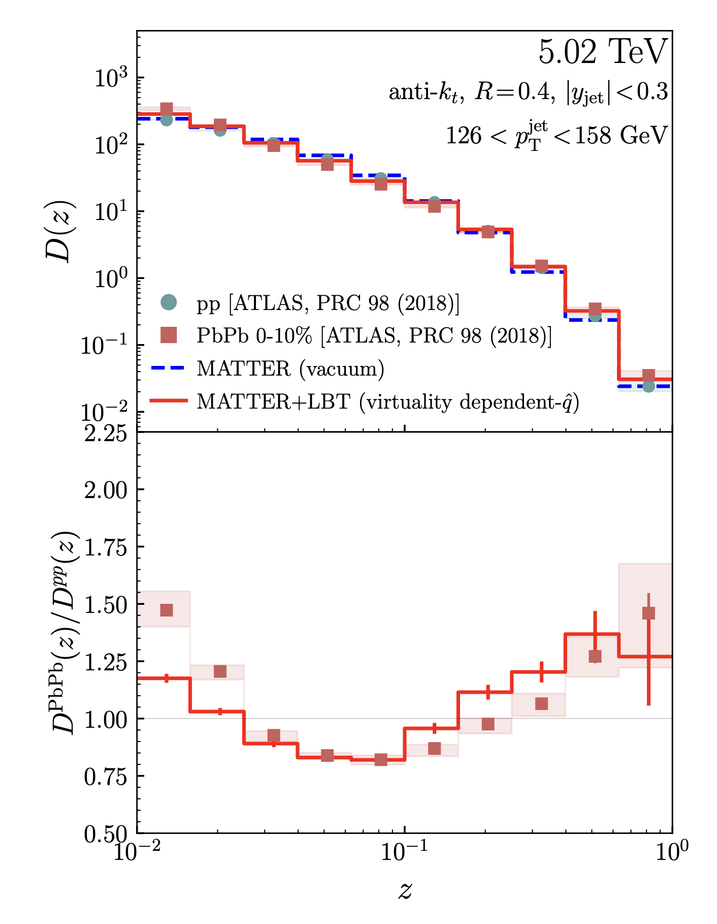
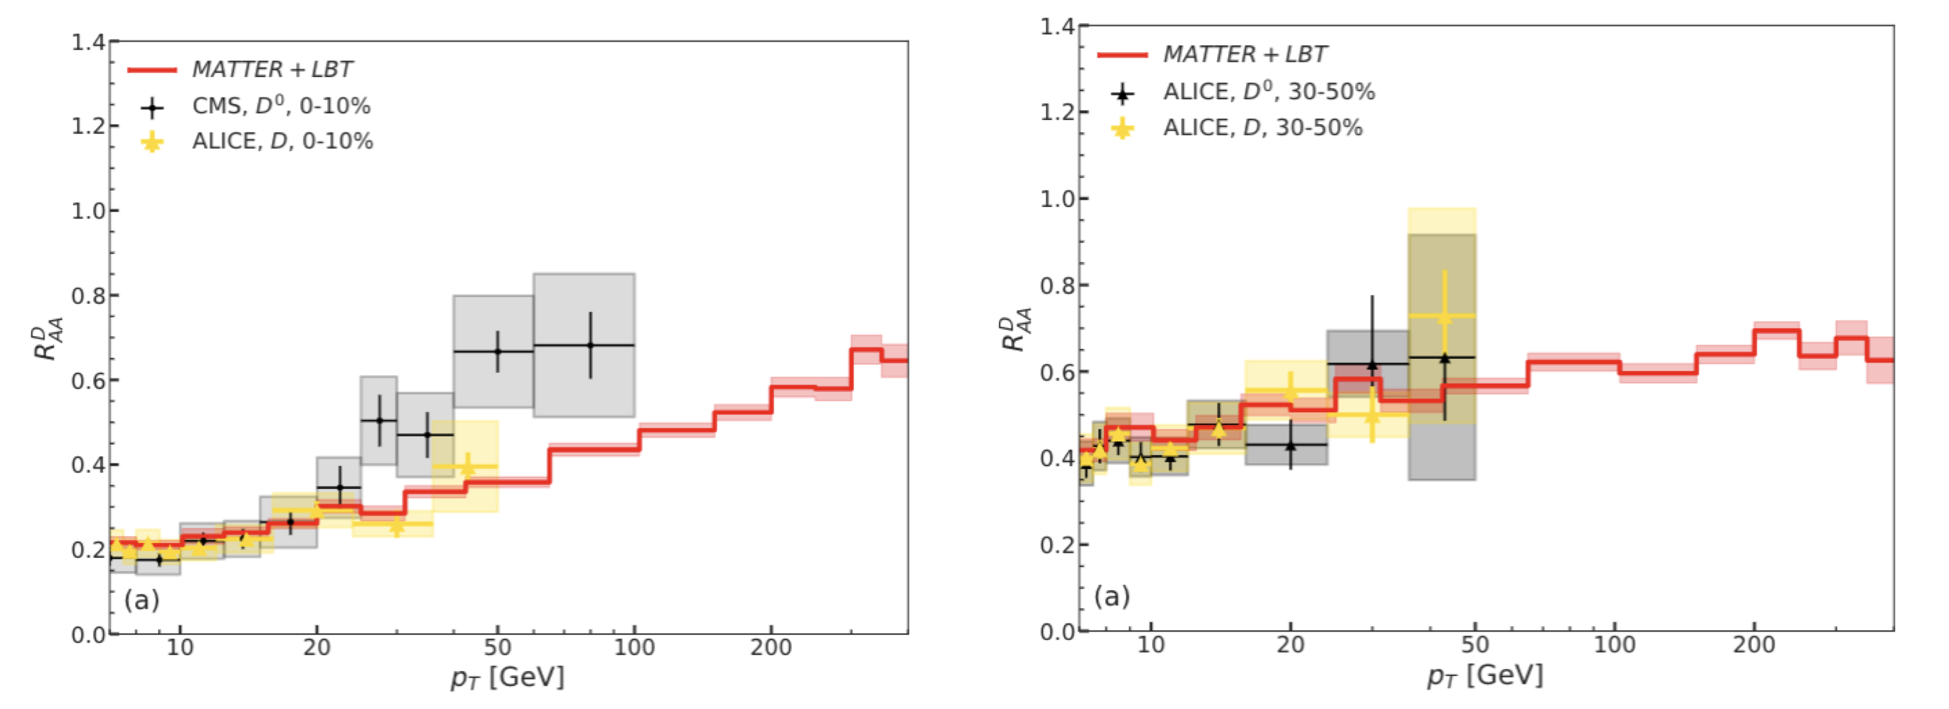
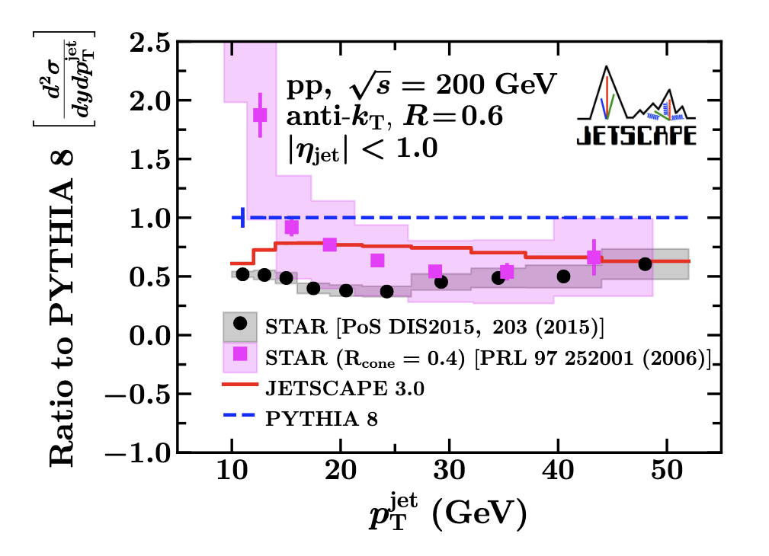
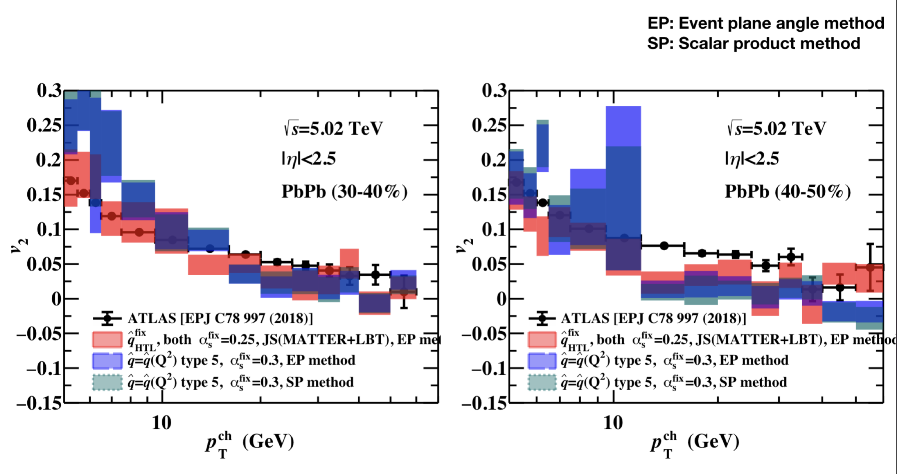
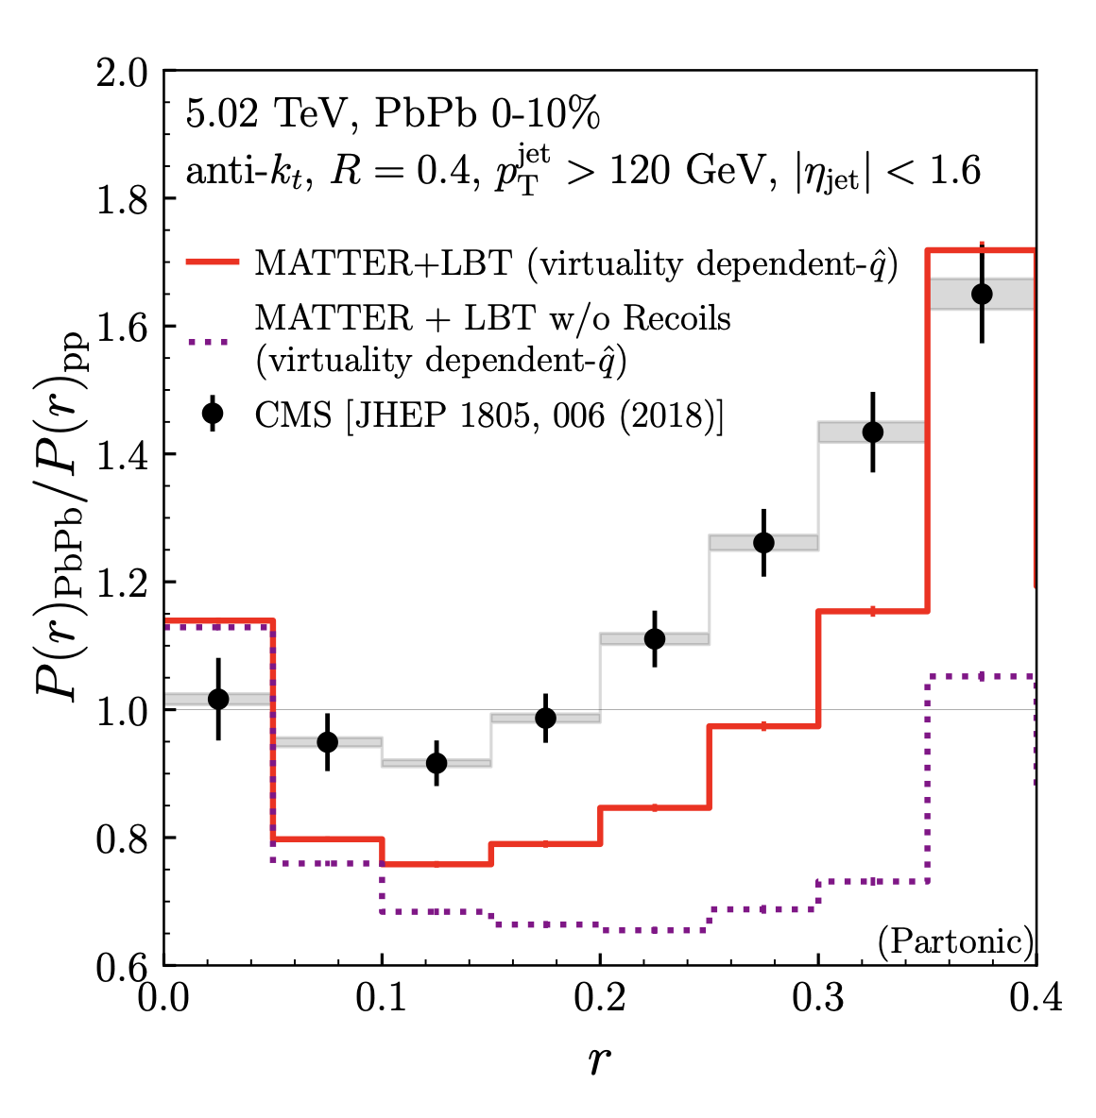
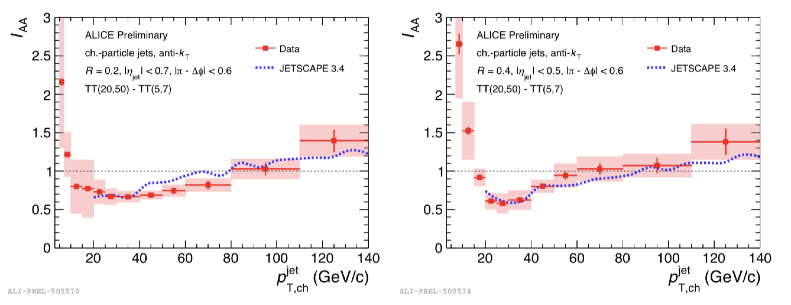
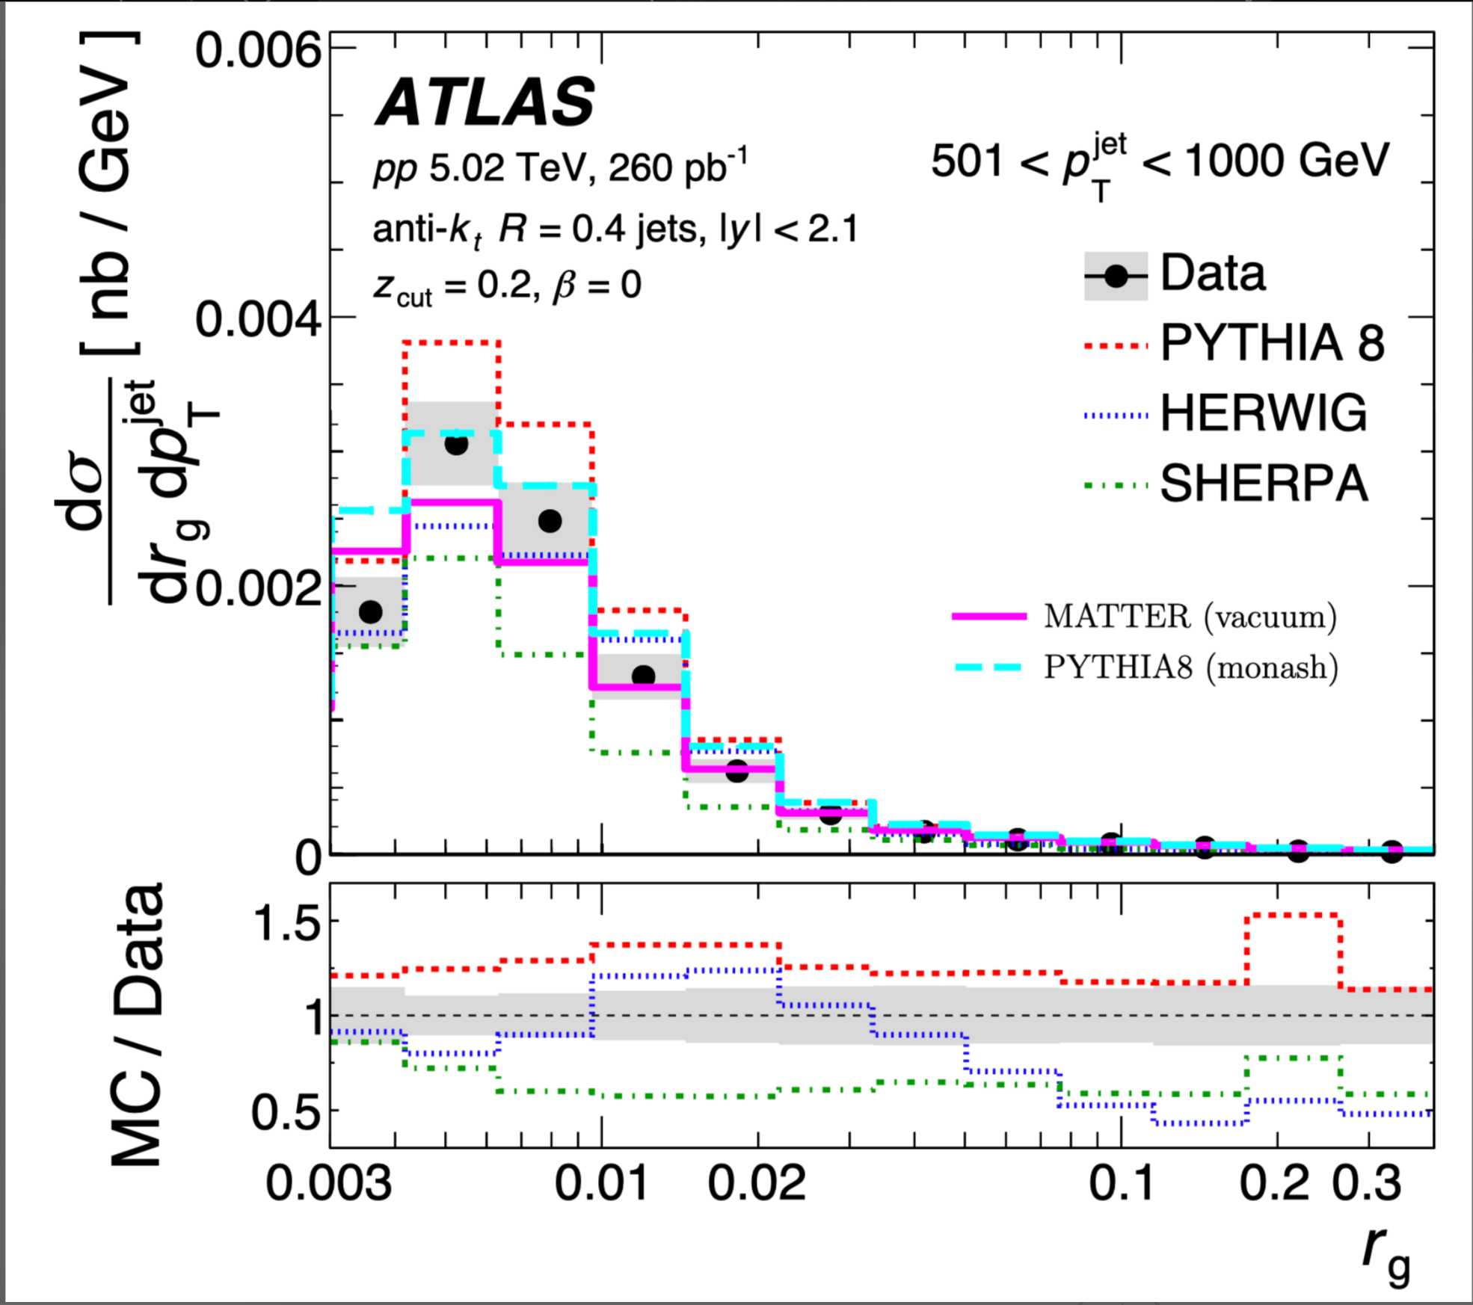
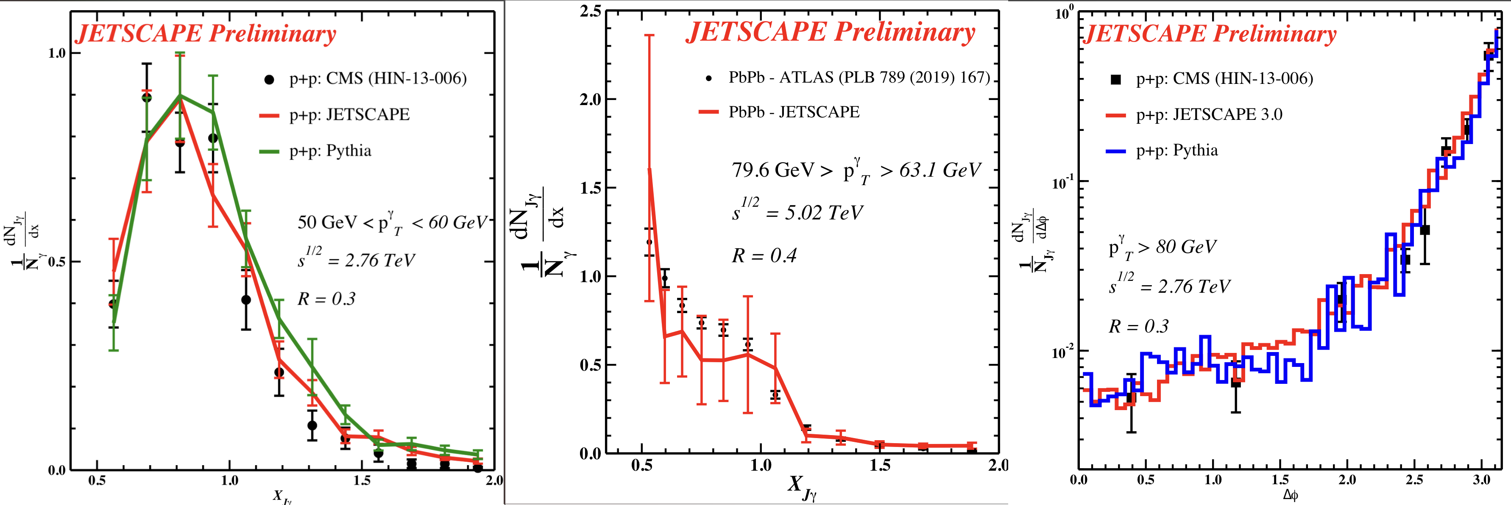
JETSCAPE results (only hard sector)
Big picture or base model (141 different data sets) vs. Fine structure
Bayesian
Posterior
JETSCAPE PRELIMINARY
Hand
Tune

Slide 6
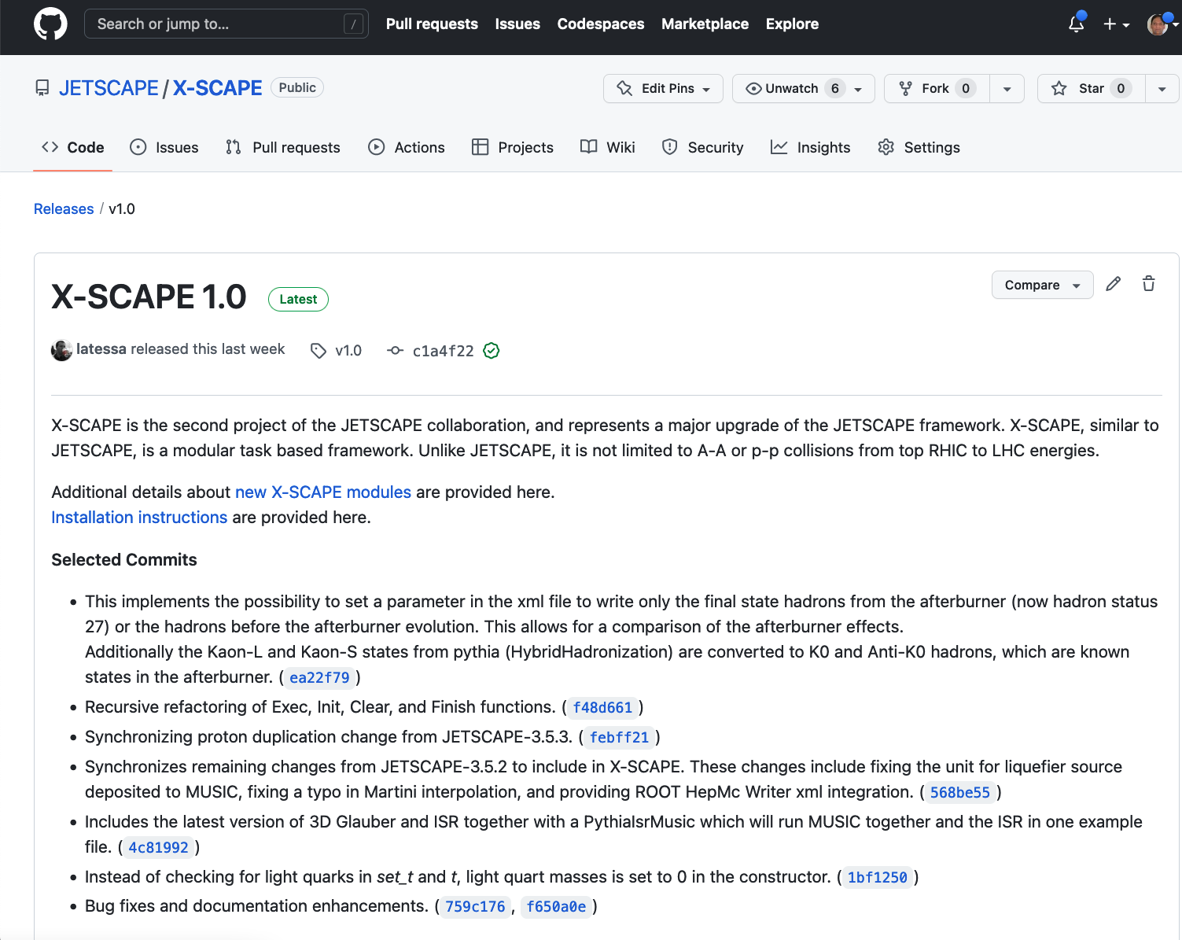
X-ion collisions with a Statistically and Computationally Advanced Program Envelop (X-SCAPE)
Small systems in p-p, p-A etc.
  Asymmetric systems such as d-A, A-A.
  Require strong correlation between hard and soft sector
  In both initial and final state.
Lower energy A-A, for Beam Energy Scan
  Require concurrent hydro + cascade
Extension to e-A, for EIC.
  Parton energy loss, CGC studies, TMD?

Slide 7
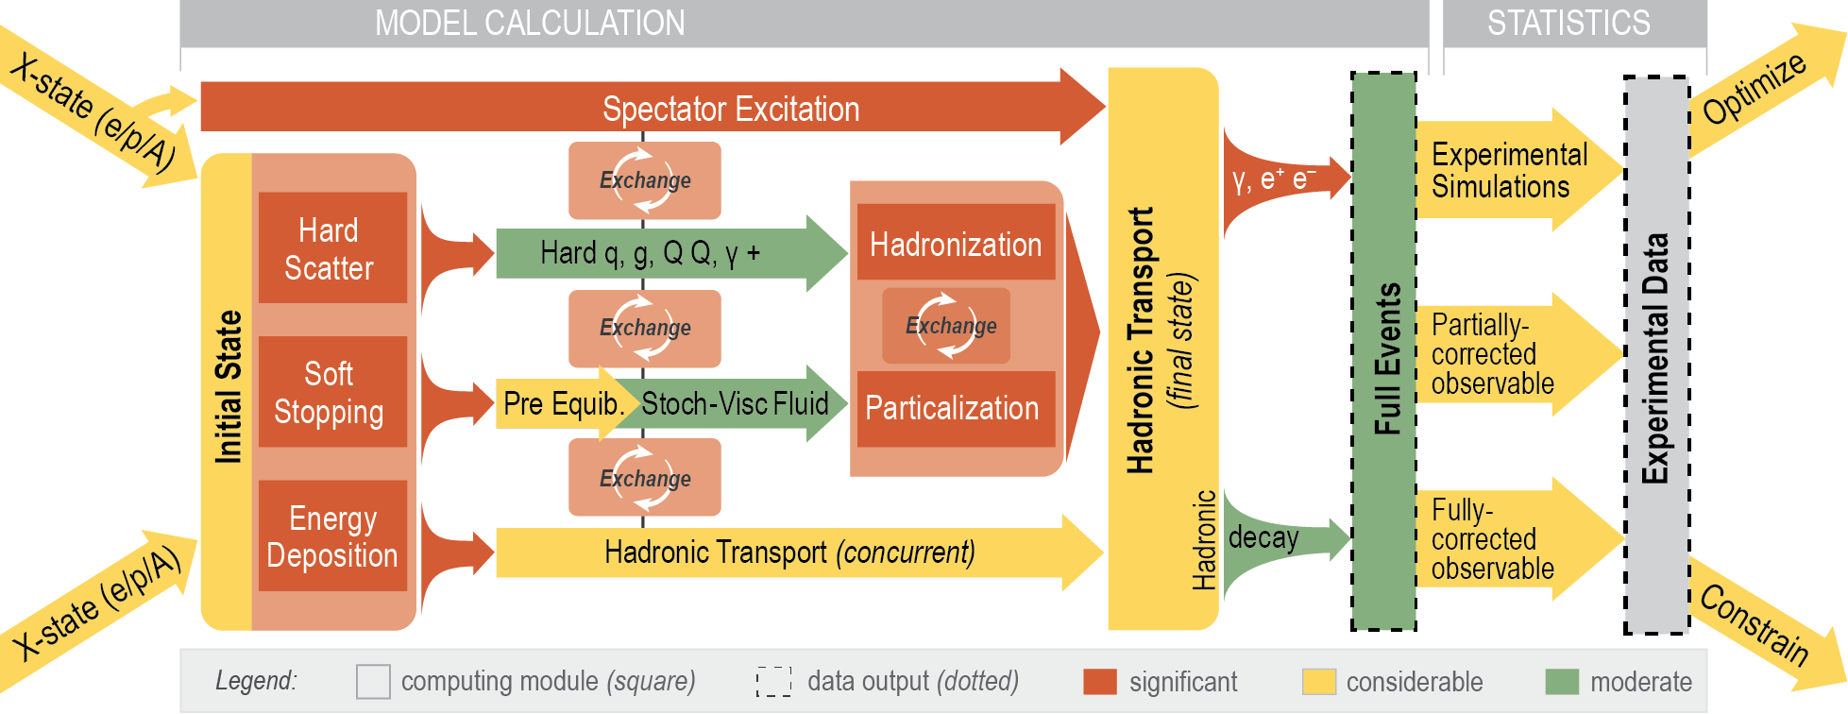
X-SCAPE framework
A new framework that allows the user to determine the order of operations
Time can go backwards and forwards !
Backward evolution allows for natural implementation of ISR.
Can be run with an arbitrary number of modules.
Artwork by R. Soltz

Slide 8
X-SCAPE module: 3D Glauber + MUSIC
Nucleons have multiple hot spots within them.
Strings connect pairs of hot spots
String 4-momentum and baryon density seeds hydro simulation
Hydro evolves producing particles
Remnants go down beam line.
Remnant
Remnant
hydro
C. Shen and B. Schenke, PRC97 024907 (2018), PRC105, 064905 (2022)

Slide 9
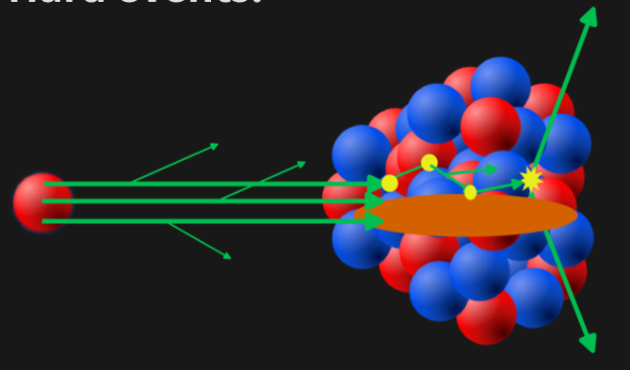
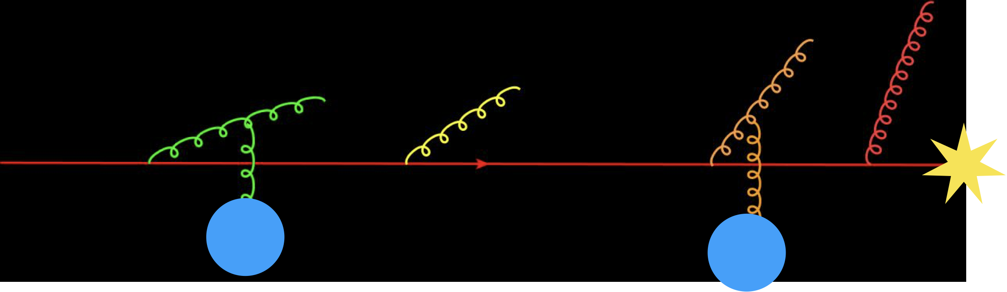
X-SCAPE module: I-MATTER
Call Pythia (ISR-FSR-OFF) generate MPI scatterings
Start each parton at Q² = -p_{T}² and evolve up to Q² = -1 GeV².
A well-established method of generating ISR*
Run Matter backwards in time with i-MATTER.
Parton energy increases with splits, keep track of position
Final parton at most negative time is the parent.
Framework can handle Initial State-E-loss, current results only include Vacuum shower
*T. Sjostrand
Phys.Lett.B 157 (1985) 321.

Slide 10
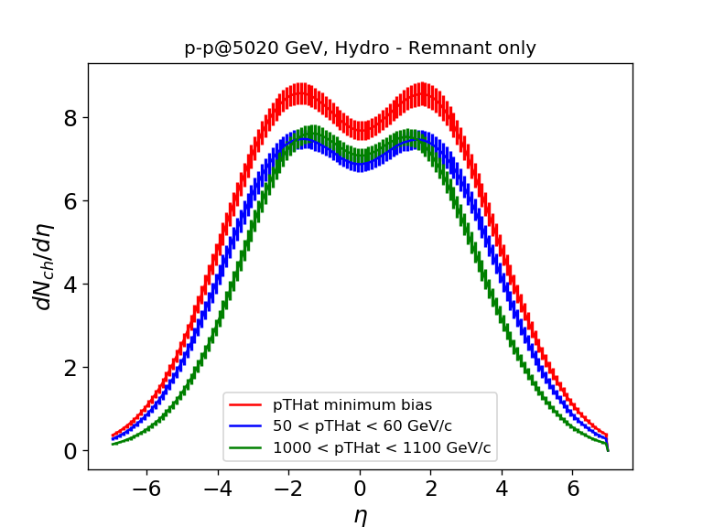
Physical Model
Hard initial state partons are included in a hot spot
Hard partons scatter with ISR and FSR.
Hard energy removed from nucleons, not available for hydro evolution
Some strings get pulled out by hard processes, fragmented by string breaking
Strings that don’t get pulled out are liquified into a fluid
Fluid evolves and produces particles
Larger jet energy implies more fragmentation hadrons, and less hydro (Cooper-Frye) hadrons
JETSCAPE
PRELIMINARY

Slide 11
Preliminary results
Set min p_{T} hat in Pythia = 8 GeV, softer phenomena modelled by hydro.
Hadron spectra in p-p and p-A.
JETSCAPE
PRELIMINARY
JETSCAPE
PRELIMINARY

Slide 12
Preliminary Results
Jets in p-p and p-A
Simple background subtraction: only use fragmentation hadrons in jet clustering
JETSCAPE
PRELIMINARY
JETSCAPE
PRELIMINARY

Slide 13
Preliminary Results
Event activity modification in p-p with jet momentum
We calculate the E_{T} from both Cooper-Frye hadrons and fragmentation hadrons
JETSCAPE
PRELIMINARY
JETSCAPE
PRELIMINARY

Slide 14
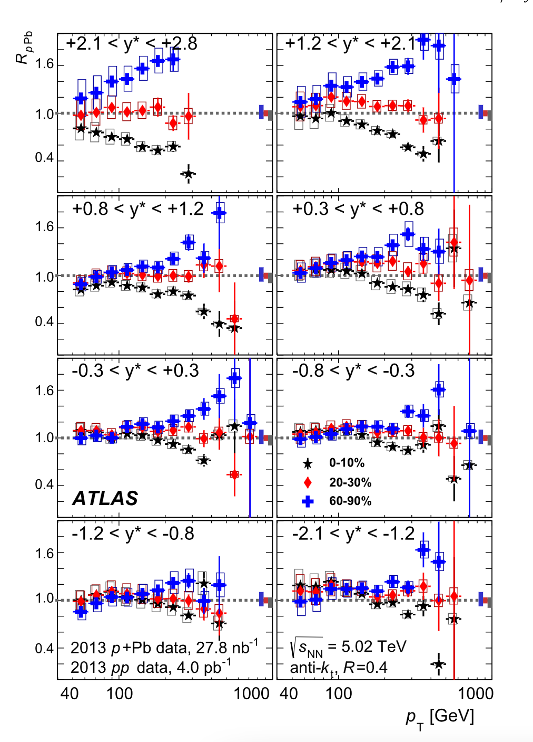
Preliminary Results
Event activity modification in p-A with jet momentum
Note the bump around 100 GeV!
JETSCAPE
PRELIMINARY
JETSCAPE
PRELIMINARY

Slide 15
Summary and upcoming results
Transition from JETSCAPE to X-SCAPE
Constructed a new multi-stage hard soft event generator for p-p and p-A collisions.
For any multiplicity!
3 D Glauber generates multiple hot spots in a nucleon
MPI interactions in Pythia generates hard scatterings
ISR done with i-MATTER, FSR done with MATTER
Energy of incoming parent partons subtracted from hot spots
Hadrons from depleted hydro and from hard fragmentation
Very good description of data on particle and jet spectra.
Appearance of energy correlation at jet energy of E>100GeV.

Slide 16
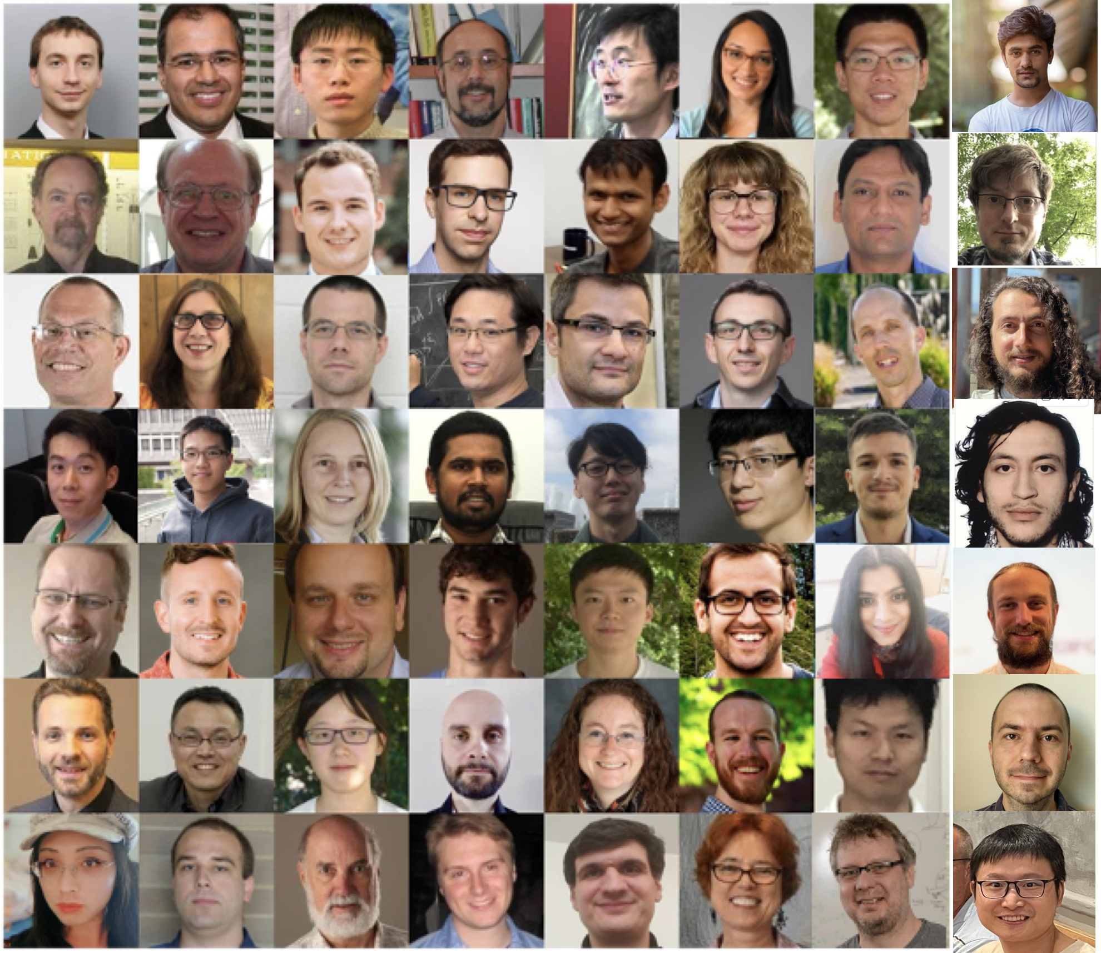
Thanks to all my collaborators

Slide 17
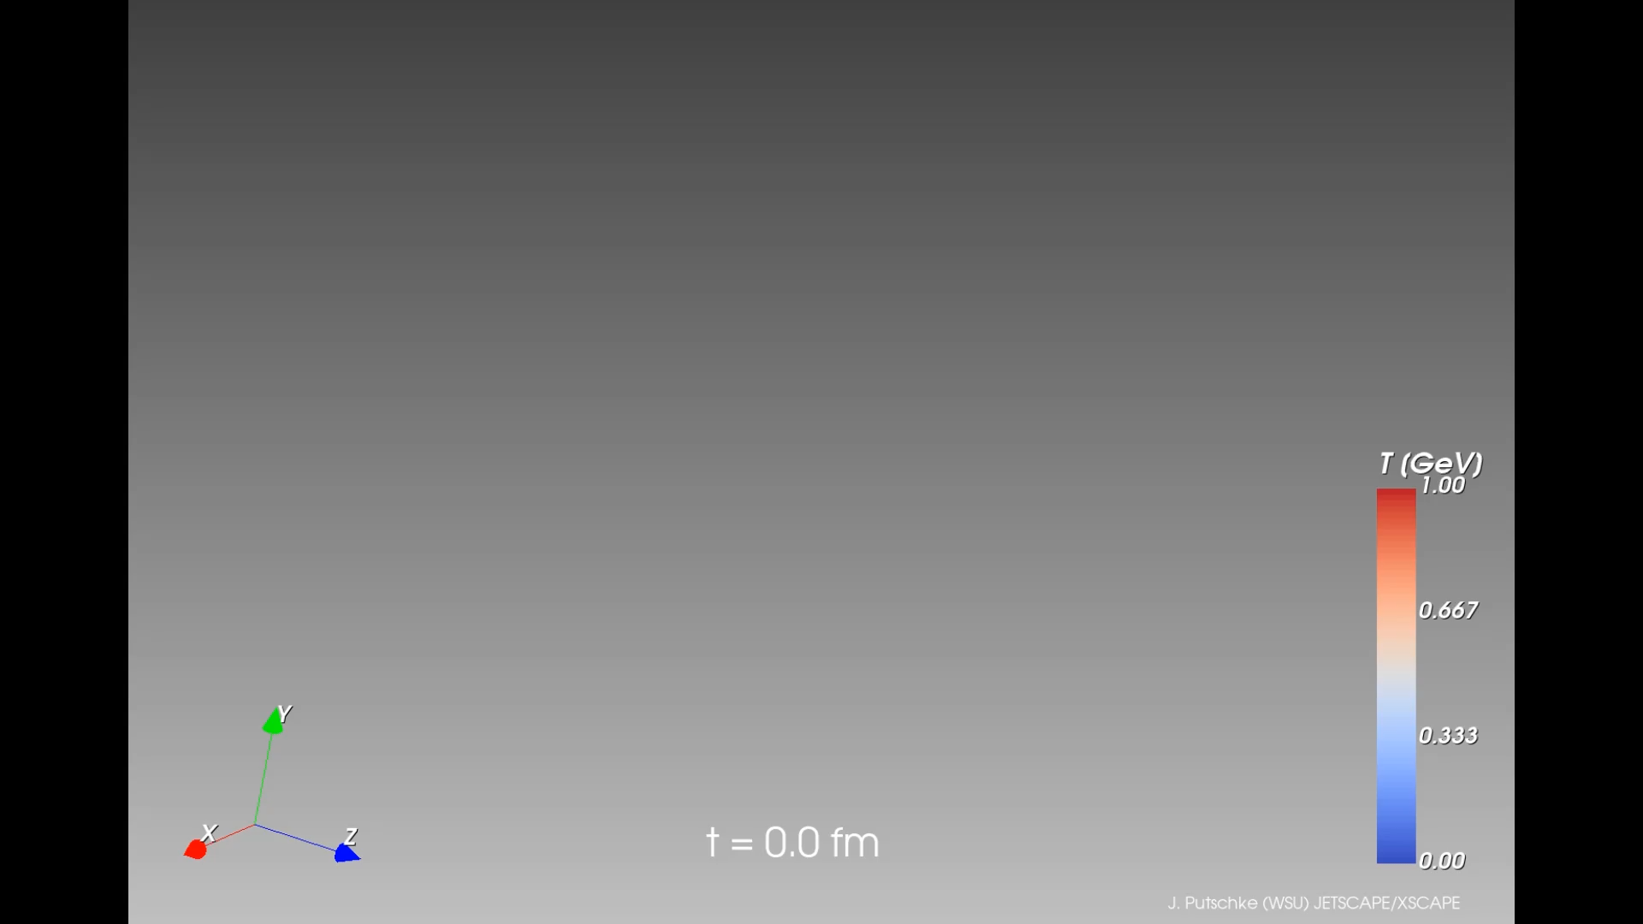
More analysis tools in JETSCAPE
Animations by J. Putschke

