Slide 1





A microscopic model of charmonia production in heavy ion collisions
Pol B Gossiaux, SUBATECH (NANTES)
Hard Probes
28th March 2023
Based on arxiv 2206.01308 ; accepted for publication in PRC
With Joerg Aichelin, Denys Yen Arrebato Villar, Jiaxing Zhao
and Pays de la Loire
Notes:
Cuation : not exhaustive

Slide 2
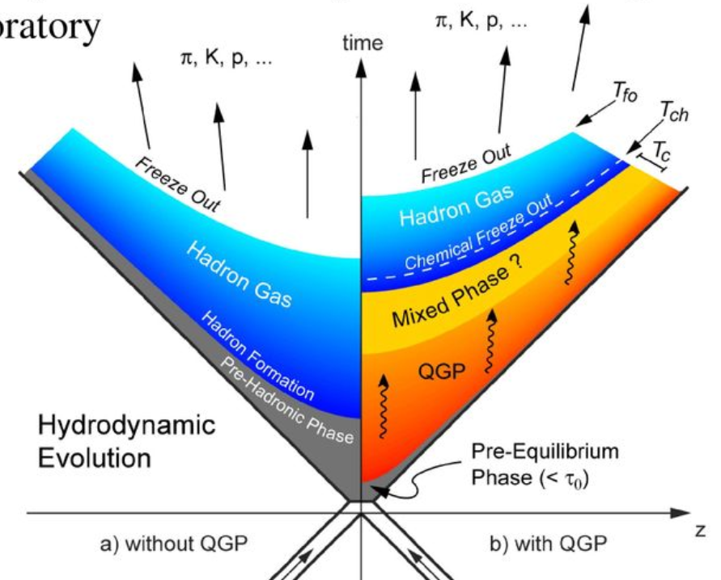
Background and Motivation Quarkonia in a microscopic model Conclusions
Charmonia in transport models
primordial
Statistical recombination (phase space) or resonance recombination model (adopted recently by TAMU for charmonia as well)
J/ψ
Paradigm: Color singlet => no flow from the medium… but could be due to CO* -> CS
Rate equations based on g + charmonia -> c + cbar instantaneous cross sections

Slide 3
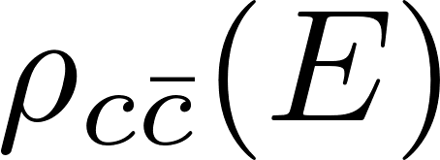
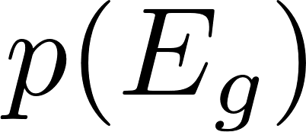
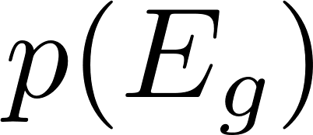

Background and Motivation Quarkonia in a microscopic model Conclusions
Charmonia in a microscopic theory
Several regimes / effects
Spectral density
T
Time
Multiple scattering on quasi free states
Gluo-dissociation of well identified levels by scarce “high-energy” gluons
(dilute medium => cross section ok)
Well identified formalisms (Quantum Master Equation, Boltzmann transport, Stochastic equations,… ) in well identified regimes, but continuous evolution and no unique framework continuously applicable (to my knowledge)
Yet, still a need to define the equivalent of a formation – dissociation rate
Notes:
Mettre les taux de dissociation de Rapp

Slide 4
Background and Motivation Quarkonia in a microscopic model Conclusions
Several motivations to go microscopic & quantum
The in-medium quarkonia are not born as such. One needs to develop an initial compact state to fully bloomed quarkonia
The dissociation-recombination reactions affecting quarkonia are not instantaneous… In dense medium, the notion of cross section should be replaced by the more rigorous open-quantum system approach (continuous transitions)
Better suited for « from small to large »
Extra complication: For RHIC and LHC : many c-cbar pairs !
Delorme, Gousset & Gossiaux
Blaizot & Ollitrault
Thews
Gossiaux and Cugnon
Akamatsu & Rothkopf
1 pair
Strickland & TUM
Katz & Gossiaux
…
2000
2010
2020
time
Many pairs
Dusling, Young, Shuryak
JP Blaizot & MA Escobedo JHEP 06 (2018) 034,1711.10812
Blaizot et al. Nuclear Physics A
Volume 946, Pages 49-88
Arrebato, Aichelin & Gossiaux
Pioneering work of Blaizot and Escobedo for many c-cbar pairs (NRQCD) => mixed Fokker-Planck + gain/loss rates for color transitions; awaits for implementation in realistic conditions

Slide 5
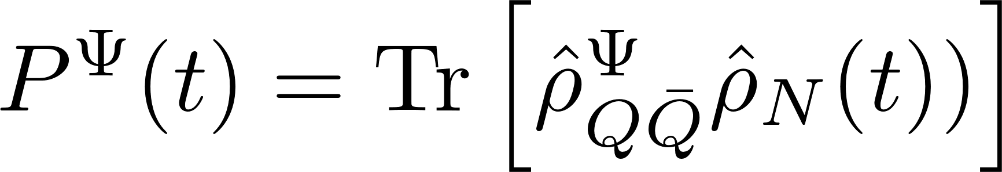
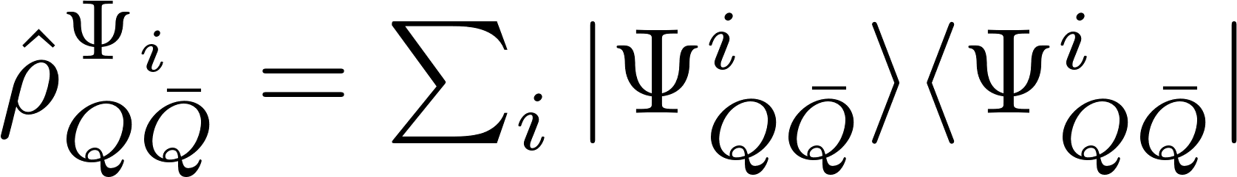
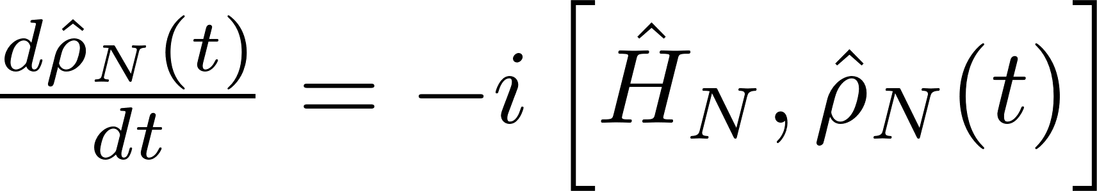
Background and Motivation Quarkonia in a microscopic model Conclusions
The spirit of the method…
Simply taken at the end of the evolution (ideal world)
Various Quarkonia bound states (in vacuum)
Unfortunately… all N-body practionners know that modelling the full system up to the last stage is quite challenging ! Issues of stability, energy conservation,…
Clear lesson from the « old » cascade and QMD codes for fragment formation
Initial state
Intermediate dense phase
Final stage (spurious nucleon evaporation)
Modelling ≈ ok
Replace « final » => « initial » + Sum of time steps and chop off at the appropriate time scale

Slide 6
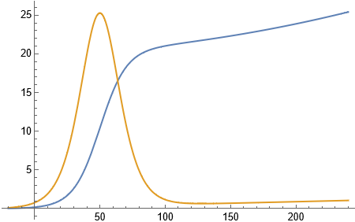
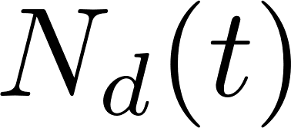
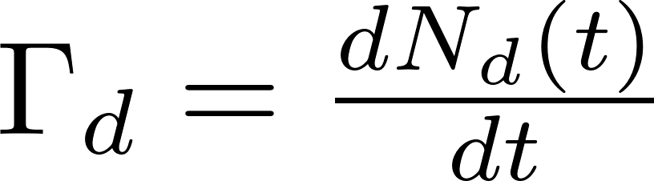
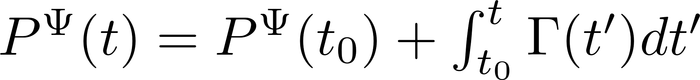

Background and Motivation Quarkonia in a microscopic model Conclusions
The spirit of the method…
Simply taken at the end of the evolution (ideal world)
Various Quarkonia bound states (in vacuum)
Unfortunately… all N-body practionners know that modelling the full system up to the last stage is quite challenging ! Issues of stability, energy conservation,…
Clear lesson from the « old » cascade and QMD codes for fragment formation
Initial state
Intermediate dense phase
Final stage (spurious nucleon evaporation)
Modelling ≈ ok
Replace « final » => « initial » + Sum of time steps and chop off at the appropriate time scale

Slide 7
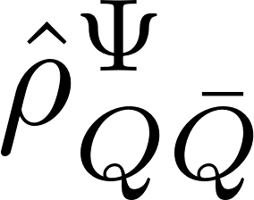
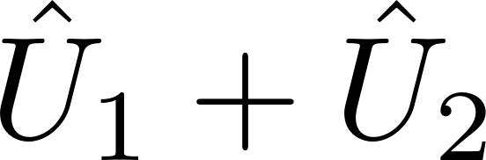
Background and Motivation Quarkonia in a microscopic model Conclusions
The spirit of the method…
Dealing with the dynamics ?
If eigenstates of the « internal » 2-body (QQbar) interaction
Free evolution => Γ=0
No « late time » evolution in this eigenbasis
Interaction with a 3rd body => modification of the
…
Total interaction of Q and Qbar with all light partons
Source of « destruction » ⬄ imaginary potential

Slide 8
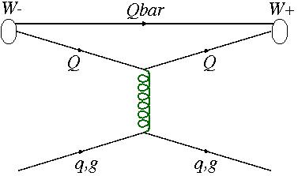

Background and Motivation Quarkonia in a microscopic model Conclusions
Remler Formalism at work
E.A. Remler, ANNALS OF PHYSICS 136, 293-316 (1981)
Level of the modelling : semi classical for the Q-Qbar evolution => Wigner distributions instead of density operators
Combining the expression of the Wigner’s distribution and substituting in the effective rate equation :
The quarkonia production in this model is a three body process; the HQs interact only by collisions with the QGP !!!
The “details” of H_{int} between HQ and bulk partons are incorporated into the evolution of W_{N} after each collision / time step (nice feature for the MC simulations)
Dissociation and recombination treated in the same scheme
Interaction of HQ with the QGP are carried out by EPOS2+MC@HQ (good results for D and B mesons production)
Then:
NB: Also possible to generate similar relations for differential rates
Notes:
Mention the trick => interaction ; show the RAA(D)

Slide 9
Background and Motivation Quarkonia in a microscopic model Conclusions
The 3 layers of the numerical modelling
Initial state
evolution
EPOS initial condition +transverse positions of the NN collisions
Fluid dynamics
Background
{T(x),v(x)}
Initialisation of c-cbar pairs according to FONLL² ⊗ EPOS positions
Evolution of HQ according to MC@HQ
HQ level
Usual EPOS2 + MC@HQ used with some success to describe open heavy flavor production at LHC (see Eur. Phys. J. C (2016) 76:107)

Slide 10
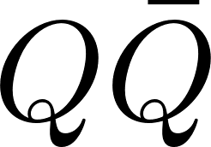
Background and Motivation Quarkonia in a microscopic model Conclusions
Extension of the Remler formalism
Confining forces inside the MC evolution ; large impact on the # of close pairs… and correlated trajectories.
(No internal potential in early applications dedicated to deuteron production in low energy AA collisions; advocated to be negligible… as only the « hot zone » was contributing
But for quarkonia, it turns out not to be the case => need for in-medium potential
D. Lafferty and A. Rothkopf,
PHYS. REV. D 101, 056010 (2020)

Slide 11
Background and Motivation Quarkonia in a microscopic model Conclusions
The 3 layers of the numerical modelling
Initial state
evolution
EPOS initial condition +transverse positions of the NN collisions
Fluid dynamics
Background
{T(x),v(x)}
Initialisation of c-cbar pairs according to FONLL² ⊗ EPOS positions
Evolution of HQ according to MC@HQ + c-cbar in-medium potential
HQ level
Correlated SC trajectories
Complicated relativistic N-body problem… Only stable at « not too high » p_{T}

Slide 12
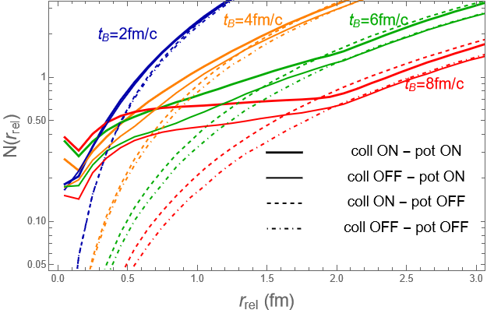
Background and Motivation Quarkonia in a microscopic model Conclusions
The dynamics of c-cbar correlation
The c-cbar potential (« pot ON ») leads to a huge increase of the c-cbar probability at close distance at large times (not a random Poisson distribution !)…
… Especially when the collisions with the QGP (« coll ») are switched ON as well

Slide 13
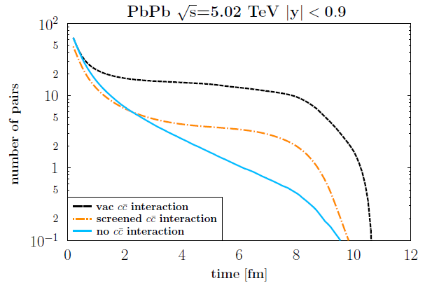
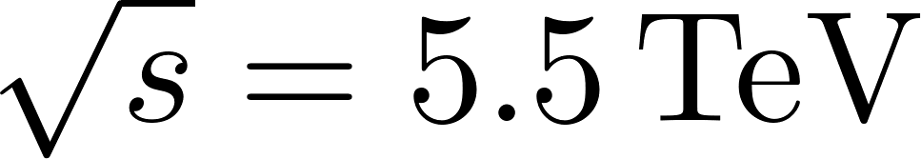
Background and Motivation Quarkonia in a microscopic model Conclusions
Extension of the Remler formalism
Confining forces inside the MC evolution ; large impact on the # of close pairs… and correlated trajectories.
D. Lafferty and A. Rothkopf,
PHYS. REV. D 101, 056010 (2020)
Instantaneous # of Q-Qbar at (invariant) distance < 1fm
V vacuum
c-quarks FO
V screened
Pb-Pb
No c-cbar interaction
Extra source of Γ due to “local-T” basis evolution with time : Γ^{loc}
Generalization to relativistic Wigner density (boosted quarkonium states)

Slide 14
Background and Motivation Quarkonia in a microscopic model Conclusions
The 3 layers of the numerical modelling
Initial state
evolution
EPOS initial condition +transverse positions of the NN collisions
Fluid dynamics
Background
{T(x),v(x)}
Initialisation of c-cbar pairs according to FONLL² ⊗ EPOS positions
Evolution of HQ according to MC@HQ + c-cbar in-medium potential
HQ level
Correlated SC trajectories
Initial J/ψ(T) P (t₀) when T(x) < T_{diss}
Evaluation of Γ according to improved Remler + Γ_{loc}.
Quarkonia level
We do not have J/ψ quasi particles in our approach, just correlated c-cbar trajectories

Slide 15
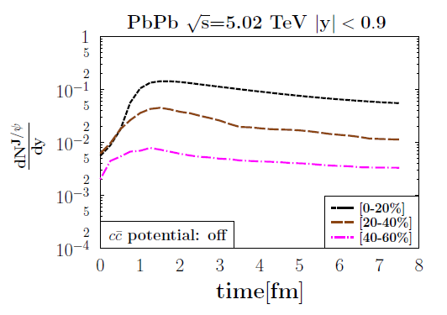
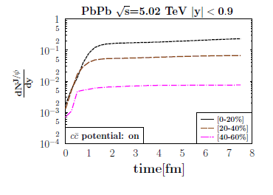


Background and Motivation Quarkonia in a microscopic model Conclusions
Results : J/ψ production vs time
Delayed initial production as T>T_{melt} in a large volume
Without interaction potential between c and cbar, the collisions with the medium manage to destroy the native J/ψ (left)
With the interaction potential between c and cbar « on », one observes a steady rate of J/ψ creation (increase of Γ^{col}, increase of Γ^{local})… No adiabaticity, but no instantaneous formation either.

Slide 16
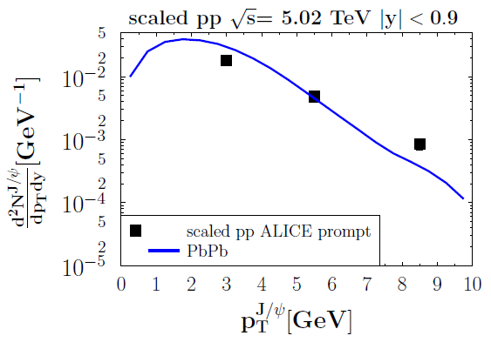
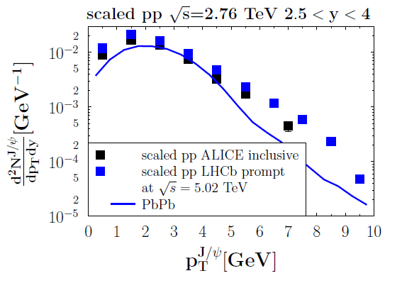
Background and Motivation Quarkonia in a microscopic model Conclusions
Results : J/ψ production vs p_{T}
0%-20%
Equivalent pp production (the denominator of the R_{AA}) : c-cbar according to FONLL² without any correlation, then coalescence with the Wigner distribution.
No feed-down from higher states (to be implemented)
Acceptable for p_{T} < 5 GeV/c, but deviations for higher p_{T}.
To investigate : more appropriate scheme for c-cbar production, including c-cbar correlation : EPOS4

Slide 17
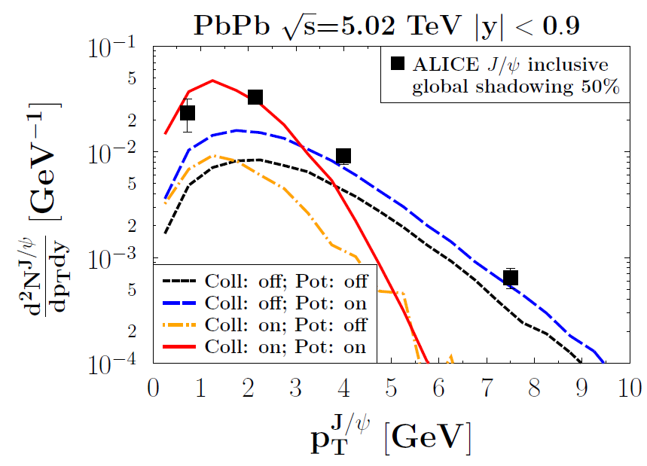
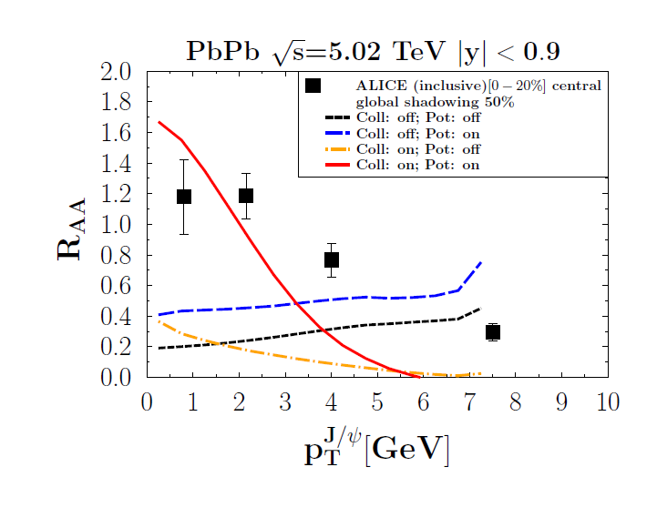
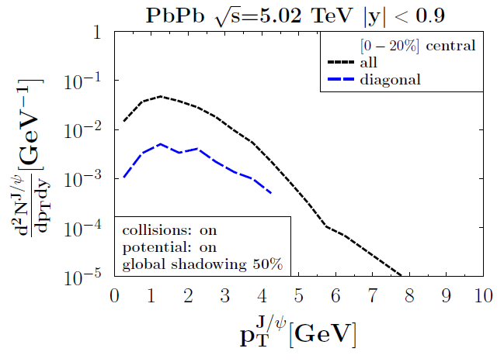
Background and Motivation Quarkonia in a microscopic model Conclusions
Results : J/ψ production vs p_{T}
0%-20%
Dynamical recombination is quite effective at low p_{T}
At higher p_{T}, we are missing J/ψ as compared to the experimental value.
Several possible reasons, under investigation:
  in terms of transport model : « primordial too much suppressed »
  lack of c-cbar correlation in the IS
  …
From the same NN collision, best proxy to « primordial »

Slide 18
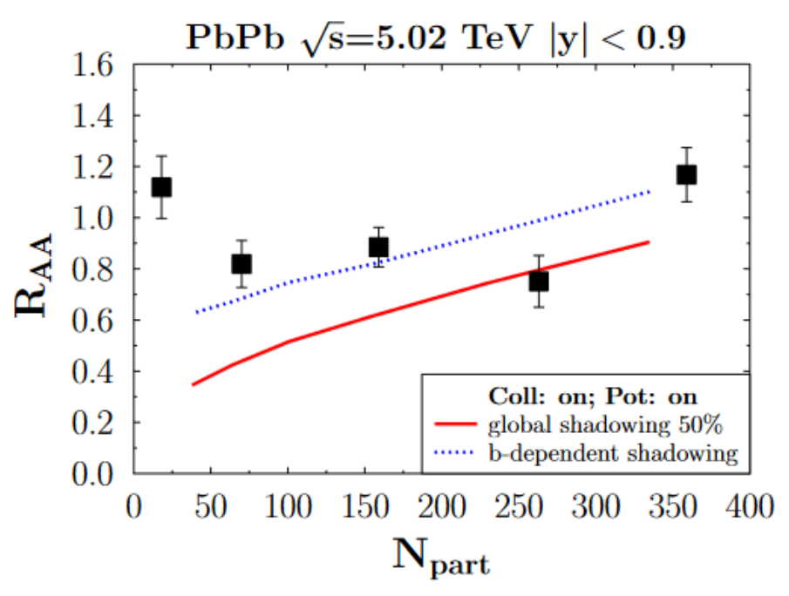
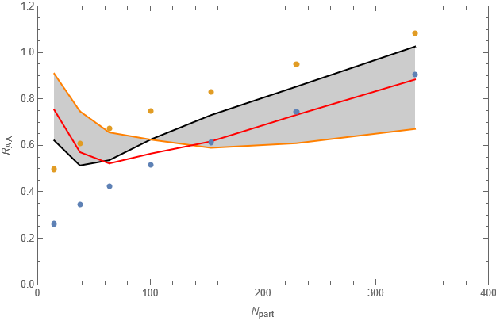
Background and Motivation Quarkonia in a microscopic model Conclusions
R_{AA} vs N_{part}
Caveat : too crude modelling of the thermalization in the bulk… assumed to happen after 0.35 fm/c independent of the centrality
=> c and cbar created at t≈0 have the time to diffuse away => reduction of the production
Corona, q_{corona}=1. GeV
One possible solution : core – corona model for c-quarks : c-quarks with momentum transfer < q_{corona} are considered to combine -> quarkonia as in vacuum…
Optimal value :
Corona, q_{corona}=1.6 GeV
Corona, q_{corona}=1.2 GeV
Corona, q_{corona}=1.2 GeV
Notes:
Mention the trick => interaction

Slide 19
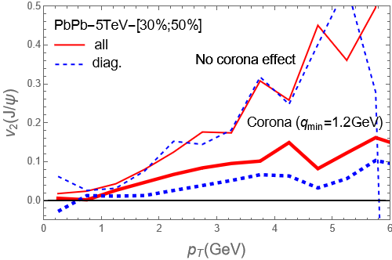
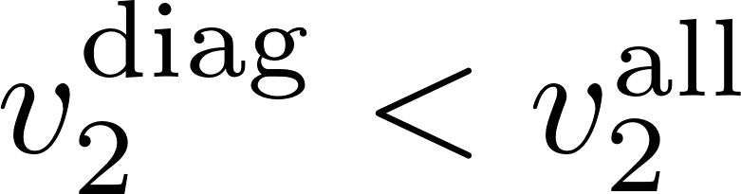
Background and Motivation Quarkonia in a microscopic model Conclusions
Results : J/ψ v₂
ALICE (2.5 < y < 4 )
v₂ excess as compared to experimental data (late formation of the J/ψ due to binding potential under restoration)
Without corona, the « diagonal » contribution shows no difference wrt the full production, what is a bit conter-intuitive
Corona has large effect on v2, even with moderate q_{thresh}. As the corona mostly affects the diagonal part, one recovers

Slide 20
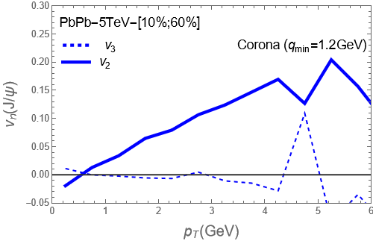
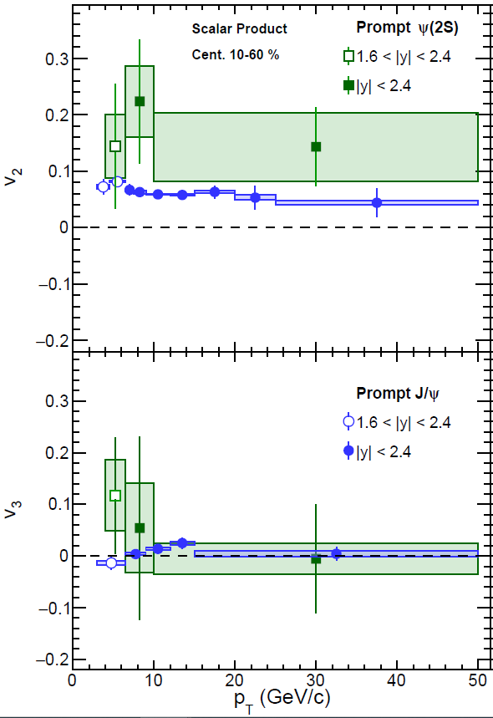
Background and Motivation Quarkonia in a microscopic model Conclusions
Results : J/ψ v_{n}
direct
Calculation for CMS centrality
!!! Our model mostly applies at low and intermediate p_{T}.

Slide 21
Background and Motivation Quarkonia in a microscopic model Conclusions
Conclusions and Perspectives
First move towards a microscopic approach based on individual c and cbar dynamics implementing some of the open quantum systems features for charmonia production in realistic HI conditions : dynamical coalescence
Encouraging results, but still many features to be refined
Rooms for improvement :
  Include excited states decay
  Including color transparency and more generally color dynamics
  More reliable treatment of the fully relativistic evolution of a N-body coupled system (under construction)
  Upgrading to EPOS4 => More realistic « initial state » for the c-cbar pairs, including correlations at intermediate p_{T}.
  Late interactions with hadronic phase
  … (suggestions welcome)

Slide 22
Back up

Slide 23
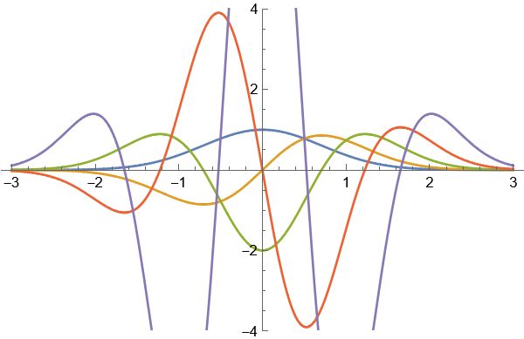
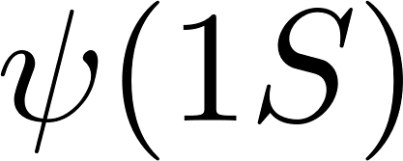
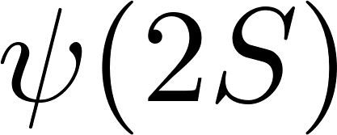

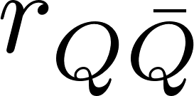
Background and Motivation Quarkonia in a microscopic theory Conclusions
Quantum coherence at early time
Initial compact state : δ
Dissociation rate:
Coherence
Neglect of coherence
Crucial to include coherence !
N.B. : one can model this effect by phenomenological formation time, but lack of control

Slide 24
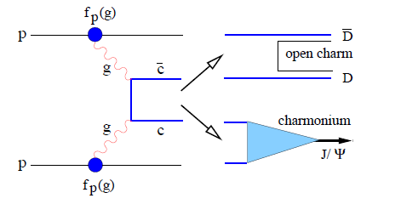
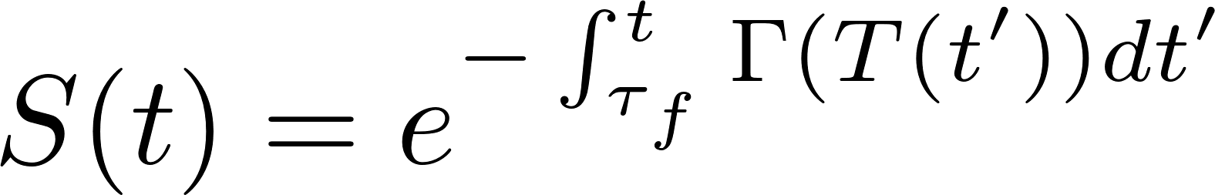
Background and Motivation Quarkonia in a microscopic theory Conclusions
Quantum coherence
Picture behind transport theory :
Open heavy flavor and quarkonia assumed to be uncorrelated
Formed after some “formation time” τ_{f} (typically the Heisenberg time), usually assumed to be independent of the surrounding medium
Common belief in the transport community:
Quarkonia initially « formed » in QGP and survive with an individual survival probability
Notes:
Cite Rothkopf

Slide 25


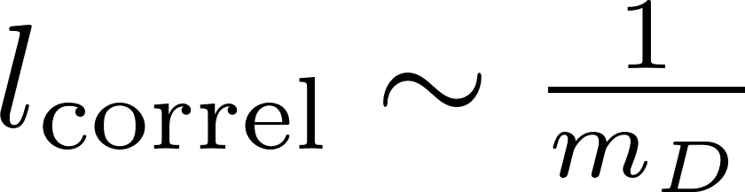
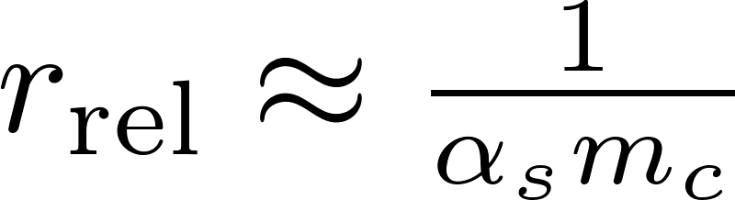
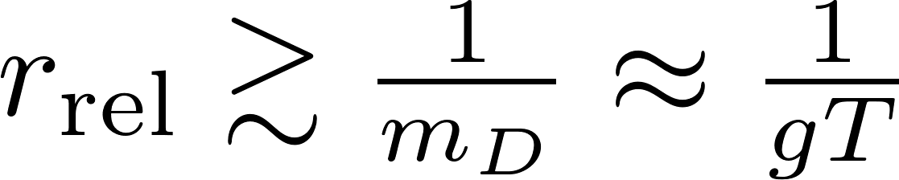


Background and Motivation Quarkonia in a microscopic theory Conclusions
The two sides of color transparency
2
Q-Qbar propagation in QGP.
If r_{rel} << l_{correl} : white object => no Energy loss
If r_{rel} >= l_{correl} : 2 HQ interact individually with QGP.
(soft modes)
Small T :
Large T :
white
Indep. scattering
Most of the transport models have considered up to now that primordial charmonia can just be destroyed (with a small probability), but not deflected.
In our approach, we have investigated the consequences of considering the opposite limit… with too large v₂ resulting from this prescription…

Slide 26
Background and Motivation Quarkonia in a microscopic theory Conclusions
Remler’s formalism for dynamical coalescence
Generic idea : describe charmonia (Ψ) production using density matrix
N-body density matrix (bulk partons + many c and many cbar)
Single quarkonia density operator
T. Song, J.Aichelin and E.Bratkovskaya, PRC 96. 014907 (2017)
“Just” looking at the initial stage brings interesting features:
pp
PbPb
IS
Primordial
Good reproduction of pp -> J/ψ + x !!!
considerable enhancement of primordial J/ψ (in the initial state): large off-diagonal contributions

Slide 27
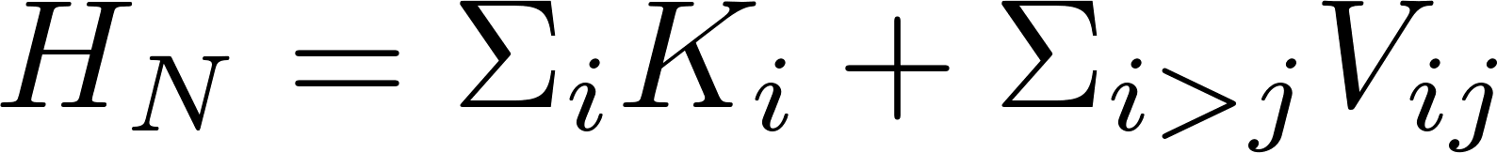
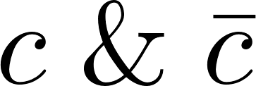

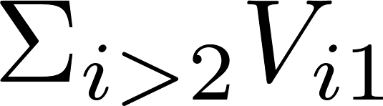
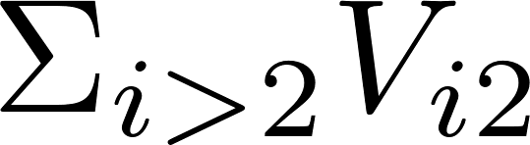
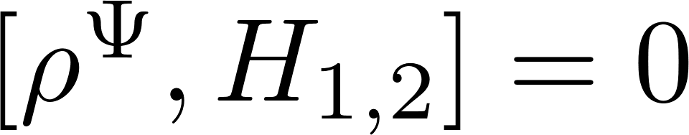
Remler formalism at work
Combining the rate definition + VN equation :
Generic case where
3
1 & 2 :
3, 4, …… : light quarks
1
Strictly speaking, not QCD. Important process partly missing : gluo-dissociation
2
Internal Hamiltonian
Light quarks
Heavy – light interaction
Only U₁ and U₂ => ≠0 (as )
Sub-part of the VN equation, still impossible to deal with exactly at the quantum n-body level
Notes:
Mention the trick => interaction

Slide 28
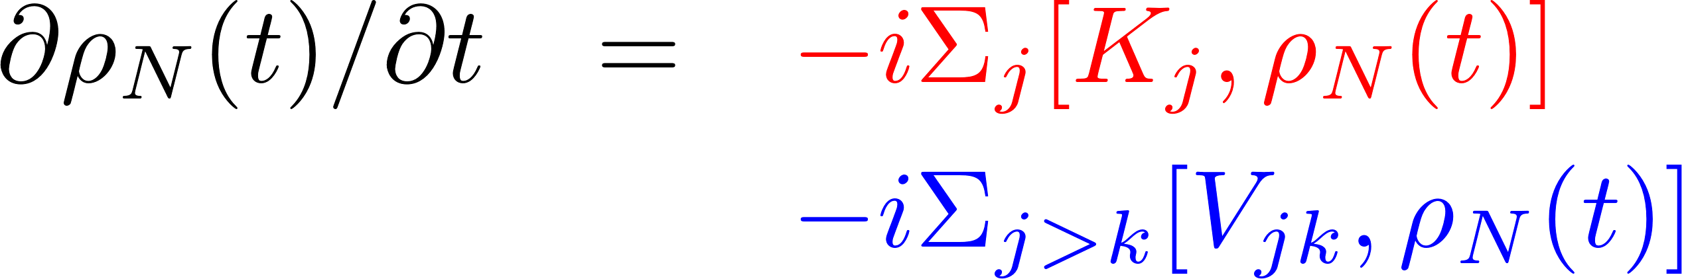
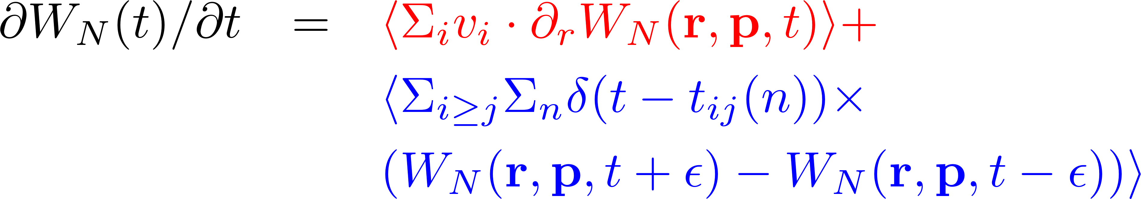
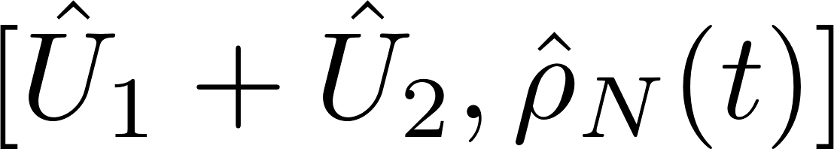
Remler formalism at work
Passing to the Wigner representation:
Direct space
Wigner space….
One to one correspondance
… treated at the semi-classical level :
Wigner distribution ⬄ {trajectories in phase space}
can be modelized from the trajectories evolution in Wigner space
Notes:
Mention the trick => interaction

Slide 29
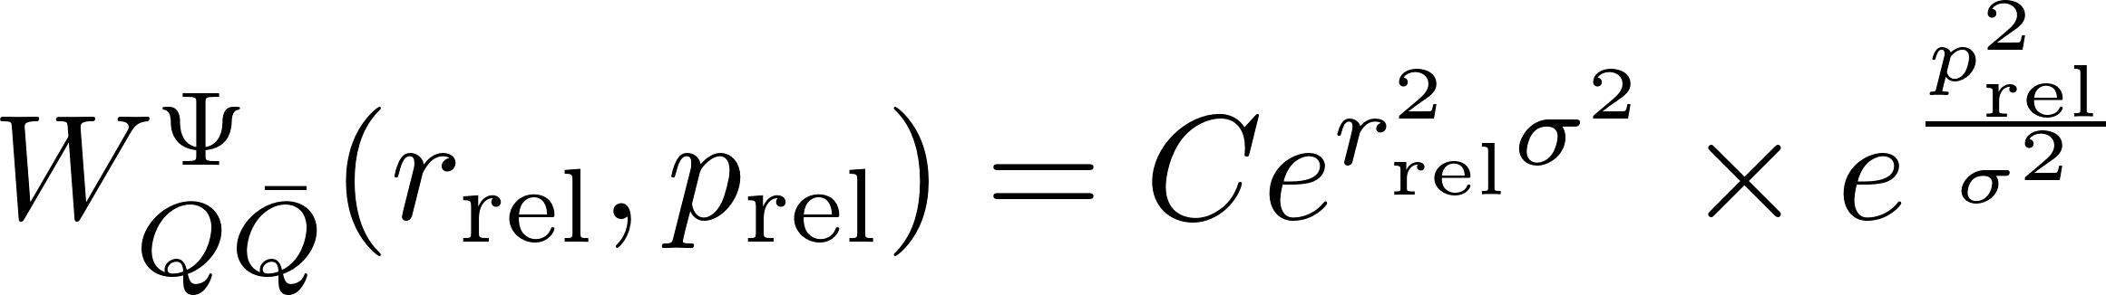

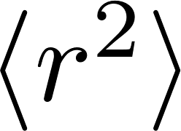

Remler formalism at work
The effective rate for quarkonia state creation (dissociation) in the medium is
Working in the phase space through Wigner distribution
Quarkonia: Double Gaussian approximation
W_{N} : Semi-classical approach
Parameter: The Gaussian width σ ≈ 0.35 fm
… but no explicit description of W_{N} required (as it appears in the trace)
W^{ψ}
and (less trivial) : generalisation at finite 4-velocity u; fully relativistic… to warrant orthogonality of states
Notes:
Mention the trick => interaction

Slide 30


Preliminary results for J/ψ production in Pb-Pb
Word of caution: Exploratory phase => not meant to have an exact comparison with exp. data
Cumulated « production » (if no rate equation), indeed oveshoots pp due to off-diagonal contributions
The denominator in the R_{AA}
The full production (i.e. the numenator in the R_{AA} )
Projection on VACUUM J/ψ
First answer to puzzle found in Song et al: the primordial production is killed rather fast by the « loss » rate.

Slide 31



Remler formalism for the QGP : last ingredient
Combining the rate definition + VN equation :
Internal Hamiltonian
…
…
…
In QGP, 2 body T-dependent effective potential => ….
One only preserves the structure of the Remler « collisional rate » if one works in the « local » basis ρ^{Ψ} (T) !!!
Accessible for T > T_{dissoc}^{Ψ} (=0.4 GeV for J/ψ)
Back to the rate :
New contribution to the rate (so-called « local rate »)
Notes:
Mention the trick => interaction

Slide 32






The Q-Qbar dynamics… the CM strategy
Main objective : evaluate the propagation towards future of N Q-Qbar interacting pairs
Strategy (adopted presently) : For each time step in the laboratory frame, pass to the cm frame and perform the evolution in the cm frame (where the potential is well defined)
2
1
future
3
Interaction with QGP
past
“Issue” : slicing the global time evolution (usual strategy in MC) is not 100% compatible with passing to c.m. frame as 2 particles are usually not at the same relative time in both frames (residual glitches ⬄ numerical noise)

Slide 33




The Q-Qbar dynamics… the CM strategy
“Minor problem” #1: Classical equations of motion are unstable (in the CM):
Solution: Work in Hamilton – Jacobi coordinates or impose the conserved quantities (L and Etot)
Need to factorize the N-body problem as an {} of 2-body problems for some evolution over time step dt, each of them to be solved in the CM
CM1

Slide 34

The Q-Qbar dynamics… the CM strategy
“Minor problem” #1: Classical equations of motion are unstable (in the CM):
Solution: Work in Hamilton – Jacobi coordinates or impose the conserved quantities (L and Etot)
Need to factorize the N-body problem as an {} of 2-body problems for some evolution over time step dt, each of them to be solved in the CM
CM2

Slide 35

The Q-Qbar dynamics… the CM strategy
“Minor problem” #1: Classical equations of motion are unstable (in the CM):
Solution: Work in Hamilton – Jacobi coordinates or impose the conserved quantities (L and Etot)
Need to factorize the N-body problem as an {} of 2-body problems for some evolution over time step dt, each of them to be solved in the CM

Slide 36


Background and Motivation Quarkonia in a microscopic theory Conclusions
Results : J/ψ v₂
[30-50%] [30-50%]
[GeV]
v₂ excess as compared to experimental data (late formation of the J/ψ due to binding potential under restoration)
The « diagonal » contribution shows no difference wrt the full production, what is a bit conter-intuitive

